Slide 1
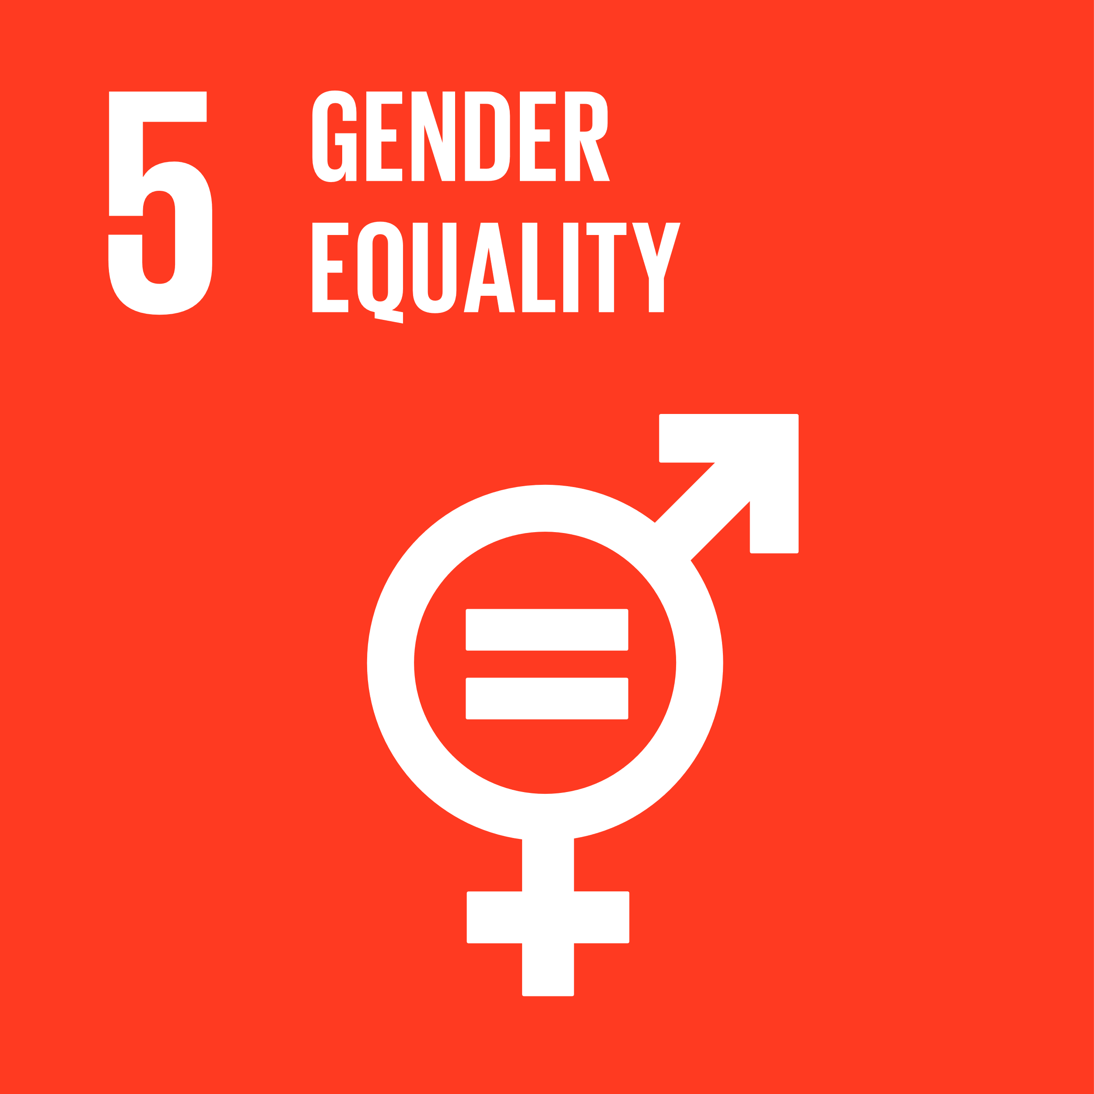
Are the current approaches to gender equality good for health and sustainable?
Jackline Odhiambo
SD4H Fellow, PhD Candidate
Seminar 3: 03 December 2020
Notes:
- Gender equality as a sensational topic – gender vs sex, equality vs inequality

Slide 2
Social institutions and gender index (SIGI)
Discrimination in the family
Child marriage
Property Inheritance
Restricted physical integrity
Gender-based violence
Restricted access to productive and financial resources
Political voice
Restricted civil liberties
Household responsibility
Female genital cutting
Reproductive autonomy
Secure access to land and non-land assets
Access to formal financial services
Citizenship rights
Child preference
Workplace rights
Access to justice
Freedom of movement
Notes:
However, varied treatment of men and women in various social sphere

Slide 3
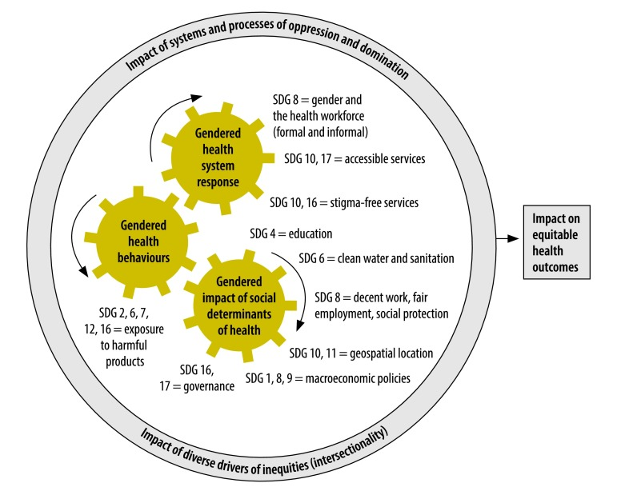
A Conceptual framework for Interactions between SDG 3 (health) and 5 (gender) with other global goals across three domains of gender and health
Notes:
This gender treatment intersects with health and also with other SDGs

Slide 4
Gendered social determinants for health in Kenya – KDHS 2014
Notes:
Examples in gender and social determinants for health (community and social context AND economic stability)
Negative masculinity affecting health of women and girls through – violence, STIs, pregnancies.
Women’s lack of autonomy to make out-of-pocket payments for healthcare can inhibit women’s access to health care

Slide 5
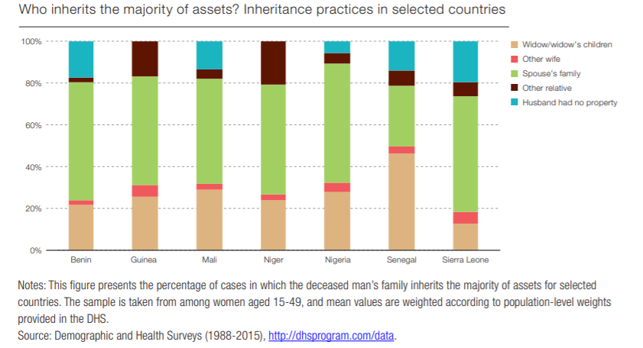

Slide 6
Gender and health behaviors among 15-49-year-old – KDHS 2014
Notes:
Health behaviors can be protective of or detrimental to health outcomes
Negative masculinity and risk-taking roles - avoiding condom use, greater use of harmful substances, lower rates of seeking testing and treatment for HIV
Tobacco smoking and alcohol consumption contribute to excess mortality male
Women more likely to seek care than men (even after adjusting for reproductive health consultations)

Slide 7
Gender and health system – WHO 2013 and KDHS 2014
Notes:
Unrepresentative leadership and decision making in the health workforce
How the health system responds to gender, including how it affects the financing of and access to quality health care

Slide 8
SDG 5: Achieve gender equality and empower all women and girls
 | Targets 5.1 to 5.3 | Targets 5.4 to 5.6 | Targets 5a to 5c
 | End all forms of discrimination, violence and harmful practices against all women and girls everywhere Sexual exploitation, child marriage, female genital cutting, trafficking | Promote access and opportunities for women and girls everywhere Value unpaid work, impactful leadership opportunities, shared responsibility at household | Create enabling environment for gender equality and gender sensitivity Enabling technology, reforms, policies and legislation that promote

Slide 9
Measurement of gender equality in SDG 5
IPV (non-IPV) in the last 12 months for women aged 15+ years
Early marriage before 15 and 18 years among women aged 20-24 years
Female genital cutting among women 15-49 years
Seats held by women in national parliaments and local governments
Women in managerial positions
Women 15-49 making own informed decisions on SRH (contraception use)
Countries with laws that guarantee women 15-49 years access to SRH care, information and education
Women owners of agricultural land, by tenure
Countries with laws that guarantee women’s equal rights to land ownership and/or control
Countries with systems to track and make public allocations for gender equality and women’s empowerment
Legal frameworks to promote, enforce and monitor gender-based discrimination
Time spent in unpaid domestic and care work by sex, age, location
Telephone ownership by sex
Notes:
Flip the focus of indicators, and be talking both men and women
Interrelations between the indicators and other SDGs

Slide 10
Measurement of health in SDG 3
Maternal mortality ratio
Proportion of births attended by skilled health personnel
Number of new HIV infections per 1,000 uninfected population, by sex, age and key populations
Proportion of women of reproductive age (aged 15-49 years) who have their need for family planning satisfied with modern methods
Adolescent birth rate (aged 10-14 years; aged 15-19 years) per 1,000 women in that age group
Tuberculosis incidence per 1,000 population
Hepatitis B incidence per 100,000 population
Number of people requiring interventions against neglected tropical diseases
Mortality rate attributed to cardiovascular disease, cancer, diabetes or chronic respiratory disease
Suicide mortality rate
Harmful use of alcohol, defined according to the national context as alcohol per capita consumption (aged 15 years and older) within a calendar year in litres of pure alcohol
Coverage of treatment interventions (pharmacological, psychosocial and rehabilitation and aftercare services) for substance use disorders
Death rate due to road traffic injuries
Proportion of population with large household expenditures on health as a share of total household expenditure or income
Mortality rate attributed to unsafe water, unsafe sanitation and lack of hygiene (exposure to unsafe Water, Sanitation and Hygiene for All (WASH) services)
Age-standardized prevalence of current tobacco use among persons aged 15 years and older
Proportion of the population with access to affordable medicines and vaccines on a sustainable basis
Health worker density and distribution
Notes:
Flip the focus of indicators, and be talking both men and women
Interrelations between the indicators and other SDGs

Slide 11
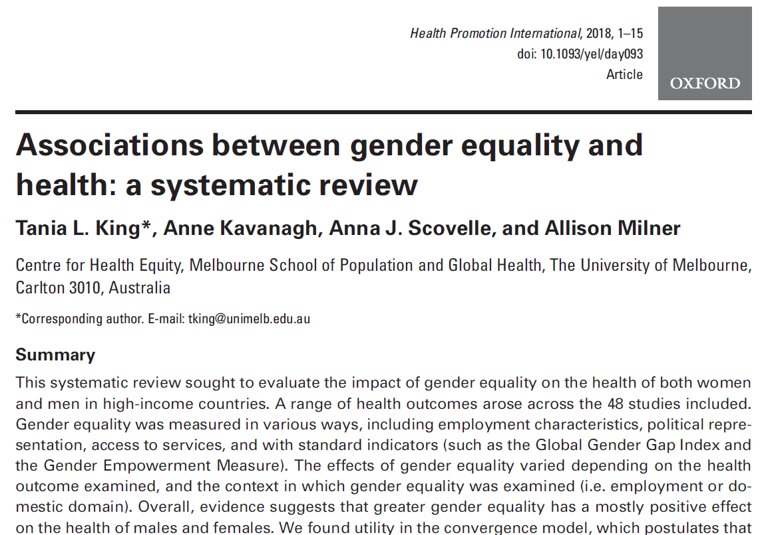
Reviewed 48 studies
Review limitations
  Studies based on self-reports,
  Focused on high income settings and gender outcomes can be context specific
Domains for measurement of gender equality and health
  Politics, the economy, and social services
  Work and employment
  Family

Slide 12
Politics, the economy and social services
Greater gender equality (measured by political participation, reproductive rights, socio-economic status) was associated with positive health outcomes.
  Lower levels and reported intimate partner violence
  Better mental health
  Lower alcohol consumption among men and women
  Lower male and female mortality rates
  Narrowing the life-expectancy gap between males and females

Slide 13
Work and employment metrics
Reducing the wage gap was associated with
  Lower depressive symptoms for women
  Reduction in violence against women
Most gender-equal workplaces had
  The lowest overall occurrence of psychological distress for men and women
  Women and men were more likely to report good health
  Lower rates of sickness absence for men and women
Longer parental leave was related to greater physical activity in fathers

Slide 14
Family metrics
Gender equality is good for men’s health
  Lower risk of death and sickness
  Decreased risk of depressive symptoms
Gender equality has mixed results for women’s health
  For women in traditional roles
  Gender inequality is good for their health
    Lower risk of alcohol related inpatient care or mortality
    Lower risk of death and sickness
  For women in untraditional roles
  Gender inequality/perception
    Increases depressive symptoms, perceived stress, fatigue, physical symptoms
    Work-family conflict
  Gender equality
    Decreases risk of anxiety symptoms
    Expose women to violence, infidelity & abandonment
    Increase sexual health risks and poorer health outcomes for women

Slide 15
Conclusions: Sustainable approaches to gender equality
Starts in the family through shared responsibility
“Unless more men take on roles and responsibilities traditionally associated with women, positive effects of gender equality will be stymied (as women will suffer the effects of being over-burdened, and men will experience the effects of losing old privileges)” - Manandhar et al, 2018
Recognizes that gender equality is good for both men and women
Includes men in the gender equality metrics
Spotlights traditionally neglected women e.g. widows currently unmentioned in SDG 5
Notes:
Gender and disease burden – morbidity and mortality
Life expectancy gap – women live 4.6 more years on average than men
GBD disproportionately affects men in terms of DALYs
Women spend longer time living with disability

Slide 16
References
OECD 2020. Social Institutions and Gender Index (SIGI) https://www.genderindex.org/sigi/
Manandhar et al. 2018. Gender, health and the 2030 agenda for sustainable development. https://www.ncbi.nlm.nih.gov/pmc/articles/PMC6154065/
Turning promises to Action. https://www.unwomen.org/-/media/headquarters/attachments/sections/library/publications/2018/sdg-report-fact-sheet-sub-saharan-africa-en.pdf?la=en&vs=3558
KDHS 2014. Kenya Demographic and Health Survey 2014. https://dhsprogram.com/pubs/pdf/fr308/fr308.pdf
WHO 2013. Understanding the labour market of human resources for health in Kenya. https://www.who.int/hrh/tools/Kenya_final.pdf
United Nations 2015. Sustainable Development Goals. Goal 5: Achieve gender equality and empower all women and girls. https://www.un.org/sustainabledevelopment/gender-equality/
King et al, 2020. Associations between gender equality and health: a systematic review. https://pubmed.ncbi.nlm.nih.gov/31916577/
SDG 5. https://sdgs.un.org/goals/goal5
SDG 3. https://sdgs.un.org/goals/goal3
https://www.thelancet.com/journals/langlo/article/PIIS2214-109X(19)30495-4/fulltext

