Slide 1
SDG 1: NO POVERTY & ITS’ RELATIONSHIP TO HEALTH OUTCOMES IN LMICs WITH A FOCUS ON AFRICA
RHODA LOREEN MUSUNGU
SD4H SEMINAR 2; SDGs

Slide 2
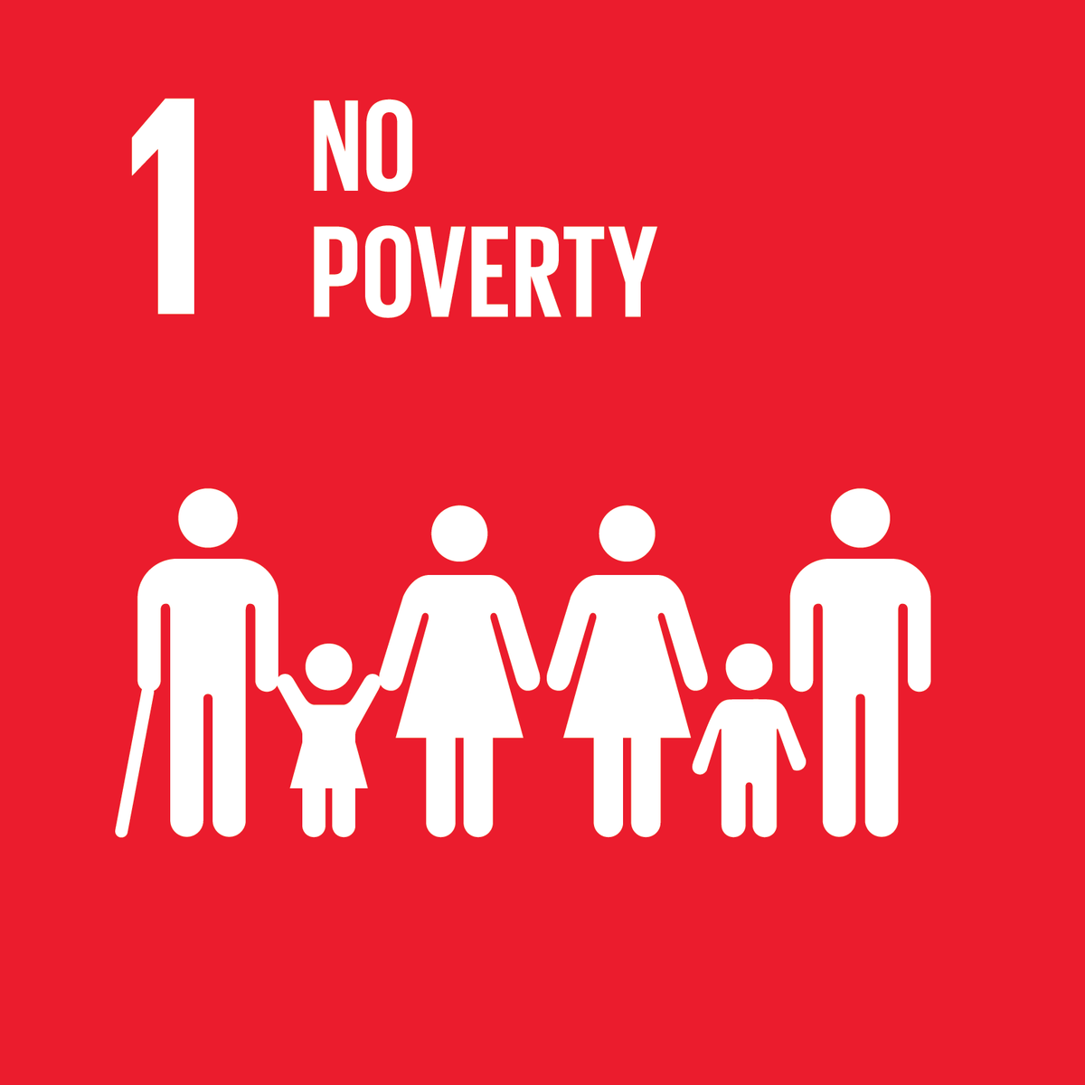
PRESENTATION OUTLINE
Introduction
SDG 1: No Poverty
Poverty in LMICs; Focus on Africa
The Complex Relationship Between Poverty and Health
Ending poverty and improved health in Africa; way forward
Conclusion

Slide 3
INTRODUCTION
Sustainable Development Goals (SDGs): principle of advancing equity and leaving no one behind in the areas of economic, social and environmental development
Poverty is a condition in which a person or group of people lack human needs because they can not afford them
SDG 1: End poverty in all its forms by 2030: < $1.90 a day
Under the Millennium Development Goals poverty was halved; global rate of poverty from 28% in 1999 to 11% in 2013
> 800M people globally still live below $ 1.25 a day (WHO, 2019). COVID-19 pandemic will increase the numbers.
Notes:
17th October: International day of eradicating poverty. 2020 theme; acting together to achieve social and environmental justice for all

Slide 4
SDG 1: NO POVERTY
The essence of sustainable development is giving people the support they need to lift themselves out of poverty.
Poverty encompasses deprivation in many domains: income, hunger, poor health, social exclusion, discrimination and lack of access to basic services
Ending poverty requires a holistic approach; inter linkages across different dimensions of sustainable development as well as interrelated strategies
17th October: International Day of eradicating poverty
Notes:
2.

Slide 5
POVERTY IN LMICs; FOCUS ON AFRICA
Half of the world’s poor live in sub-Saharan Africa (SSA) with another third living in Southern Asia.
Those in extreme poverty live in fragile situations: conflict zones and remote areas; 80% in rural areas and 64% working in the agriculture sector and are women
Those above the poverty line are vulnerable due to economic volatility, natural disasters, conflict and wars and other shocks putting them at risk
> 1/3 of employed workers in SSA still live on less than $1.25 a day, social protection systems fall short and there is a rising toll in climate related disasters
Notes:
3

Slide 6
THE COMPLEX RELATIONSHIP BETWEEN POVERTY AND HEALTH
Poverty is a cause and a consequence of poor health: a disease, a major cause of ill health and a barrier to accessing health care when needed
It affects both the likelihood that an individual will have risk factors for disease and their ability/opportunity to prevent and manage disease
The poor do not have the finances to receive: the best health care, nutrition, education, living conditions and access to water and sanitation, increasing their chances of poor health
Ill health is a major cause of poverty: cost of health care, transport to facility, loss of income due to illness; traps communities in poverty

Slide 7
THE COMPLEX RELATIONSHIP BETWEEN POVERTY AND HEALTH CONTINUED
Poverty affects health from pregnancy and continues throughout an individuals’ life;
Influences an individuals’ health status and affects their life expectancy, learning abilities, health behaviors and risks of developing diseases
Affects health by limiting access to proper nutrition, shelter, safe neighborhoods to live, learn and work, clean water and utilities etc.
Poverty is associated with adverse health outcomes: shorter life expectancy, higher rates of infant mortality and higher death rates
Notes:
2. as well as their educational, work and lifestyle opportunities.

Slide 8
ENDING POVERTY AND IMPROVING HEALTH IN AFRICA; WAY FOREWARD
Investing in health to reduce poverty
Scaling up financial resources for health should be a priority
2. Supporting health systems
Strengthening the capacity of the public sector to carry out core functions of providing health services for all; UHC
3. Focusing on key policy areas and frameworks implementation for the poor
Support the poor have access to affordable and quality health, education, food security, water and sanitation, decent jobs etc.
Notes:
1. More health financing from the countries’ budgets and partner agencies, political good will.
2. Developing public and private sector services that are of good quality and responsive to the health needs of the poor
3. Policies that promote food security, education, water and sanitation; reduce risk of addiction to tobacco and alcohol, road traffic and other injuries and of the devastating impacts of conflict and other natural disasters

Slide 9
CONCLUSION
Poverty is not an accident….. It is human made and can be removed by the actions of human beings ~ Nelson Mandela
Tackling poverty requires cross-sectoral action across all the SDGs; collaboration and partnerships
The health of the poor should be prioritized through health financing, strengthening existing health systems and adopting appropriate policies and frameworks implementation
Enact policies, work with communities and governments to improve health and tackle injustice: social, political and economic development
Notes:
Oxfam International, Concern Worldwide, End Poverty Now, Care International, Health Poverty Action, Innovations for Poverty Action etc.

Slide 10
Poverty is a denial of choices and opportunities; a violation of human rights and dignity
United Nations ‘Indicators of poverty and hunger’
THANK YOU FOR LISTENING

Slide 11
REFERENCES
The SDG Report 2019
Measuring health inequalities in the context of sustainable development goals; Bulletin of the World Health Organization, September 2018
Poverty and Health-The Family Medicine Perspective (Position Paper)
Poverty and Health: DAC Guidelines and reference series; Organization For Economic Cooperation and Development of the World Health Organization 2013
Health Poverty Action, 2018 Bulletin
UN.org

