Slide 1
Sustainable Development for HIV Health (SD4H)

Slide 2
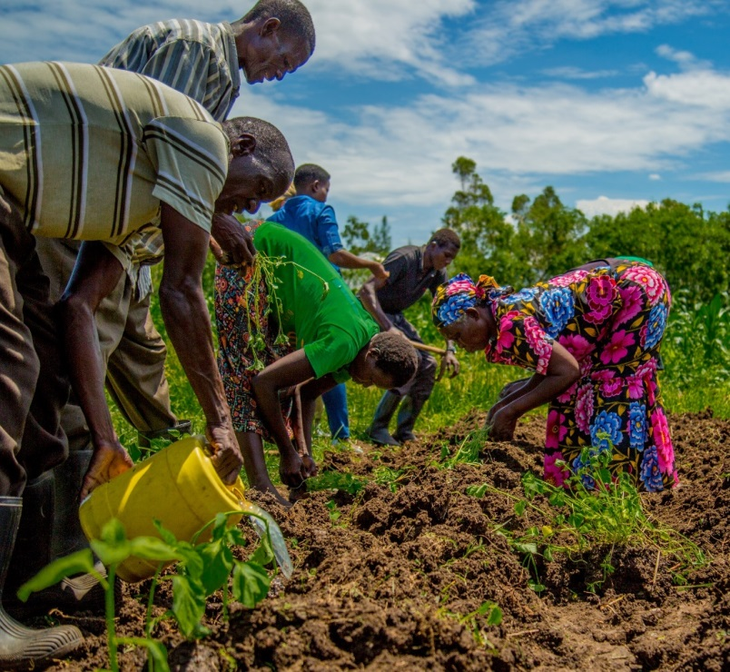
Background
Despite advances in HIV care & treatment, morbidity and mortality among people living with HIV/AIDS (PLWHA) is unacceptably high in sub-Saharan Africa
In western Kenya, HIV prevalence
14.3% in Migori county
26.0% in Homa Bay county
Kenyan national prevalence of 5.9%

Slide 3
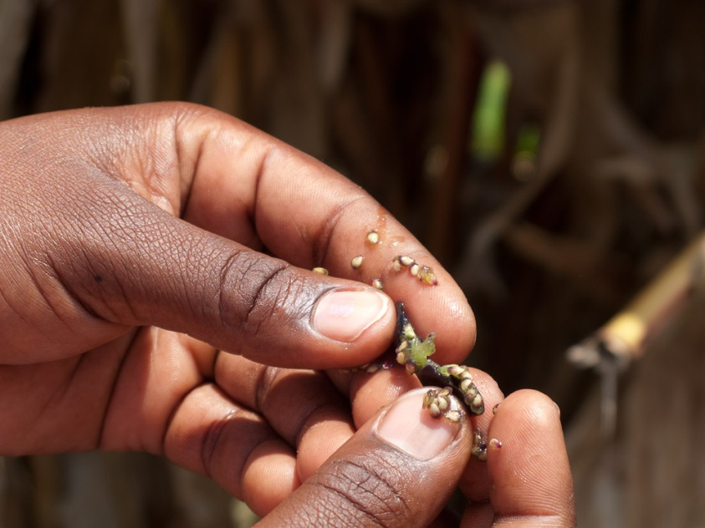
Background - Food insecurity and poverty
Food insecurity and poverty are key contributors to poor health outcomes among PLHIV receiving treatment
Among PLHIV, food insecurity has been associated
Declines in physical health status
Decreased viral suppression
Worse immunologic status
Increased incidence of serious illness
Increased mortality
In western Kenya
50% of the rural population is food insecure
Primarily due to unpredictable rainfall & limited irrigation

Slide 4
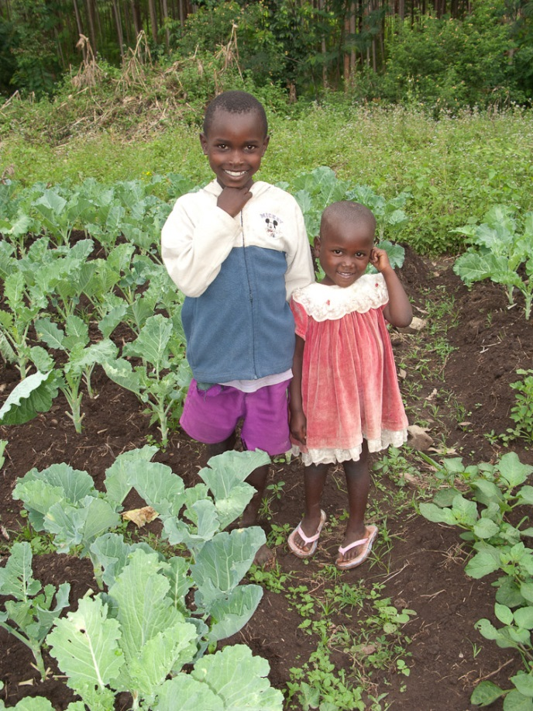
Background - Food insecurity and poverty
Morbidity and mortality from HIV/AIDS poses adverse social and economic consequences for households with HIV, perpetuating the vicious cycle of food insecurity, poverty and HIV/AIDS.
PLHIV are susceptible to food insecurity and poverty and are least able to rely on social support for assistance when faced with health and agricultural shocks.

Slide 5
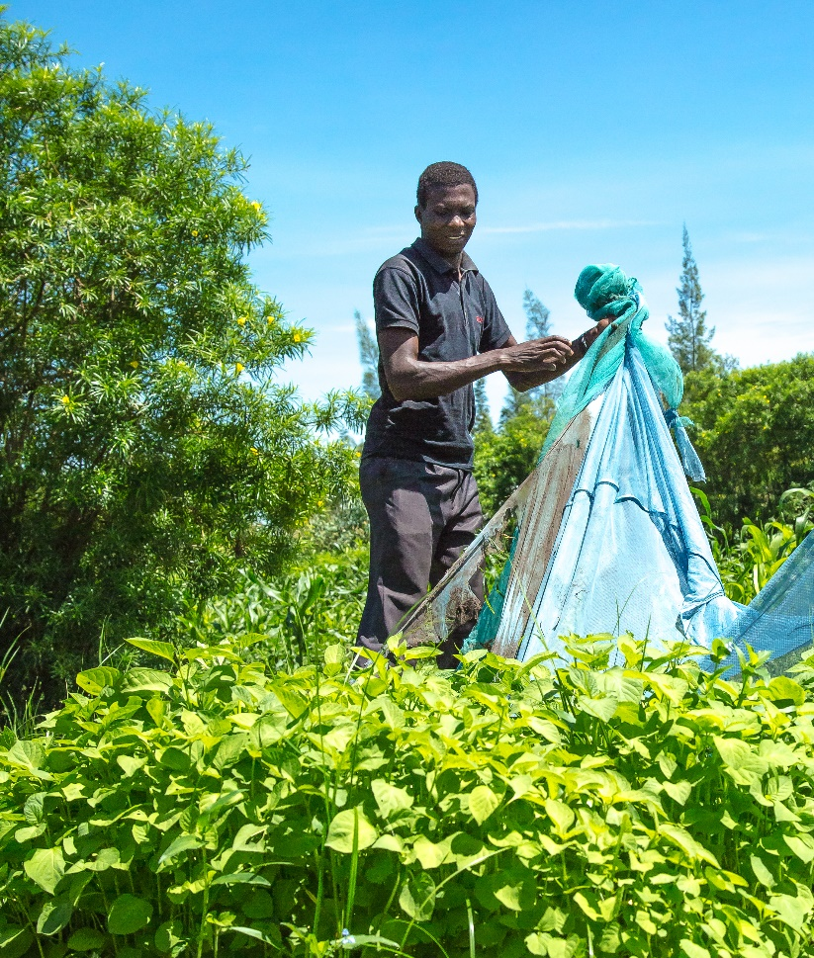
Syndemics of HIV/AIDS and food insecurity
Syndemics overlap in severity across sub-Saharan Africa, and negatively impact each other;
Most food security and poverty alleviation solutions have not been developed with health as a key target, and thus have not evaluated health impacts of these programs;
We need to understand how to design and test sustainable development and food security interventions that can improve HIV treatment and prevention outcomes.

Slide 6
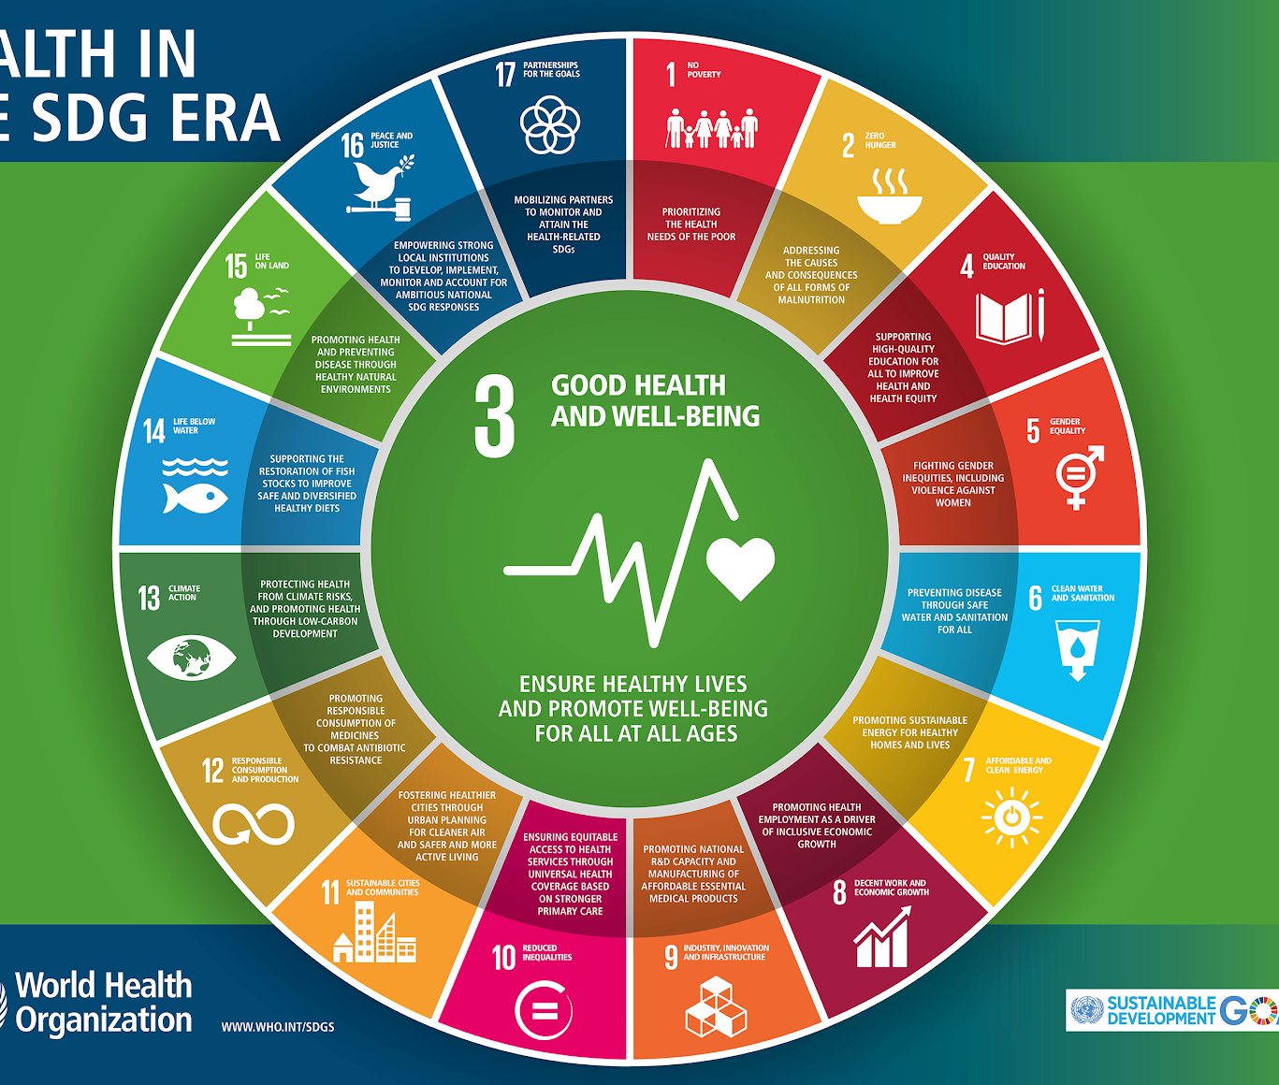
All SDGs aim to improve health and well-being

Slide 7
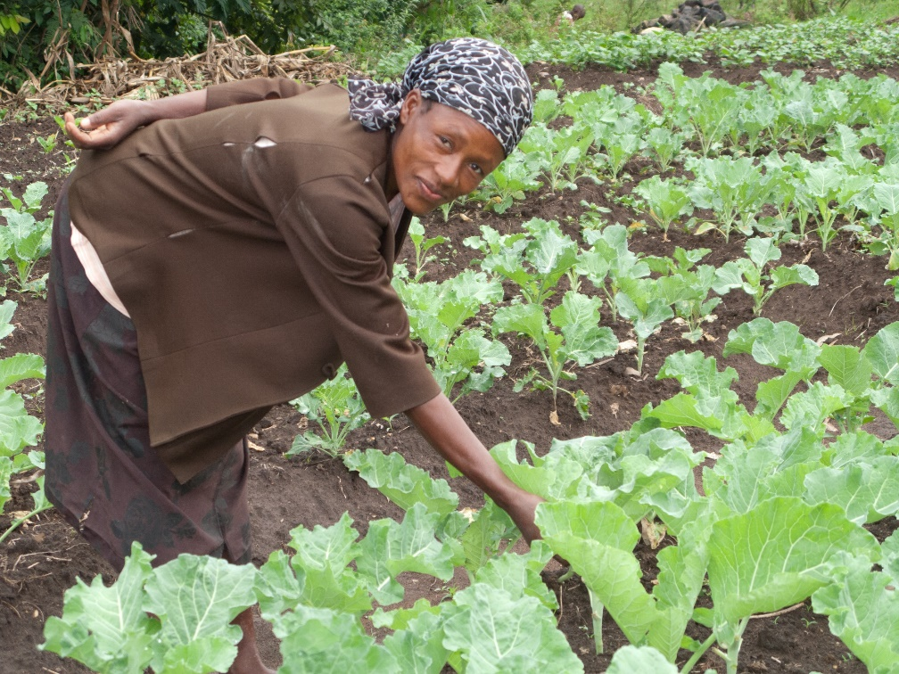
Needs Statement
Increasing recognition that improved food security and reduced poverty are essential for a successful response to the HIV epidemic
Little research to systematically evaluate the impacts of sustainable food security and livelihood interventions on health, economic, and behavioral outcomes among PLHIV

Slide 8
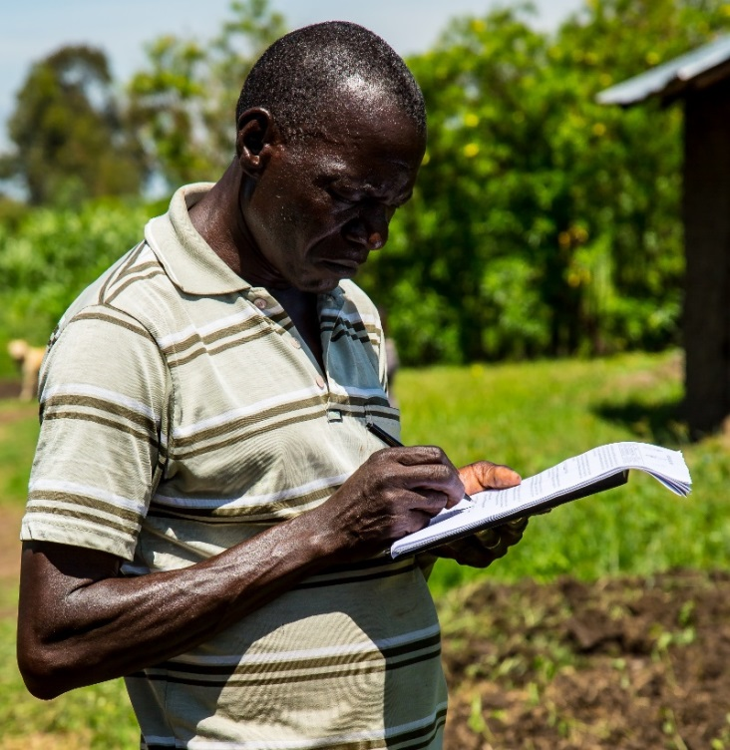
What is Sustainable Development for HIV Health (SD4H)?
Researchers who work at the intersection between sustainable development (e.g. economics, agriculture, animal science, environmental science, etc.) and global public health with a focus on improving HIV care, treatment and prevention outcomes.

Slide 9
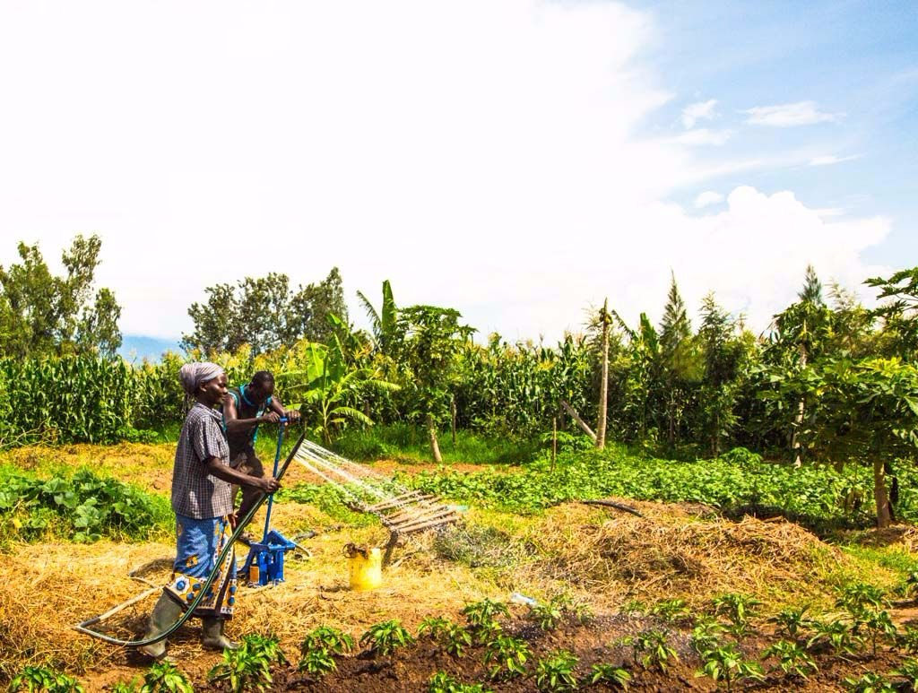
SD4H Researchers
Design, lead, implement and scale innovative, transdisciplinary interventions within Kenya with the aim of improving HIV prevention and treatment outcomes by targeting food insecurity and poverty, some of the root drivers of poor HIV outcomes

Slide 10
Discussion
How/why did you become involved in Sustainable Development for Health?

