Slide 1
Observational Study Designs
Association, causation, bias
SD4H Seminar
December 1, 2022
Pam Murnane, PhD MPH

Slide 2
Outline
Causation as an objective in observational studies
The underlying cohort or study base
Study designs
  Cross sectional
  Cohort
  Case control

Slide 3
What is a cause?
“A cause of a disease event is an event, condition, or characteristic that preceded the disease event and without which the disease event either would not have occurred at all or would not have occurred until some later time.”
Rothman & Greenland. Am J Public Health. 2005;95:S144–S150
Notes:
Event, condition, characteristic – “exposure”
Not everyone who has the exposure will have the disease
Not everyone who has the disease will have the exposure
Sometimes we are looking for links that will inform interventions (characteristic)
Sometimes we are looking at the effectiveness of interventions

Slide 4
Exposure
(Event, condition,
or characteristic)
e.g.:
Smoking
Hormonal contraception
Food insecurity
Heavy rainfall
?
Outcome
(Disease event)
e.g.:
Lung cancer
Pregnancy
Preterm birth
High school
academic performance
Time
Notes:
Some very time constrained – e.g. pregnancy
Some not – long duration between smoking and lung cance
Note this is over simplified -
Later will discuss defining the exposure more specifically –
- timing -- when does food insecurity matter in association with preterm birth? Early pregnancy, late pregnancy, preconception?
- does duration of FI matter?
- what exactly is food insecurity
What are the mechanisms by which heavy rainfall might impac school performance
- travel to school is disrupted
- help at home due to flood damage
- if none of these intermediate challenges are present, maybe rainfall doesn’t matter, but because it’s rainfall that led to the intermediate challenges, we may still be interested in the total effect of rainfall itself

Slide 5
“Association does not equal causation”
Studies suggest coffee drinking is associated with having a heart attack. 5 possible explanations:
  Chance (they are not associated in truth, just in the sample)
  Systematic bias (e.g., non coffee drinkers with early symptoms of disease did not participate in the study – systematically left out – selection bias)
  Reverse causation (having a heart attack leads to coffee drinking…?)
  Confounding (the baseline risk for heart attack among coffee drinkers is high due to some other cause, e.g., smoking)
  Coffee drinking causes heart attack
Notes:
Reverse causation - Being diagnosed with diabetes may lead to a more active lifestyle, a better diet, to reduce the risk of poor outcomes
If our goal is to identify a causal association, we need to closely consider how to address explanations 1-4 in the design and analysis.

Slide 6
“Exchangeability” in an RCT
The groups, on average, have the same baseline risk for disease
  Individuals will still differ – old vs young, high SES vs low SES – but the distribution of these other risk factors are expected to be the same in each group due to randomization (Table 1 in an RCT gives us this reassurance)
Importantly, the groups are also expected to have the same distribution of unmeasured or unknown risk factors for the disease.
The group assigned to control represents what would have occurred to those in the intervention, had they not been assigned to the intervention
We would expect the same results if:
  group ”A” was assigned to the intervention and group “B” was assigned to control, OR
  group ”B” was assigned to the intervention and group “A” was assigned to control
Thus, the groups are “exchangeable”
Notes:
With the same baseline risk across comparison groups, we have taken care of concerns about confounding and selection bias at enrollment.
How can we apply this concept to observational designs?
Unethical to randomly assign people to smoking or not smoking
Even if we could, too expensive to enroll, follow, and wait 20 years for an outcome to occur
When exposure is not randomly assigned, the reasons for being exposed are likely to be associated with some other risk factor for the outcome – e.g., coffee drinking and smoking are associated socially, uptake of one might lead to uptake of the other.
Trying to achieve exchangeability in an observational study is analogous to what wacholder calls deconfounding

Slide 7
The underlying cohort or study base
All observational study designs are defined within some populations over time
They differ in how they sample exposed and non-exposed as these groups develop disease over time

Slide 8
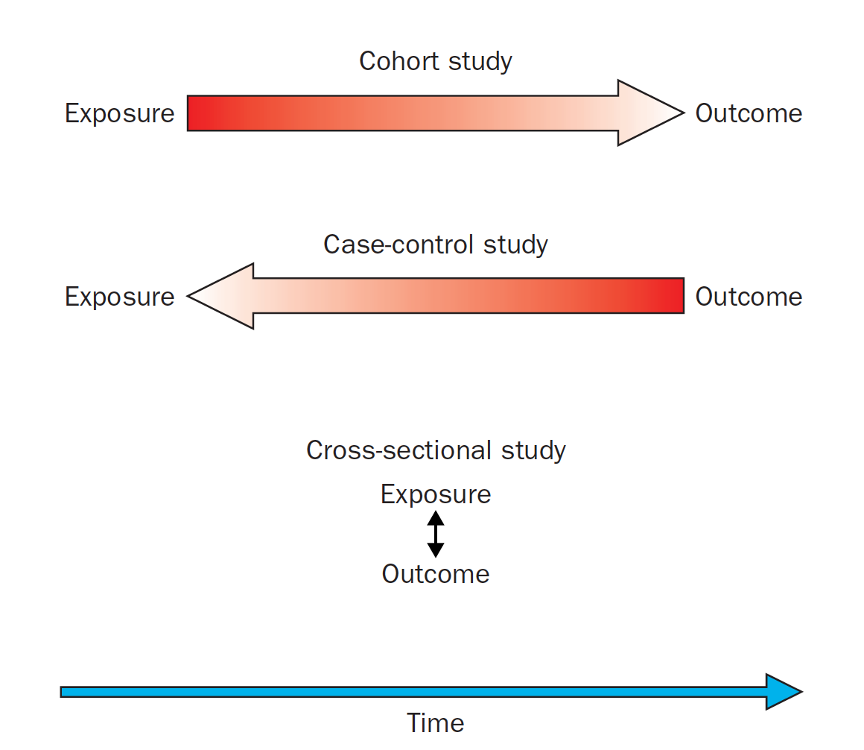
3 most common observational study designs
Grimes Lancet 2002; 359: 57-61

Slide 9



D
Disease/had the outcome
Unexposed
Exposed
Migrated out or died
?
Exposure
Disease
D
Time
Notes:
Underlying cohort
So when we design a study we can think about people marching through time, either being exposed or not, entering the population at different points in time, either through birth or in-migration (and leaving either through outmigration or death)
The people in this graphic represent the time in which they entered this population and their exposure status

Slide 10
D
Disease/had the outcome
Unexposed
Exposed
Migrated out or died
?
Exposure
Disease
D
D
D
2010
Time→
Today
Notes:
We might think of this population as our “study base” as described in the Wacholder article
Now let’s see see what happens to some of these people over time

Slide 11
D
Disease/had the outcome
Unexposed
Exposed
Migrated out or died
?
Exposure
Disease
D
D
D
Time
Today
Notes:
Suppose we sample case and controls from this study base today.
note that some have had the disease outcome for a long time, others recently, and some have died or out migrated
Those who are eligible for the study strictly today may not represent the full experience of the study base

Slide 12
D
Disease/had the outcome
Unexposed
Exposed
Migrated out or died
?
Exposure
Disease
D
D
D
Time
Today
Notes:
Cross sectional study conducted at this time point – wil miss some who might have latent disease, may not be able to distinguish who has had the disese for a long vs very short time

Slide 13
D
Disease/had the outcome
Unexposed
Exposed
Migrated out or died
?
Exposure
Disease
D
D
D
Time
Today
Notes:
Cohort study – can have a defined start – but critical to be clear on inclusion / exclusion criteria (exclude those who already have disease – depending on your outcome may want to do testing for latent disease.)
Also need to consider loss to follow up.

Slide 14
Cross-sectional studies
Example: Demographic and Health Surveys, NHANES
  Sample is representative of the population
  Excellent source for measuring prevalence
  Repeated every ~5 years, can assess how prevalence changes over time
  BUT it is not the same people who enroll every 5 years – nobody is followed longitudinally
Limitations when comparing exposure-disease associations
  We don’t know the temporal association (e.g., diabetes & diet; arthritis and obesity)
  We miss latent disease
  We miss disease with rapid progression to death
Notes:
DHS – in Kenya
NHANES – recently in SF
From grimes: a cross-sectional study
finds obesity to be more common among women with
than without arthritis. Did the extra weight load on joints
lead to arthritis, or did women with arthritis become
involuntarily inactive and then obese?

Slide 15
D
Disease/had the outcome
Unexposed
Exposed
Migrated out or died
Cross
Sectional
?
Exposure
Disease
D
D
D
Time
Today
Time
of sampling
Notes:
Cross sectional study conducted at this time point – wil miss some who might have latent disease, may not be able to distinguish who has had the disese for a long vs very short time

Slide 16
Cross-sectional studies are still useful….
Addressing some limitations
  In some cases, can test for recency of disease acquisition
  Can use rigorously designed questionnaires to aid recall, e.g., use of calendars and using important life events as anchors to recall
    Still temporality not as rigorously assessed
Even if limitations can’t be overcome, cross sectional studies are
  Inexpensive and efficient
  Can help generate hypotheses for future study
  Can be repeated over time and in many settings to be used later in interrupted time series analyes
Notes:
Causation doesn’t always have to the goal – knowing that 2 characteristcs are associated can help inform interventions.
e.g.
Disease more likely to impact women than men – know to screen women

Slide 17
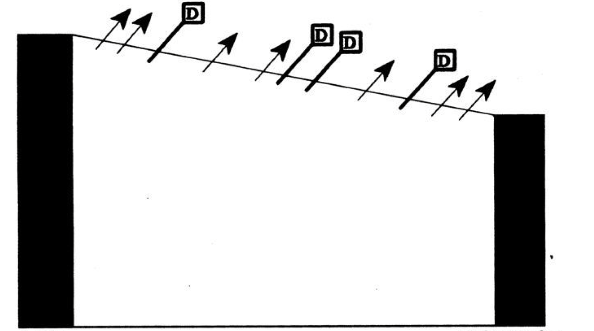
Cohort, or, study base
Szklo & Nieto. Epidemiology: beyond the basics. Aspen Publishers, 2000
Notes:
Another view for thinking about our underlying cohort - this doesn’t capture exposure status

Slide 18
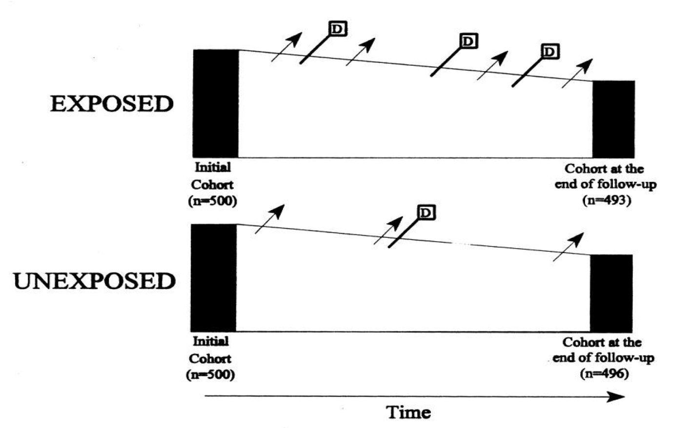
Cohort studies
Szklo & Nieto. Epidemiology: beyond the basics. Aspen Publishers, 2000

Slide 19
Cohort studies
Those with the outcome of interest are excluded from the study
  Follow-up time starts in a population at risk of the disease
Exposure is measured at baseline
  Outcomes are measured at the end, or, throughout follow up
  May also measure exposure repeatedly throughout
    Cumulative exposure over time, patterns of exposure over time
  We can ensure a temporal relationship between exposure-outcome
Therefore we can measure incidence of disease over time
  And compare indicence in the exposed vs unexposed
For rare outcomes – require large sample and/or long-term follow up

Slide 20
Types of cohorts/ how assembled
By region (Framingham MA, USA – heart study)
By occupation (Nurses Health Study, USA – many exposures & outcomes)
By disease – to look at sequelae as outcomes (IeDEA)
By risk status (pre-conception cohort)
By exposure event (Persons exposed to radiation in Chernobyl Accident)
By exposure status – enroll known exposed & unexposed for a primary exposure of interest – a good approach for rare exposures
  Enroll all exposed + a random sample of unexposed

Slide 21
Data collection in a cohort study
IeDEA – clinical records
Framingham – participant questionnaires, labs
Environmental samples over time
Community/geographic characteristics over time
Outcomes
  From individual/family members
    Questionniares, labs
  From vital records/death certificates
  From clinical records

Slide 22
Addressing exchangeablity in cohort studies
High quality, systematic data collection of potential confounders
Collected throughout follow up
Enables statistical methods to account for lack of balance
  Propensity score
  Inverse probability weighting
  Multivariable adjustment
Loss to follow up is a big challenge
  If associated with both exposure and outcome – causes bias
  Again, quality data collection prior to loss will enable methods to address this
Notes:
Exchangeability, or deconfounding – addressing the imbalance in baseline risk in exposed vs unexposed.
Because not randomized, we expect differences. But if we can measure those differences we can adjust for them

Slide 23
Case control – still interested in the underlying cohort, or, study base
Szklo & Nieto. Epidemiology: beyond the basics. Aspen Publishers, 2000

Slide 24
Case-control
Participants are sampled based on their outcome status
First we select cases – Incident cases – at the time of disease onset
  Characteristics of prevalent cases may reflect their survivorship
Then we sample controls -- who represent the underlying cohort which gave rise to the cases
Then measure prior exposure in cases and controls in the same manner
Selecting appropriate controls is the biggest challenge in the case-control design
Ideal if feasible to do a case-control study nested within a well defined cohort
Otherwise we need to define the study base

Slide 25
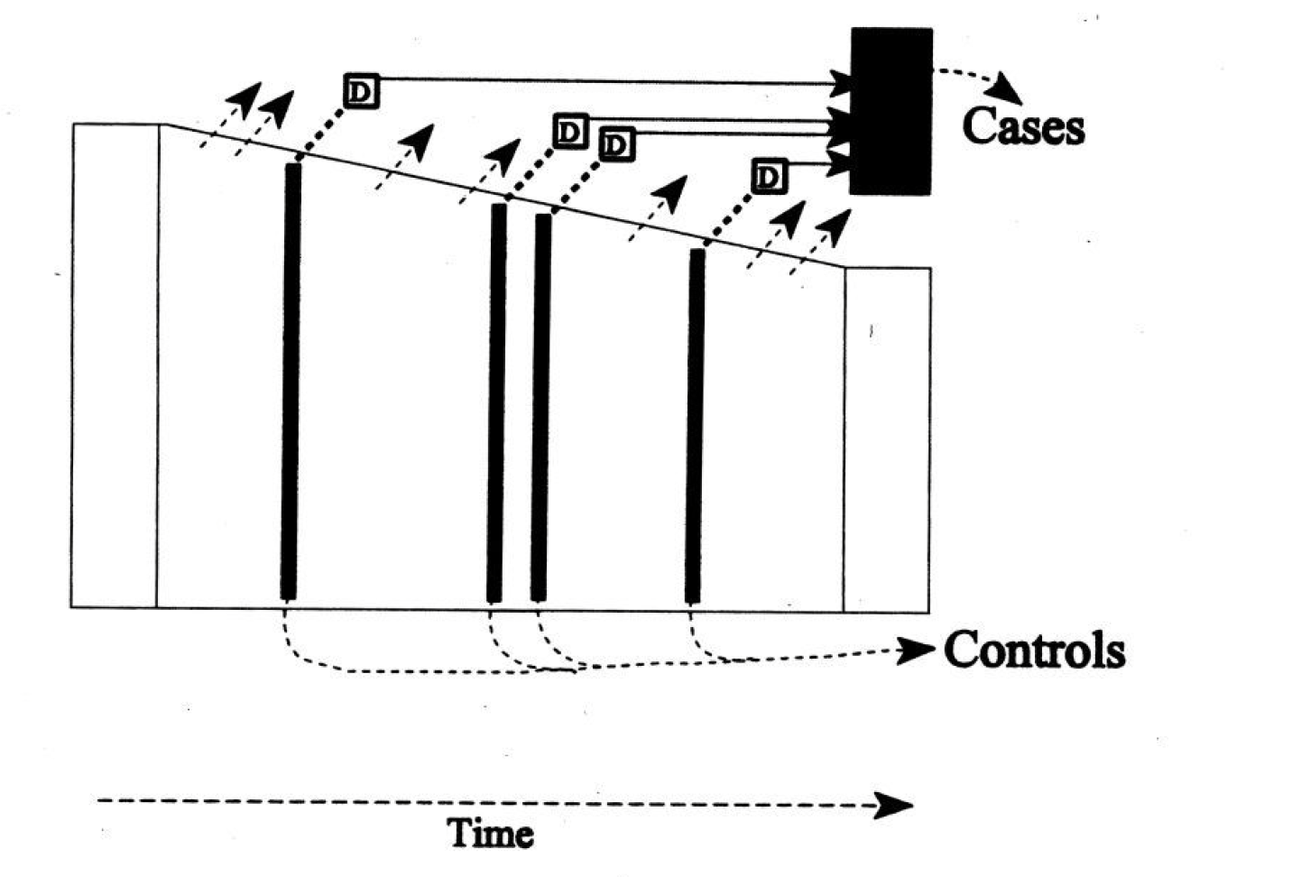
A case-control within an existing cohort
Szklo & Nieto. Epidemiology: beyond the basics. Aspen Publishers, 2000
Notes:
If this is nested within a cohort study, we will have collected exposure and outcome data iteratively throughout follow up.

Slide 26
If the underlying cohort is not well defined…
Consider how cases are sampled
  If clinic based – who is the population that would seek care at that same clinic if they were to become diseased
  Selecting from the community can be problematic
Consider restricting the study to “deconfound”
  E.g., if sex is a strong confounder, restrict the study (Cases and Controls) to just women
Must select controls without regard to exposure status
  To address the concern about confounding, matching may help but over-matching will lead to comparable exposure frequency in controls – that does not reflect the expsosure frequency in the underlying cohort

Slide 27
Types of controls when the underlying cohort is uncertain
Population-based sampling, neighbors of cases
  Problem → if cases recruited at clinic, the neighborhood may have cases that did not/would not seek care at that clinic
Hospital-based controls
  Different illness than the cases
  But what type of illness…. Many illnesses may be assocated with the exposure of interest (either negatively or positively)
Friend controls
  May have similar SES, a potential confounder
  But also may have very similar exposure frequency – not reflective of the underlying cohort
Notes:
There is no magic/perfect solution other than the notion of selecting controls from the underlying cohort from which the cases arose….
Sometimes investigators will sample more than one set of controls – a population based set, a sibling set – to see if results are comparable

Slide 28
Case-control pro/cons
PROs
Efficient for rare events, or disease with long latency
Can examine multiple exposures
CONs
Hard to get a non-biased control group
Recall bias, temporality may be a challenge
Cannot calculate incidence

Slide 29
Case-control example
A Population-Based Case–Control Study of Extreme Summer Temperature and Birth Defects (Environ Health Perspect. 2012 Oct; 120(10): 1443–1449)
Background: Although hyperthermia is a recognized animal teratogen and maternal fever has been associated with birth defects in humans, data on the relationship between high environmental temperatures and birth defects are limited.
Objective: To determine whether pregnancies are potentially vulnerable to the weather extremes anticipated with climate change, we evaluated the relationship between extreme summer temperature and the occurrence of birth defects.

Slide 30
Methods
We performed a population-based case–control study by linking the New York State Congenital Malformations Registry to birth certificates for the years 1992–2006. We selected nonmalformed infants from a 10% random sample of live births as controls. We assigned meteorologic data based on maternal residence at birth, summarized universal apparent temperature (UAT; degrees Fahrenheit) across the critical period of embryogenesis, and estimated adjusted odds ratios (aOR) and 95% confidence intervals (CI) with multivariable logistic regression, controlling for confounders available on the birth certificate.
Among 6,422 cases and 59,328 controls that shared at least 1 week of the critical period in summer, a 5-degree increase in mean daily minimum UAT was significantly associated with congenital cataracts (aOR = 1.51; 95% CI: 1.14, 1.99)
Notes:
Should have selected at 10% random sample regardless of outcome status

Slide 31
Summary
 | Cross-sectional | Cohort | Case-control
How sampled | Without regard to exposure or outcome | Non-diseased at baseline. Exposure assessed at baselind | Selected at the time of disease onset
Follow-up | None | Inherent to the design | We look BACK in time rather than follow forward
Cost | Low | High | Low-ish
If outcome is rare | Would require very large sample to ensure representation | Would require very large sample to ensure representation | Good choice
If exposure is rare | Would require very large sample to ensure representation | Can over-sample exposed at baseline | Would require very large sample to ensure representation

Slide 32
A note on terminology
Literature can be inconsistent. A common mis-use of “case-control” is a study of health outcomes in diseased vs non-diseased., e.g.,
  Among men age 50, does the risk of heart attack within the next 5 year differ by HIV status?
    HIV Status is the exposure – heart attack is the outcome

