Slide 1




Preventing Sexual Violence, Workplace Harassment and Gender-Based Violence:
A Mixed Methods Study at Maseno University in Kenya
SD4H Seminar Series Dr. Karen Nyangara – Maseno University
Dr. Jennifer Wagman – UCLA Fielding School of Public Health
September 8, 2022

Slide 2
Introduction
1974 Barnes v. Train The first sexual harassment
case in America
2018 Luku vs NBK Sought damages for
sexual harassment
2022 Aisha vs G4S Was awarded Ksh 26m (filed 2006)
Notes:
Paulette Barnes, a payroll clerk lost her job after refusing the advances of a male supervisor.[1] The case was initially dismissed, but won on appeal in 1977 US Court of Appeals ruled it was sex discrimination for a woman to suffer tangible employment losses (for example losing her job) for refusing to submit to requests for sexual favor
Aisha- her dismissal was solely to cover up her ordeal at the hands of the individual tasked with protecting employees from workplace challenges like sexual harassment and gender discrimination – the human resource director

Slide 3
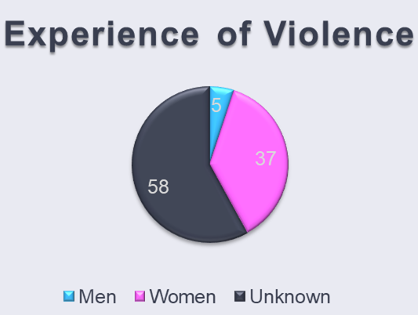
Why workplace harassment (WH) and sexual violence (SV) are important
Gender Violence Recovery Center in Nairobi treats 3000+ yearly, 86% for sexual and gender-based violence (SGBV) [1]
Kenya National Crime Research Center - total number of GBV cases increased by 88% in the first 3-months (April–June 2020) of Covid-19 (news report) [2].
Kenya launches the first specialised SGBV court in March 2022 (news report).
Nurses indicated a lifetime incidence of 87%[3]
Notes:
Gender violence recovery center
Kenya National crime research center
Participant Q why are these an issue?

Slide 4
Case study- names are fictitious
Jane is a 3rd year student who attended an end of semester bash where she had too much to drink, was put to bed where she passed out. Jane was sexually assaulted by John, who was also drunk. Two female friends caught John in the process of violating her and chased him off. Jane woke up with her clothes ripped off and in pain.
With the support of her friends Jane went to the student clinic where an examination was done, and later the next morning filed a case at the police station. In addition, Jane was re-examined at the local dispensary and a P3 form filled. A (female) police officer accompanied her to the dispensary, along with a (male) university security officer.
John admitted guilt, was jailed for a month, and then arraigned in court. Jane had to travel 8 hours to make the court mention which was postponed twice. John often called or sent emissaries, asking for forgiveness or threatening her. Jane was scared as the security office and the police needed physical proof of harm to act.
During the court sessions Jane had either the gender focal person or the dean of students accompanying her. Meanwhile John also faced a student disciplinary hearing where he was suspended indefinitely.
Eventually the trips became too expensive for Jane, and she stopped attending court. The outcome of the case is unknown. She is currently undergoing counseling
Notes:
Questions:
What form of GBV are we seeing here? Whose fault was it?
What do you think about the process of reporting and handling of this case? From the point of view of the institution? From Jane’s point of view? (pluses and minuses)
What procedures do you feel have not been explained or were overlooked?
What can be changed

Slide 5
Why are WH and SV under-reported?
What did you find out?
Sang, Kemboi and Omenge [4]
Akili Dada [5]
Notes:
What do you know from the 2 readings?
Sang- not a part of CBAs, lack of policy framework
Akili Dada- nothing will be done fear of retaliation lack of knowledge

Slide 6
What does Kenyan law say about SH?
Any kind of sexual behavior that makes the victim feel uncomfortable, includes using language (written or spoken) or visual material of sexual nature; and showing physical behavior of sexual nature is considered SH
An establishment with 20 or more workers may issue a policy statement on SH, which clearly defines SH and states that the workplace is free of SH
Each worker should be well aware of the provisions of the policy statement.
Any person, in a position of authority, or holding a public office, is guilty of the offence of sexual harassment is liable to imprisonment of at least three years or to a fine of at least 100,000 shillings or to both. [6,7]

Slide 7
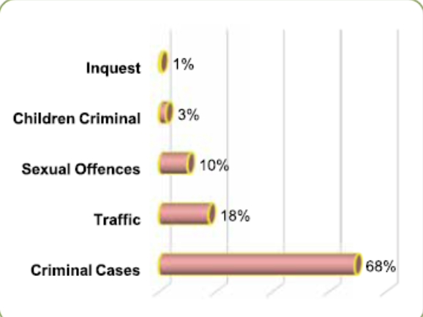
Main cause- nothing will be done about it
Facts
512,454 pending cases in the Magistrates’ Courts at the end of FY 2020/21 [8]
274,584 are backlog cases
In the study by Akili Dada most cases of WH and SV are reported as assault. [5]
Case backlog by age in Magistrates’ Courts, 30th June 2021
Notes:
Deeply entrenched belief that nothing will come of it appears supported by the case backlog.
Institutions lump WH and SV as assault- leading to underreporting and probably poor handling

Slide 8
However
Magistrate court cases 2020/2021
Notes:
66% of cases resolved- this is good considering that sexual assault is one of the most confounding crimes police confront. Many investigations lack corroborating witnesses and physical evidence. A significant chunk of complaints are reported months or years after the fact. Researchers believe only a third of rapes are reported at all.
Police successfully closed just 32 percent of rape investigations nationwide in 2017, according to the data, ranking it second only to robbery as the least-solved violent crime. That statistic is down from about 62 percent in 1964, despite advances such as DNA testing- FBI

Slide 9
Background Summary
Workplace sexual misconduct and harassment are global public health problems.
Focused data on sexual misconduct and harassment in Kenya is limited but sexual violence – more broadly defined – is pervasive throughout the country and region.
Maseno University has a gender policy to promote gender equity and prevent discrimination and harassment but substantial gaps – from limited resources to lack of enforcement of rules – preclude achievement of a “safe” academic and professional environment.
Notes:
People who experience sexual misconduct and harassment have significantly higher odds of anxiety, depression, and insomnia and these outcomes are exacerbated in persons with preexisting conditions, such as HIV, diabetes, high blood pressure and heart disease.^{3,4} Sexual harassment-related loss of work productivity and quality is associated with mental health problems and – among students – poor academic achievement.⁵ Research from the US suggests that, relative to men, women are significantly more likely to experience sexual harassment and misconduct. This is especially the case in the fields of science, engineering, and medicine,⁶ precisely where the SD4H fellows at MSU are situated, and exposure to harassment/misconduct has been found to adversely impact women’s ability to advance, succeed and gain equity in these academic fields.⁶
A 2019 survey of students at 5 Kenyan universities found 49% of female and 24% of male students reported sexual harassment and 66% of incidents were perpetrated by a lecturer. Most victims to no one about the harassment because they did not think the institution would take the report seriously.⁷ In a qualitative study, female Kenyan university students reported sexual harassment was common during exam periods, whereby male lecturers would give higher grades in exchange for sexual favors. Male students reported being bullied or harassed into having “love triangles” when male lecturers sexually interested in a female student with whom the male student had a relationship.⁸ Despite the lack of data on harassment, sexual and physical violence are pervasive in Kenya. Close to half (47%) of adult women experience physical or sexual violence at some point in their life. In the past year, 8% and 20% of women report sexual and physical violence, respectively.⁹

Slide 10
Gaps preventing Maseno University (MSU) from being a “safe” environment for NIH-supported SD4H trainees from conducting research in an equitable, harassment-free setting
Low knowledge and awareness about applicable laws, regulations, policies, and codes of conduct related to sexual harassment and sexual misconduct.
No comprehensive outreach and prevention education to learn about sexual violence, sexual harassment/misconduct or other forms of GBV.
Provision of services for victims and others affected by sexual harassment at MSU is fragmented.
Various gaps related to the MSU Gender Policy.
Notes:
The MSU Gender Policy outlines mechanisms for dealing with all forms of GBV and discrimination, including sexual and workplace harassment. It defines ‘workplace’ as “all places where staff and students need to be or go to by reason of their work and studies and which are under the direct or indirect control of MSU. The Policy sets out roles and responsibilities of members of the University Council, administrative staff, and other MSU members. It stipulates that all cases of sexual harassment and misconduct be reported to the Institute for Gender Studies (see section 4.2). While the MSU Gender Policy is an excellent first step in working toward the prevention of sexual harassment and misconduct, there are critical gaps that must be addressed before MSU is truly a “safe” work environment that fosters NIH-supported SD4H trainees and other members of the campus community to conduct high-quality research in an equitable, harassment-free setting. These gaps include:
Knowledge and awareness are low – among staff, faculty and trainees – about applicable laws, regulations, policies, and codes of conduct related to sexual harassment and sexual misconduct.
There is no comprehensive outreach and prevention education for the campus community to learn about sexual violence, sexual harassment/misconduct or other forms of GBV (e.g., dating violence, stalking).
Provision of services for victims and others affected by sexual harassment at MSU is fragmented. Few providers are trained to recognize the signs and symptoms of harassment, abuse or other forms of GBV. Even fewer are trained in how to provide confidential, trauma-informed, survivor-centered care.
Related to the MSU Gender Policy: (i) Dissemination to staff and students has been limited due to inadequate funding for printing and circulation. Availing the Policy electronically has increased dissemination but most students indicate they do not read policy documents in any format. Students have told MSU administration they prefer discussing policy-related issues which has been accounted for by holding in-person discussion forums, but it is not possible to engage every MSU community member this way. (ii) The Policy lacks recommendations for procedures/penalties for cases of harassment. MSU lacks comprehensive procedures for ensuring the immediate safety for all involved, protecting victims or whistleblowers from retaliation, investigating allegations, and taking appropriate sanctions.

Slide 11

We set out to conduct a 12-month research and programming project to raise awareness, develop training programs, and strengthen policies and procedures for responding to allegations of sexual harassment and misconduct at MSU.

Slide 12

Supplement to: Sustainable Development for HIV Health (SD4H)
Dr. Louisa Ndunyu, Maseno University, Kenya
Dr. Elizabeth Bukusi, Kenya Medical Research Institute, Kenya
Drs. Sheri Weiser & Craig Cohen, University of California Global Health Institute, USA
Notes:
This award is a supplement to the Sustainable Development for HIV Health (SD4H) Training Program with attribution to MSU, Kenya Medical Research Institute (KEMRI) and University of California Global Health Institute (UCGHI)
The aim of SD4H is to train Kenyan PhD and Masters students to design, lead, implement and scale innovative, transdisciplinary interventions within Kenya, with an aim of improving HIV prevention and treatment outcomes by targeting food insecurity and poverty, some of the root drivers of poor HIV outcomes.
As trainees on an award funded by the NIH, SD4H fellows benefit from exposure to the NIH’s comprehensive policies, practices, and initiatives for addressing sexual harassment and misconduct but the extent to which they and MSU community members are protected by NIH regulations, policies and procedures is limited, given Kenya has different laws and customs surrounding sexual harassment and MSU’s policies and procedures for handling gender-based violence (GBV, including sexual harassment and misconduct) have gaps that preclude assurance of a safe and harassment-free environment

Slide 13

The SPHCD focuses on addressing the problems and challenges for the Great Lakes region in Kenya and neighboring countries. The school provides hands-on training combined with practical knowledge in public health, biomedical science and technology, applied research and community outreach for the enhancement of economic, social, cultural and technological advancement of communities in Kenya
SPHCD
SD4H is a consortium that aims to create an academic and professional environment at MSU
SD4H
FIC is a supplement to SD4H that seeks to build the capacity of MSU to develop awareness, training, procedures and policies for responding to and preventing sexual violence and workplace harassment at MSU
FIC

Slide 14
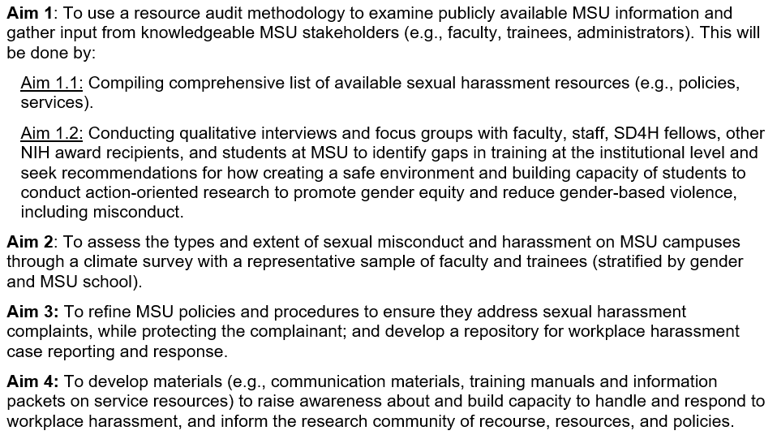
Research Aims

Slide 15
Methods
Resource Audit
Qualitative Research
In-depth interviews with faculty, SD4H fellows, NIH award recipients, and students at MSU
Focus group discussions with service providers and MSU staff
Survey Research with:
1,000 undergraduate students,
250 graduate/diploma students,
250 faculty and staff

Slide 16
RESULTS

Slide 17
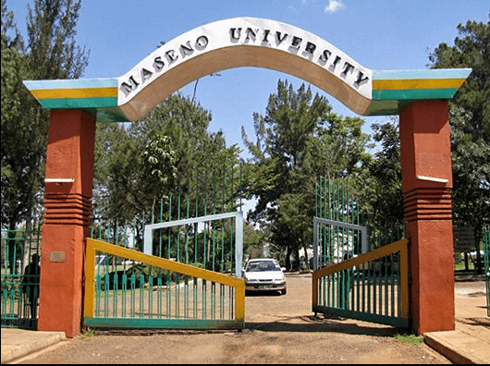
Stakeholder Participation
Stakeholder buy-in was ensured at the start by engaging management, faculty and student groups as well as the GMC.
MSU is committed to meeting policy development and implementation in its performance contract
All qualitative participants were purposively sampled based on their role at MSU as service providers
https://commons.wikimedia.org/wiki/File:Maseno_University_Kisumu.png

Slide 18
Research Participants
Qualitative participants
11 in-depth interviews
4 focus group discussions
3 with undergraduate students (1 female; 1 male; 1 mixed gender)
1 with postgraduate students
Survey participants
664 total
507 students
157 staff members

Slide 19

Qualitative Research Findings

Slide 20
Definitions of Sexual Violence and Sexual Harassment
Overall, students described sexual harassment as a “weaker form” of sexual violence; one that may be more difficult to “see” and acknowledge
“Sexual violence can be; one can be able to see sexual violence. But sexual harassment basically lacks evidence. It's weaker. It's a weaker form of sexual violence” (KII 09)
Students described instances of rape, sexual touching without consent, intimate partner violence, leaking of nudge photos, online harassment, verbal harassment, and LGBTQ-related stigma
The topic of what constitutes “violence” and consent also arose
“And that is why you add with or without your consent. So the consent will define whether it is violence for you or no violence. Moderator: So if it's with your consent? Participant 10: It's not violence” (Female FGD)

Slide 21
Sexual Violence and Sexual Harassment Occurred in Relationships Between Students and with Faculty
SVSH in intimate relationships between students
“I tend to believe most of the sexual harassment and violence that are not talked about happen in relationships. Just because we're in a relationship you feel because today you need sex and I'm not ready we still can have sex today because we are in a relationship… Yes, so harassment happens in relationships” (Mixed Group FGD)
Faculty violence and power dynamics
“Lecturers harassing students is whereby you find a lecturer calling you and tells you to meet in Kisumu, do this and that, I am in love with you and such things. The lecturer is probably the age of your dad or even your grandfather. In case you turn him down, he threatens you that he will give you a re-sit. You will never actually graduate with re-sits.” (Mixed Group FGD)
Notes:
When asked about general perceptions of SVSH, and the relationships or interactions in which SVSH occurred, respondents mentioned: dating and intimate partner violence, peer interactions/peer pressure, power dynamics and faculty-initiated violence

Slide 22
Determinants of Sexual Violence and Sexual Harassment on Campus
Alcohol use/partying
[Referring to parties at Maseno University] “we have alcoholic drinks and some of us have never used them. You find a lady who has just come from home, a very innocent lady finds a student who has been a senior comrade like me, but you find this other lady has never even had alcohol. You force the lady to take this drink and after that she will not make it to her place, so you may end up going with her to your place because she is drunk. You know she is unconscious. She wakes up in a different environment in the morning and doesn't recall what happened but what she can recall is that there was some sexual act” (Male FGD)
Peer pressure
“Sometimes I feel people will harass you because their peers harass people. If you are in a group of people that spank people any how, you are going to spank any how if those are your friends. There's this statement that says that show me the friends that you hang out with and I will know your character. Sometimes it might not be true, but it's not far away from truth.” (Mixed Group FGD)
Notes:
Respondents narrated many factors they thought increased students’ risk for experiencing SVSH. These included peer interactions and peer pressure, partying and alcohol use, security and community violence, and power dynamics.

Slide 23

Survey Research Findings

Slide 24


What staff and students say:
Prevalence of WH and SV in MSU
>76% of staff say they have never experienced WH
15% say they have experienced it at least once
12% more than once
62% say it is a problem only to a small extent
13% think it is a problem to a large extent
70% feel there is little to no risk of experiencing SH
Notes:
Both off and on campus

Slide 25
What students say:
Knowledge of sexual violence
>65% describe various forms of physical sexual violence correctly
<40% recognize emotional and psychological forms of sexual violence
Only 18% are aware of the official MSU definition of sexual violence
Notes:
E.g. only 20% recog cat calling, hissing and whistling as sexually offensive

Slide 26
What staff and students say:
Knowing where to get help
29% know where to get help
50% do not know
21% are unsure
24% know where to get help
52% do not know
24% are unsure

Slide 27


What staff and students say:
72% are not aware of the formal procedures to address complaints
48% are not aware of what the policy says
45% of students, 23% of staff believe in a fair investigation
41% believe action would be taken
BUT
79% staff and 46% students believe they would not be protected if they make a report

Slide 28
Qualitative findings on student awareness of protocols and policies to address SVSH
“I think the university is trying to provide some measures that can prevent sexual harassment and violence. One, we have the policies that govern on the ways within the university on how we visit the hostels… I think the university has tried to improvise these policies that you should not visit a hostel belonging to the opposite gender past a certain time. I think it is trying to protect us from the sexual harassment and violence…” (FGD Male)
Notes:
Knowledge and Efficacy of policies/protocols- Overall, low student awareness of protocols and policies to prevent and address SVSH

Slide 29
Ten to Ten Rule
I think the “ten to ten rule” was put in place in the female hostels so a guy should not be seen past 10PM and before 10AM (in the female hostel) but that only helps the students who are within the school… ” (Female FGD)
“Just to add on ten to ten, I think ten to ten is working because there are some watchmen who walk in the dormitories. Actually they are always outside the windows. For example if it is a ladies' hostel, they will stay outside and when they hear a base or boys talking, they will come outside. They actually have consequences and most of the students fear it. I think it is working because they always patrol at night.” (Mixed FGD)
Notes:
The “Ten to Ten rule” was the only policy ne mentioned widely among students; students expressed mixed opinions about the efficacy and success of this policy in preventing SVSH

Slide 30

What can be done to raise awareness, build knowledge, increase skills both for prevention and redress?
policies
procedures
people

Slide 31
Future MSU policy development plans
Individual relationship skills; ensure service information is received through multiple sources
Service provider capacity to provide information, collect and collate data, refer students and staff for services, carry cases to completion
An ecological implementation model will be used to conduct training at 4 levels:
Campus community by promoting positive gender norms, safety and workplace respect
Build society’s capacity to support and understand MSU efforts in ensuring safety and freedom from incidents of sexual violence/harassment

Slide 32

What research says
Make it a leadership priority
Make it a workplace health and safety issue
Inform and empower all actors
Support those who are impacted [9]

Slide 33
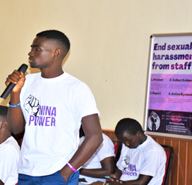


What students want:
Notes:
Awareness raising #CampusMeToo
Tougher policies and regulations
Training students on respect for women posters and messaging
Conduct GBV Policy induction orientation for new students, included Gender issues in PHT 112
Provide a toll-free university number for reporting

Slide 34

If you are neutral in situations of injustice, you have chosen the side of the oppressor. If an elephant has its foot on the tail of a mouse, and you say that you are neutral, the mouse will not appreciate your neutrality.

Slide 35
References
1. Gender Based Violence Recovery Center Kenya Country Programme 2017-2020. Thematic Health Program- Enhancing Services and Advocacy for GBV in Kenya. https://www.globalwps.org/data [1]
2. Kenya National Crime Research Center (2020). Protecting the Family in the Time of Covid-19 Pandemic : Addressing the Escalating Cases of Gender Based Violence, Girl Child Disempowerment and Violations of Children Rights in Kenya. https://www.crimeresearch.go.ke/protecting-the-family-in-the-time-of-covid-19-pandemic/ [2]
3. Kibunja. B. K. et al (2021). Prevalence and Effect of Workplace Violence against Emergency Nurses at a Tertiary Hospital in Kenya: A Cross-Sectional Study. Safety and Health at Work12(2) pp249-254. https://pubmed.ncbi.nlm.nih.gov/34178404 [3]
4. Sang, R. K. A., Kemboi, J. K. and Omenge, R. O. (2016). Sexual Harassment among University Students within University of Eldoret, Uasin Gishu County, Kenya 15 (8). IOSR Journal of Dental and Medical Sciences pp 142-151. www.iosrjournals.org [4]
5. Akili Dada (2020). Prevalence of GBV in Selected Public Universities in Kenya. The Africa Center for Gender, Social Research and Impact Assessment. [5]
6. Republic of Kenya. The Employment Act 2007. [6]
7. Republic of Kenya. The Sexual Offences Act 2006. [7]
8. The Judiciary of Kenya (2021). State of the Judiciary and Administration of Justice Annual Report 2020/2021. www.judiciary.go.ke [8]
9. Norton Rose Fulbright (2020). Sexual harassment in 2020: Time to disrupt the system? https://www.nortonrosefulbright.com/en-ke/knowledge/publications/dcb48089 [9]

Slide 36



