Slide 1
Emerging Tools For HIV prevention & treatment; m-Health experiences from the field by Eliud Akama, MPH University of Washington
Notes:
Record Zoom!!!

Slide 2
Outline
Overview of Digital Health
Overview of m-Health
Experiences From the Field

Slide 3

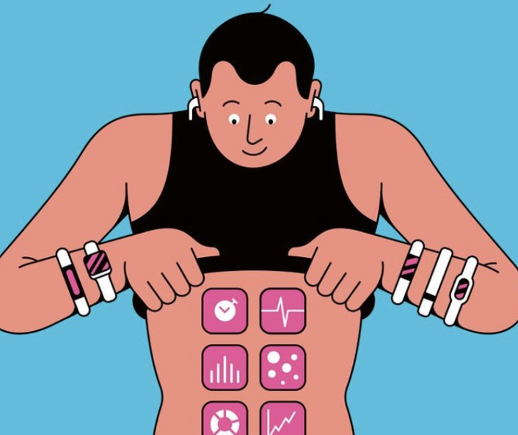


Background
Digital Health, is an evolving concept that encompasses internet focused technologies and tools that enhance health care delivery and public health
Digital health is deeply rooted in eHealth ”the use of information and communication technology in support of health and health-related fields”
mHealth
Wearable devices
Machine Learning and Artificial Intelligence
Telemedicine
Notes:
The term digital health is rooted in eHealth, which is defined as “the use of information and communications technology in support of health and health-related fields”. Mobile health (mHealth) is a subset of eHealth and is defined as “the use of mobile wireless technologies for health”.

Slide 4
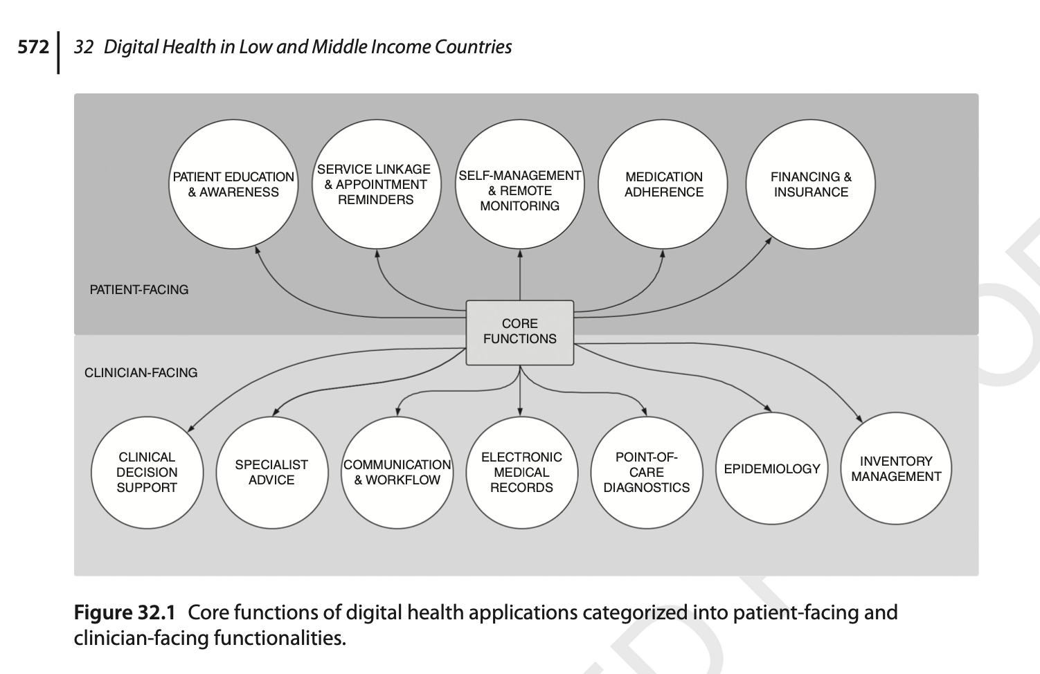
Seneviratne, Martin & Peiris, David. (2019). Digital Health in Low- and Middle-Income Countries. 10.1002/9781119282686.ch32.

Slide 5
Digital Health
Telehealth
mHealth
Healthcare Data
Medical Records
Activity Monitoring
Outpatient Monitoring
Smart Wearable Devices
Mobile/
Wireless devices
Machine Learning, Artificial Intelligence
Patient Held Records
Healthcare Chatbots
Remote Medication Adherence
Implantable Devices
Mobile/
Wireless devices
Precision Medicine/
Public Health
Provider Held Records
Video Consults
Smartphone Medical Applications
Cloud Computing

Slide 6
mHealth
“The use of mobile and wireless technologies to support the achievement of health objectives” (WHO)
“The use of mobile and wireless devices (cell phones, tablets, etc.) to improve health outcomes, health care services, and health research” (NIH)

Slide 7
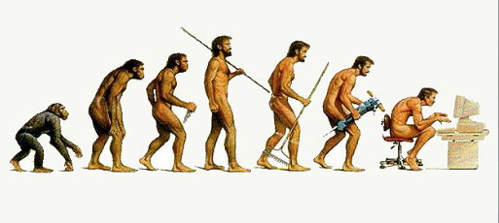


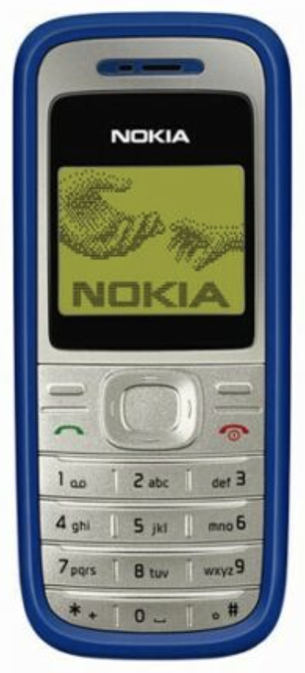



Evolution

Slide 8
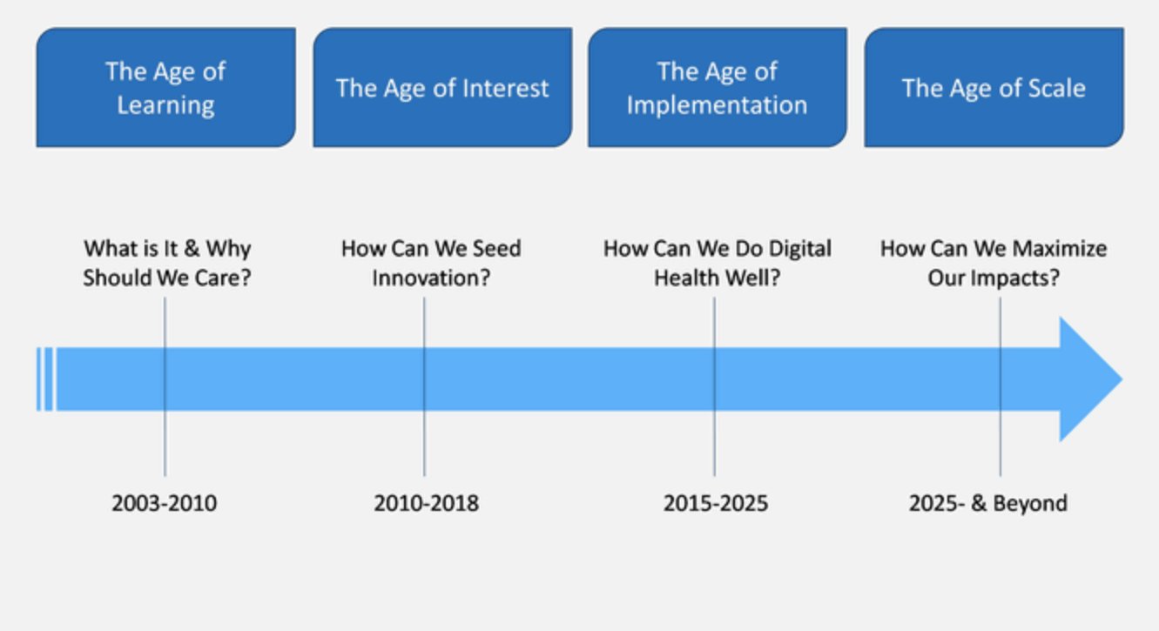
Evolution

Slide 9
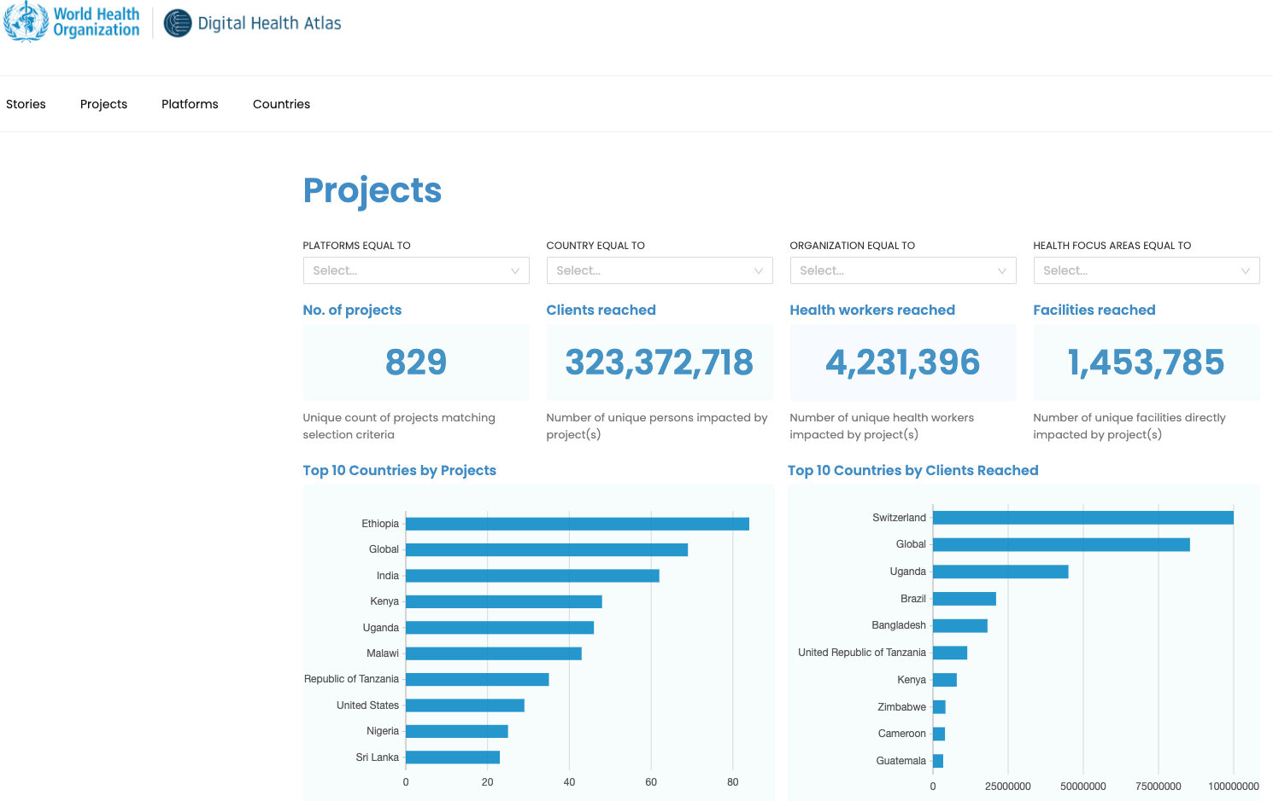
https://stories.digitalhealthatlas.org/post/86da3247-b989-4afc-a65a-7f7752481447
Notes:
The Digital Health Atlas (DHA) is an open-source web platform designed to support governments, technologists, implementers, and donors to better coordinate digital health activities globally.

Slide 10
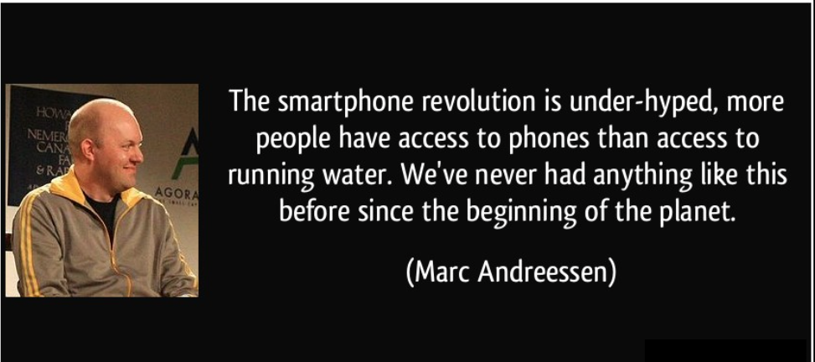

Slide 11
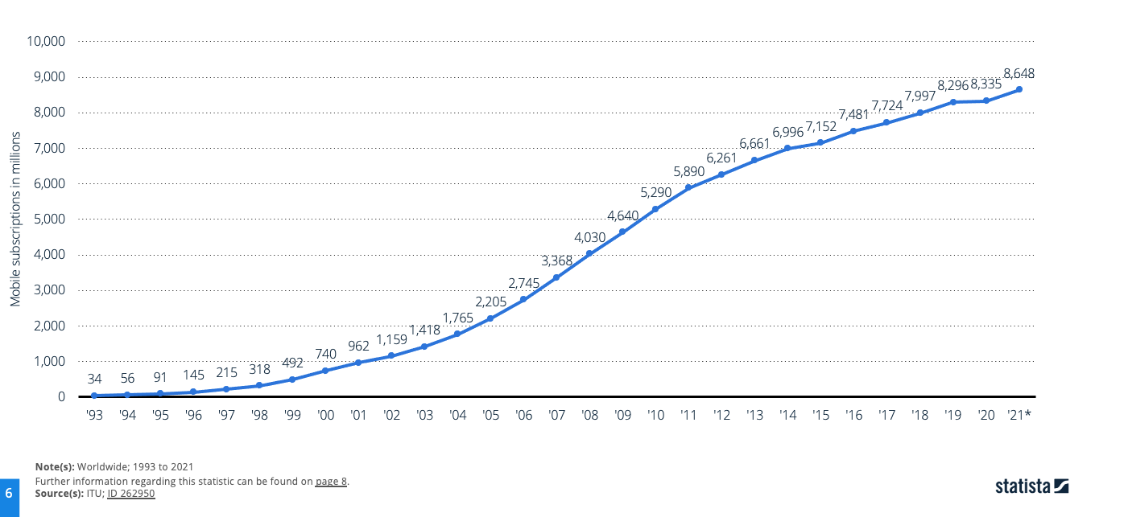
Number of moble subscriptions worldwide 1993-2021
Notes:
The total number of mobile subscriptions is estimated to have exceeded eight billion for the first time in 2019, reaching 8.3 billion subscriptions. In 2021, this figure increased to 8.6 billion. More smartphones than people
With a global population of 7.8 billion as of 2021, the number of smartphone subscriptions now significantly exceeds the number of people on the planet. This comes off the back of an extraordinary period of growth. On other continents, such as Africa, the penetration rate has also increased steadily. Cameroon , for example, increased by 123 percent from 2010 to 2020, with 95.1 mobile subscriptions per 100 residents as of 2020, and the rate exceeded 114 in Kenya in 2020.

Slide 12
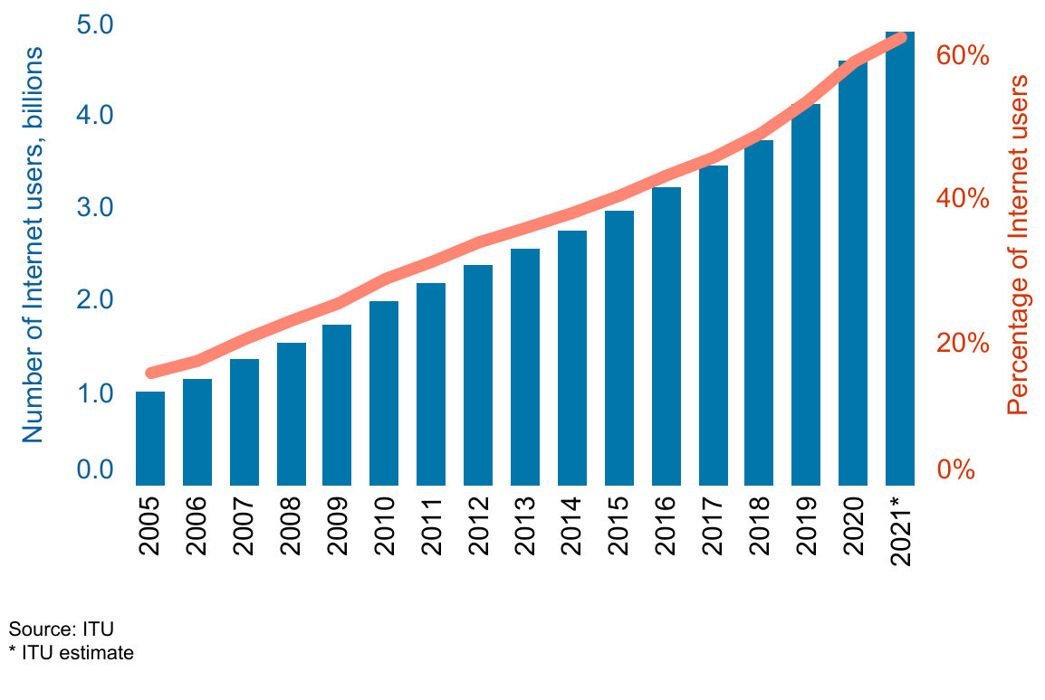
Number of individuals using the internet

Slide 13
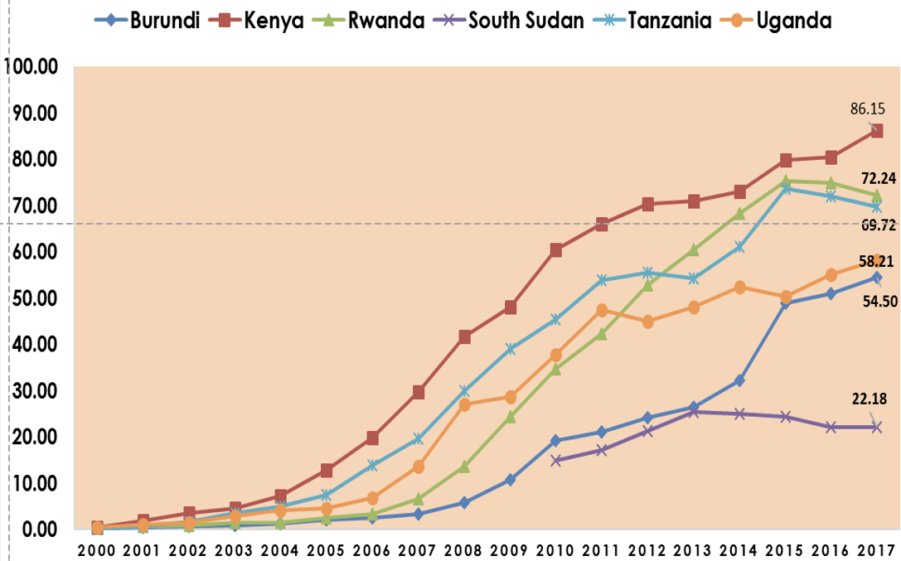
Mobile-Cellular Telephones Subscriptions Per 100 inhabitants
Source: International Telecommunication Union, Country ICT Data Until (2018)

Slide 14
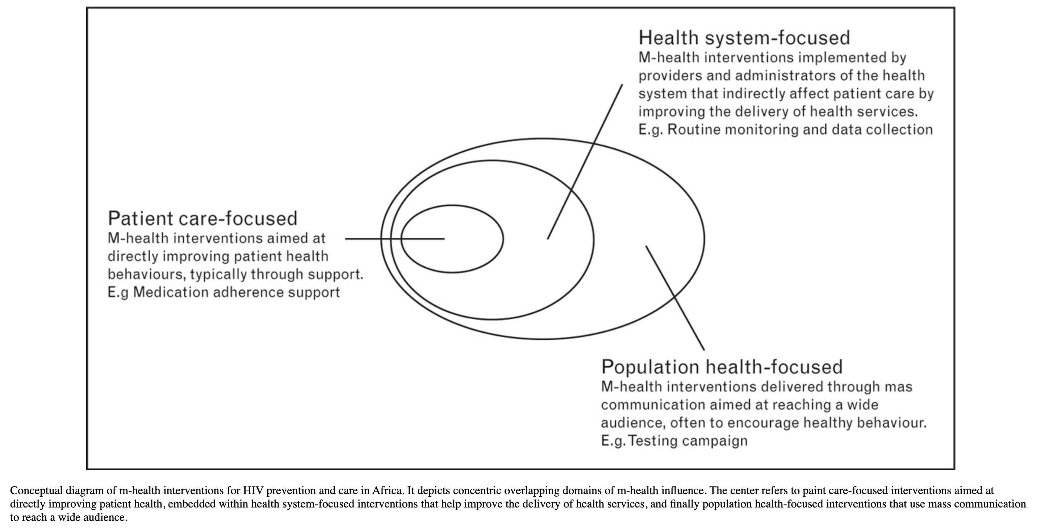
Conceptual Diagram of m-Health interventions for HIV prevention in Africa

Slide 15
Group work Discussion Questions
Group 1: What are your thoughts regarding policies for regulating m-Health? What are your greatest concerns?
Group 2: The rapid smartphone penetration, access to the internet, and improving internet speeds have created opportunities for health systems strengthening. How would you take advantage of these opportunities?
Group 3: Short time-pilot of m-Health interventions in Low and Middle-Income Countries impede long-term health system improvements. What are your thoughts/experiences regarding piloting m-Health interventions?
Group 4: What are some health problems that you would use
m-health technologies to address? What m-Health techniques would you use?

Slide 16

Text messaging to reduce missed opportunities in early infant diagnosis and postpartum retention in HIV care

Slide 17
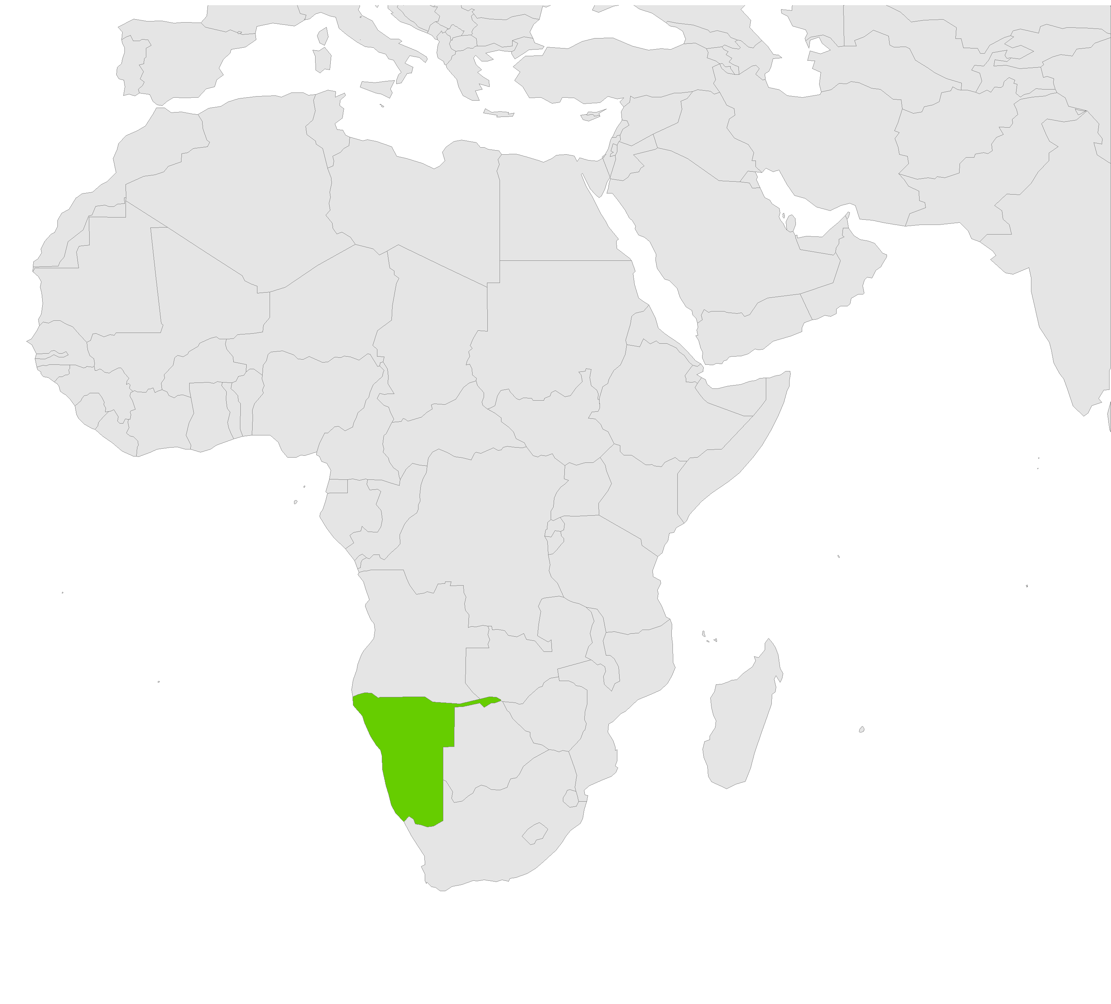
Proportion of infants receiving a virological test for HIV within 2 months of birth
Namibia
88%
Notes:
Going from close to 90% in Namibia

Slide 18
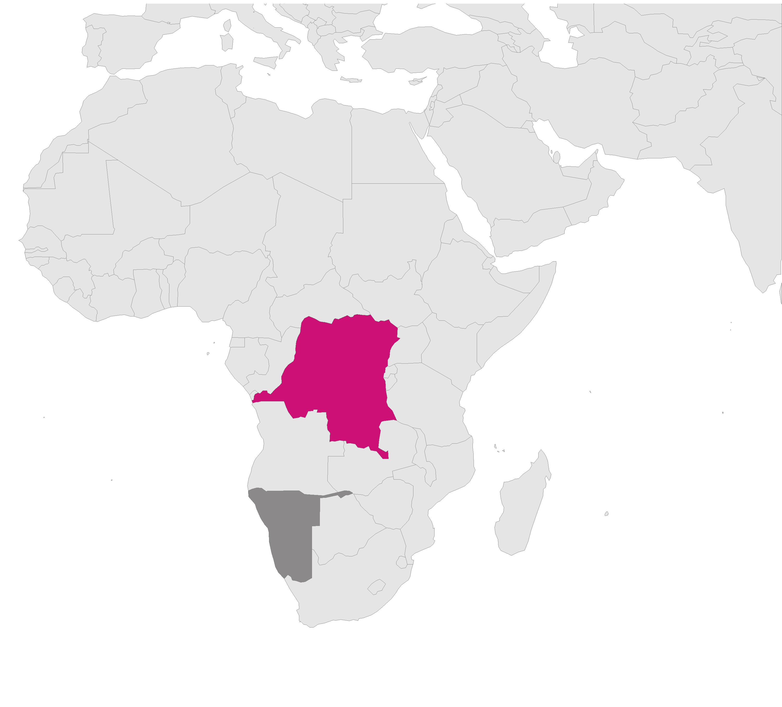
Proportion of infants receiving a virological test for HIV within 2 months of birth
D. R. Congo
2%
Namibia
88%
Notes:
To as low as 2% in the D.R. Congo

Slide 19
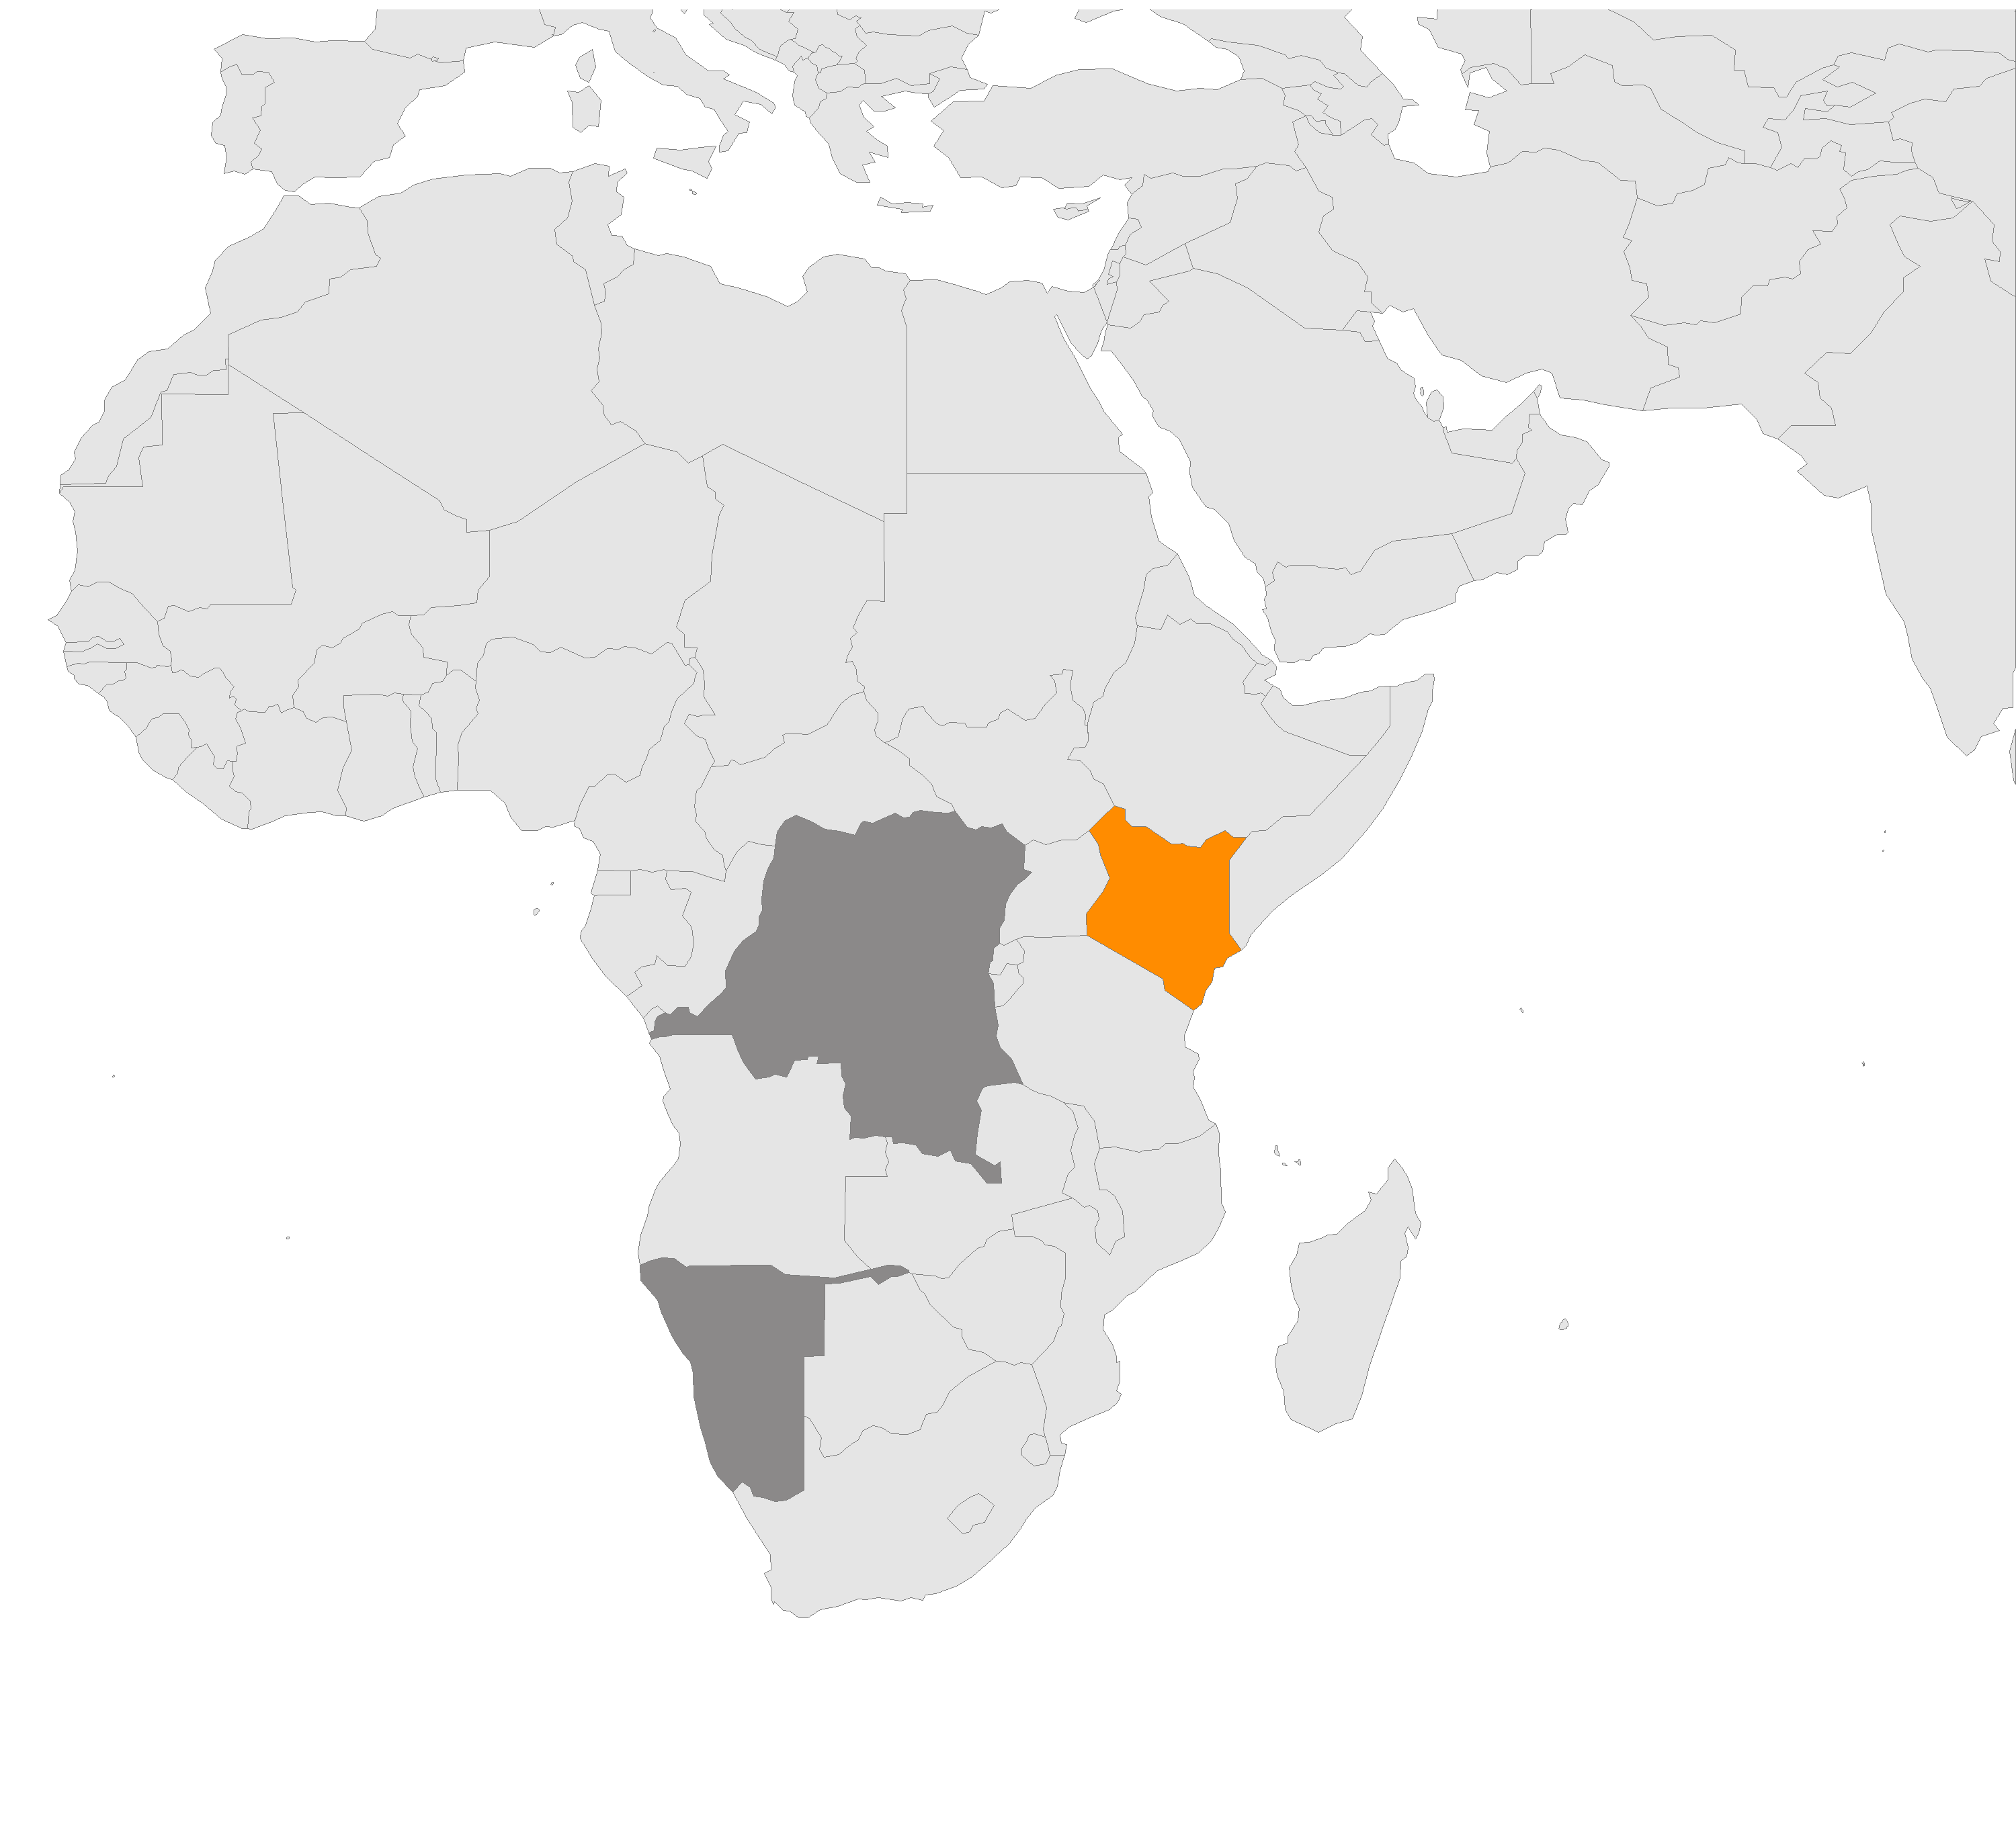
Proportion of infants receiving a virological test for HIV within 2 months of birth
Kenya
39%
D. R. Congo
2%
Namibia
88%
Notes:
With most African countries lying somewhere in between. Kenya, for example is at 39%

Slide 20
Postpartum follow-up is a critical part of PMTCT
Infant feeding counseling
POST-PARTUM FOLLOW-UP
Family planning
Danger signs
Infant ARV prophylaxis
Early Infant Diagnosis
Notes:
The benefits for attending postpartum clinic and bringing infants for HIV testing include:
counseling on infant feeding options, access to family planning services, counseling on danger signs and when to return to hospital, initiation of infant ARV prophylaxis, and early infant diagnosis of HIV

Slide 21
Postpartum follow-up is a critical part of PMTCT
Infant feeding counseling
POST-PARTUM FOLLOW-UP
Family planning
Danger signs
Infant ARV prophylaxis
Early Infant Diagnosis
Notes:
Early determination of infant HIV status is important for two main reasons:
For HIV negative infants, it is the entry point for prevention efforts such as continued ARV prophylaxis for breastfeeding infants
For HIV positive infants, it is the entry point to receiving life-saving ART
However, questions still remain regarding how to ensure adequate follow-up of mother-infant pairs and ensure the best health outcomes for both moms and babies

Slide 22

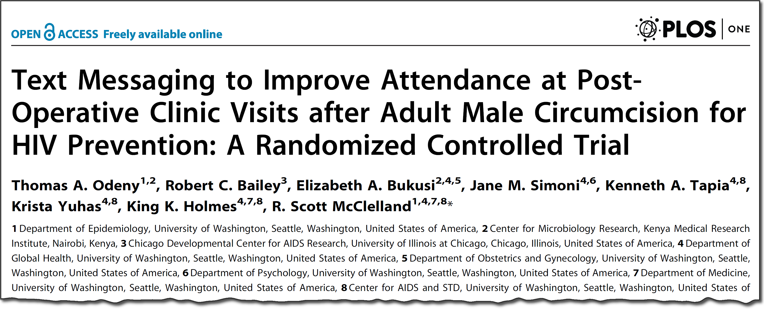

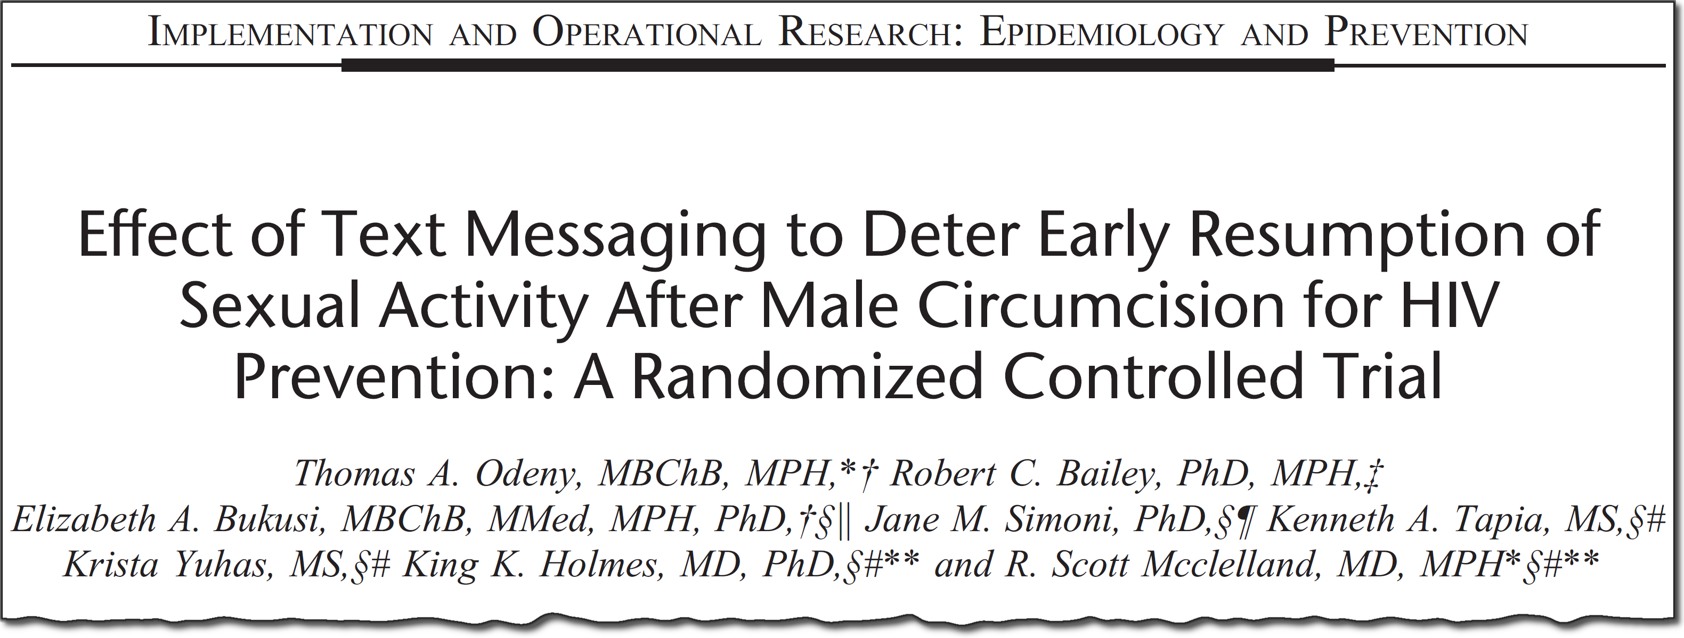
SMS improves clinic attendance after MC for HIV prevention
Notes:
Now, we previously demonstrated that mobile phone text messaging, or SMS, significantly improved clinic return for other HIV prevention programs such as male circumcision. This was work done as part of my MPH

Slide 23



SMS improves clinic attendance after MC for HIV prevention
Notes:
And other studies have shown that text messaging is associated with improvements in:
Vaccination uptake
Adherence to antiretroviral medication
And even smoking cessation

Slide 24


SMS improves clinic attendance after MC for HIV prevention
?
Notes:
So we wanted to leverage our experience with mobile health technology, or mHealth, and see if it can be applied to improve the health of babies born to HIV-infected mothers

Slide 25
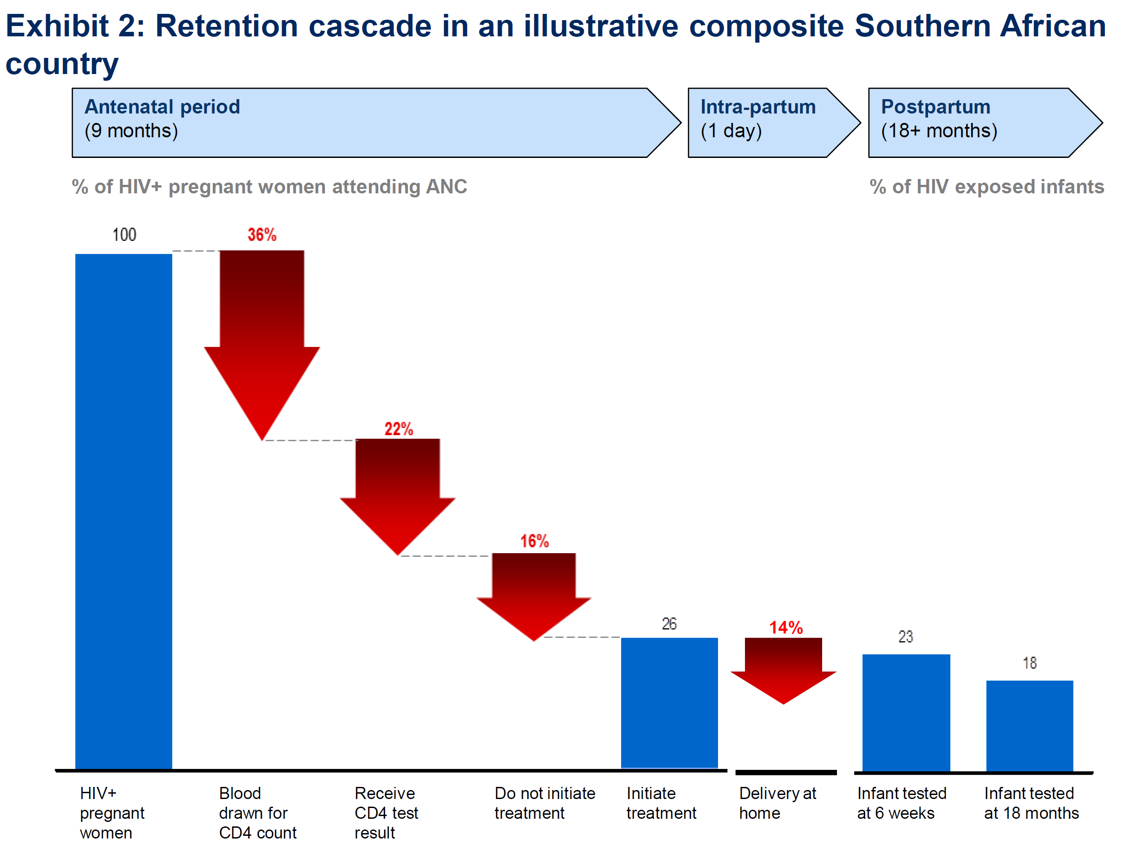
Notes:
So, the care for women living with HIV and their babies includes delivery under skilled attendance at a hospital, and diagnosis of infant HIV within six weeks of birth. Unfortunately, a substantial proportion of HIV-positive pregnant women and their babies in Kenya do not return to clinic after delivery.

Slide 26
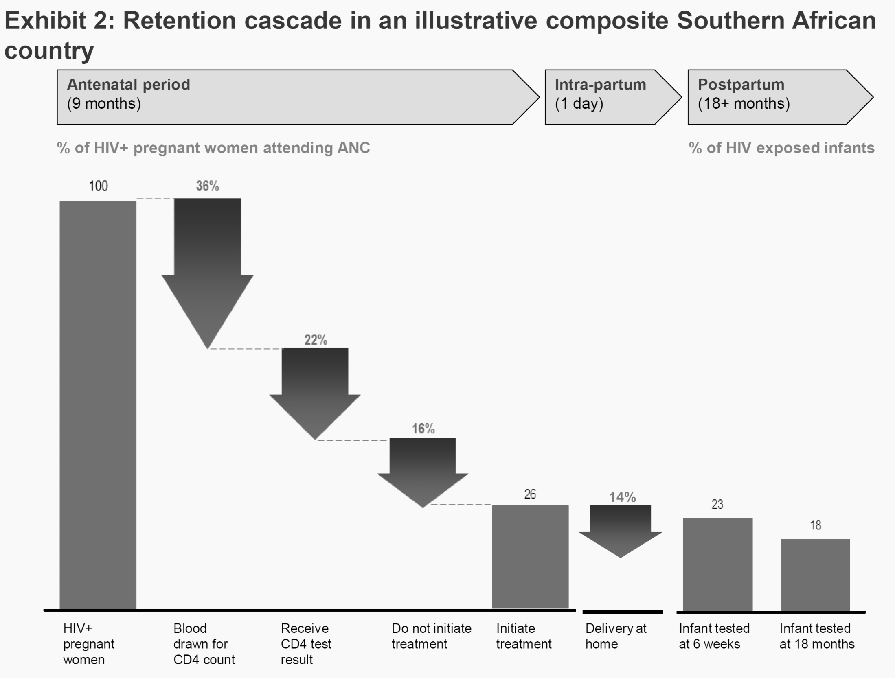
Notes:
Worse, less than 40% of eligible infants receive HIV testing within the recommended six weeks after delivery. Left untested and untreated, half of these children will die before the age of two years. The other half will not see their fifth birthday. Early diagnosis of HIV infection and early initiation of antiretroviral therapy (ART) reduces infant mortality by 76%.
In response, we have developed an innovative strategy to mitigate this problem.

Slide 27
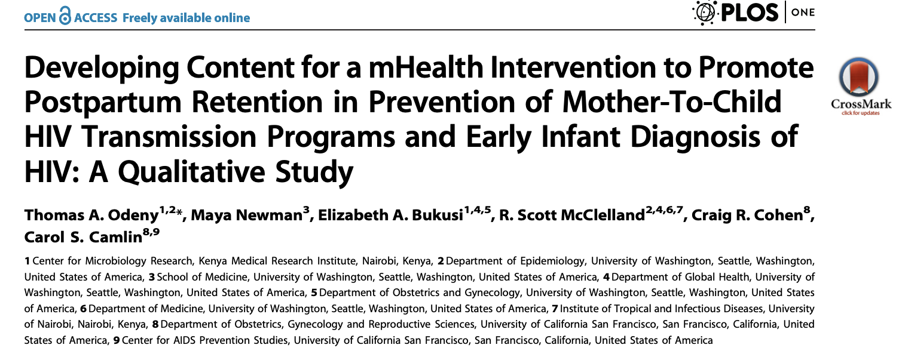
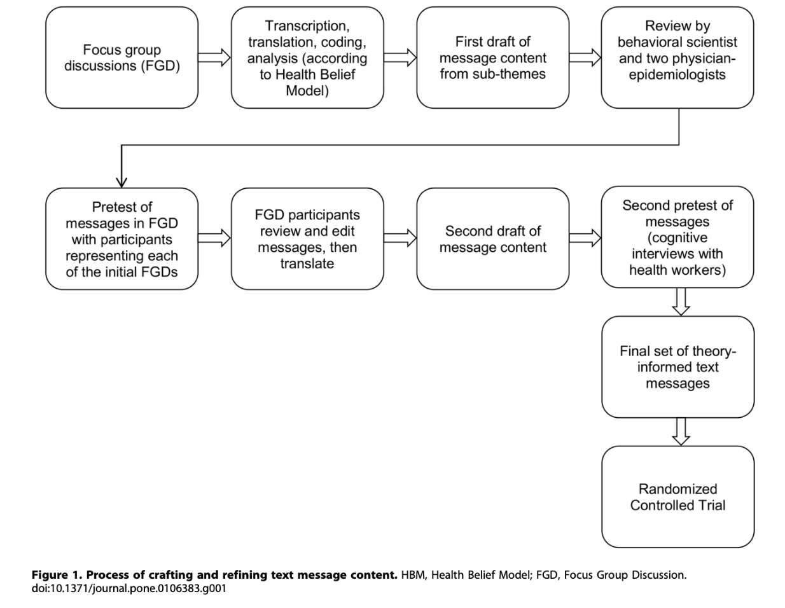
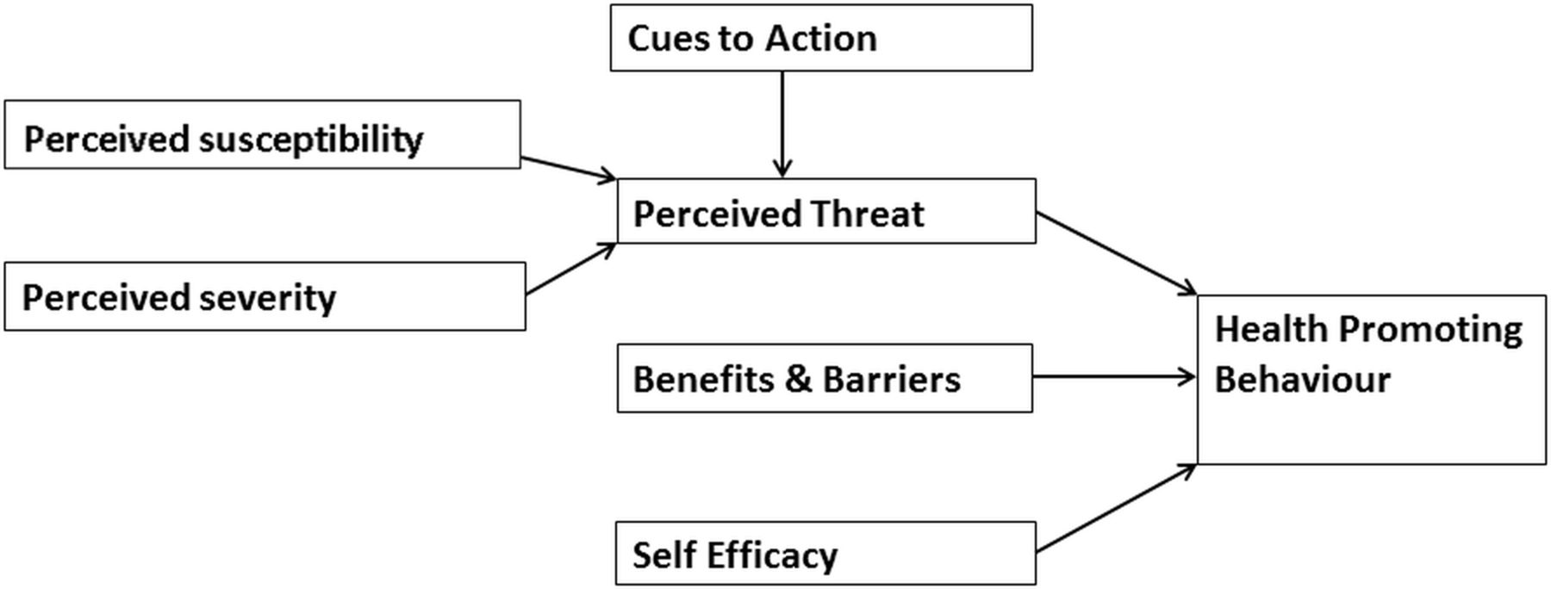
Alison Bruce et al. bmjpo 2018;2:e000307

Slide 28
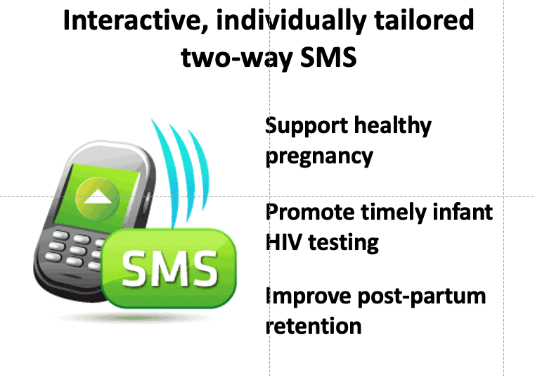

Slide 29
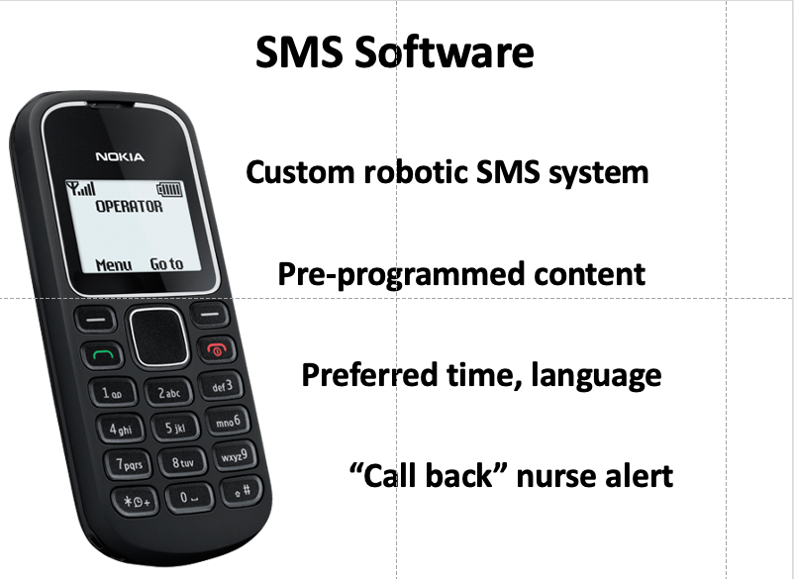
Notes:
When pregnant women come to our clinics, we determine their gestational age, and enroll them into the automated system. The system automatically calculates the estimated delivery date, and determines the type of message a woman should receive based on her gestational age. During pregnancy, the system sends messages to guide women through the journey of pregnancy, including reminders on how to plan for a safe delivery.
Women can text our system with questions or comments or send free “please call me” message which our system automatically routes to an experienced nurse who is on call 24/7.

Slide 30
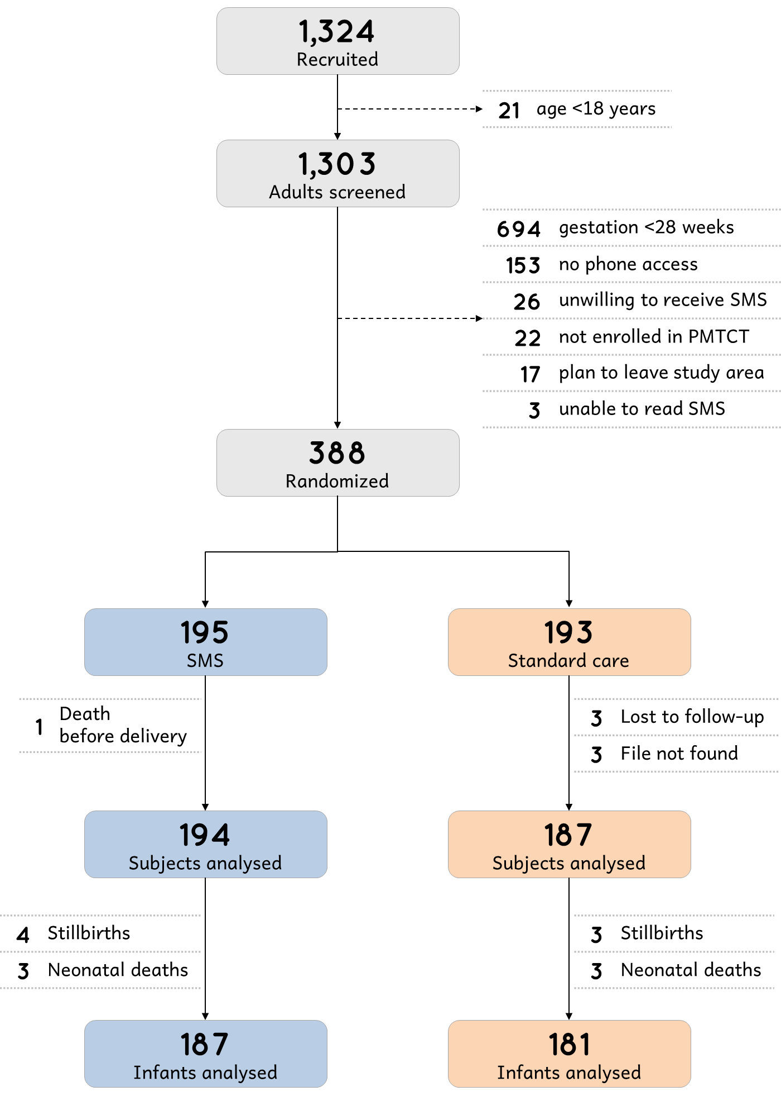
Notes:
We screened 1,324 HIV-positive pregnant women
We excluded 21 women who were less than 18 years old.
Of the remaining 1,303 adults, we excluded 915 for various reasons:
We randomized the remaining 388 women to receive SMS or standard care

Slide 31
Notes:
And this is the flow diagram through enrolment, follow-up, and outcome ascertainment
In the end, there were 194 in SMS arm and 187 in control arm for analysis for the first aim
And there were 187 in the SMS arm and 181 infants in the control arm eligible for virological HIV testing

Slide 32
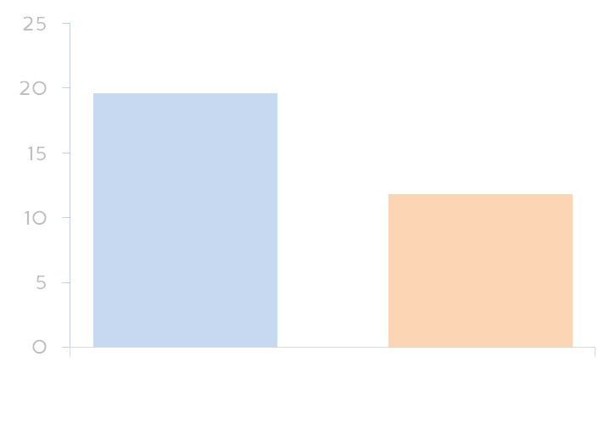
Postpartum clinic attendance
SMS | Control | RR [95% CI] | P
38/194 | 22/187 | 1.66 [1.02–2.70] | 0.04
19.6%
11.8%
Notes:
In the SMS group, 38/194 women attended a maternal postpartum clinic compared to 22/187 (11.8%) in the control group; for a statistically significant relative risk of 1.7

Slide 33
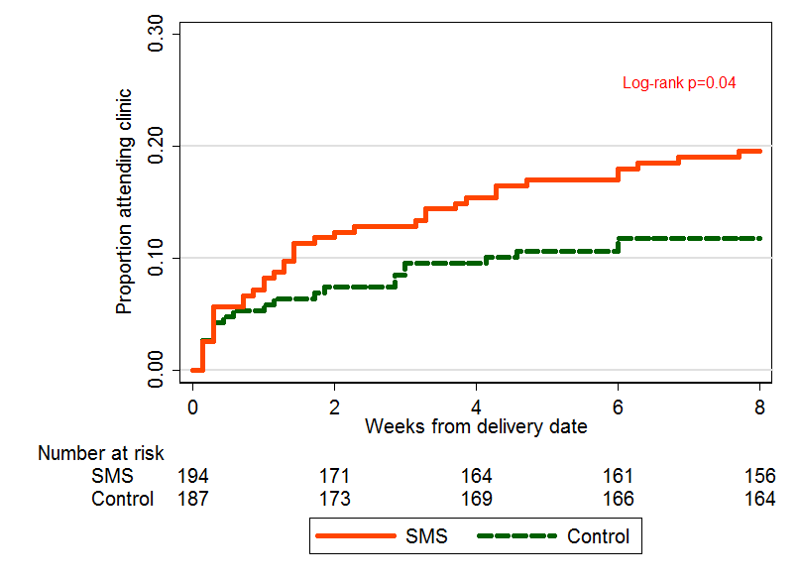
Time to clinic attendance
Notes:
Because women may attend postpartum clinic visits at different times, we also compared the time to clinic visit by study arm
The cumulative probability of clinic attendance by 8 weeks was significantly higher in the SMS group than the control group as shown in this Kaplan-Meier plot

Slide 34
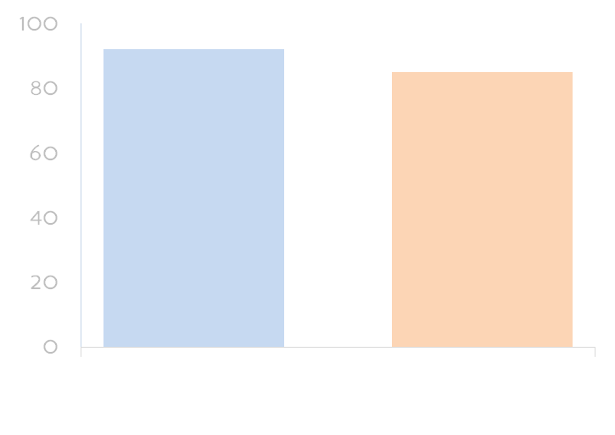
Infant HIV virological testing
SMS | Control | RR [95% CI] | P
172/187 | 154/181 | 1.08 [1.00–1.16] | 0.04
92%
85%
Notes:
For the second primary outcome, 172/187 infants (92%) in the SMS arm were tested for HIV within eight weeks compared to 154/181 (85%) in the control arm; for a significant relative risk of 1.08

Slide 35
SO WHAT DOES IT TAKE TO ATTAIN NATIONAL SCALE-UP OF evidence-based m-HEALTH interventions?

Slide 36
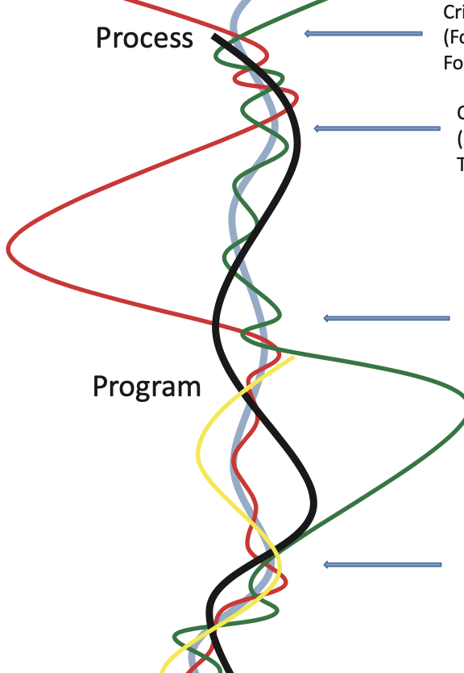
Research/Evidence
Moving from Research Evidence to Actual Practice involves complex steps with no guarantees
To Practice

Slide 37
Politics
Research
Evidence
Stakeholder input and governance
Policy formulation
Policy Adoption
Policy implementation
Policy evaluation
Policy Maintenance
Data
Policy
Practice
Values
Policy implementation Life Cycle
Implementation capacity
Funds
Outcomes
Competition
Professional judgment
Notes:
Why does a program, policy, or management approach implemented with success in one jurisdiction or organization fail to achieve similar results in another context? There are constraints within institutional systems relative to humans’ agency in bringing that bring about successful outcomes, and there is a tendency to generate lists of factors that enable or impede successful implementation.
Empirical scholarship and theory to re-examine what is known about structural elements that influence the implementation process: rules, routines, culture, and resources.

Slide 38
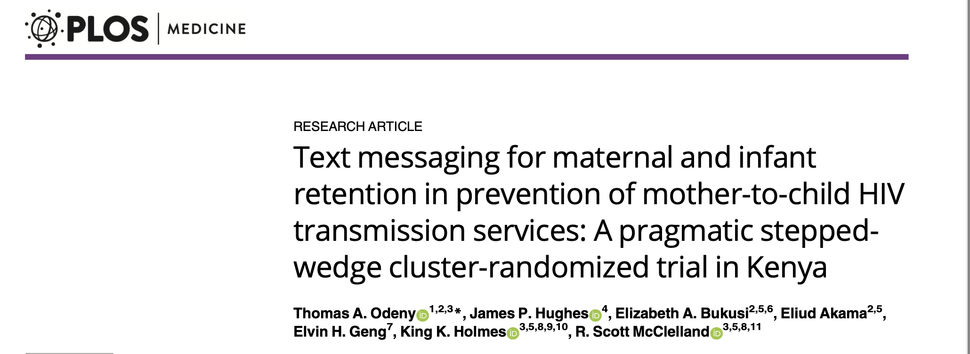

Slide 39
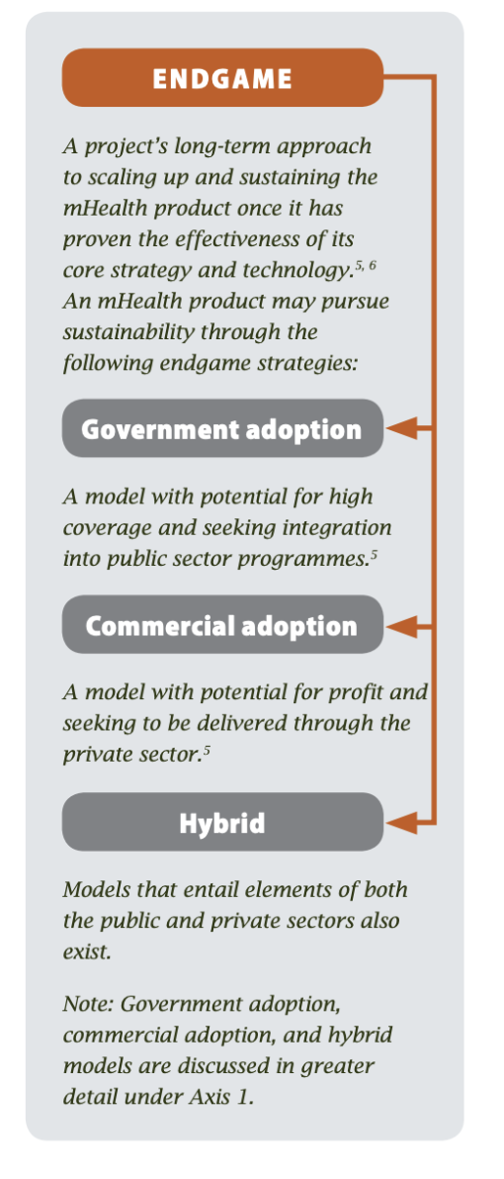

Slide 40



Slide 41
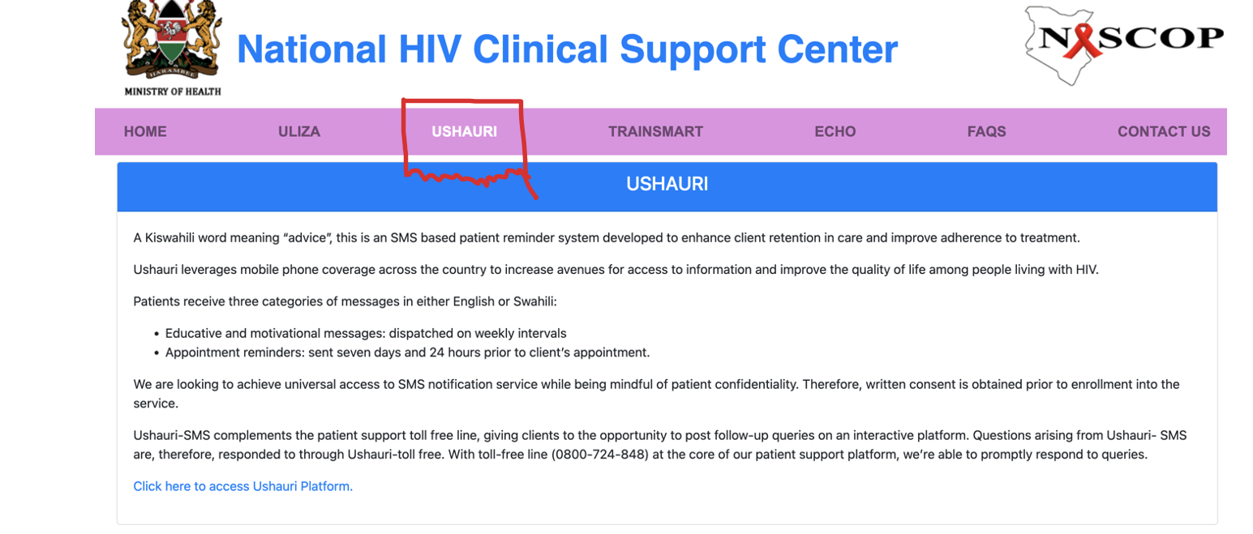

Slide 42
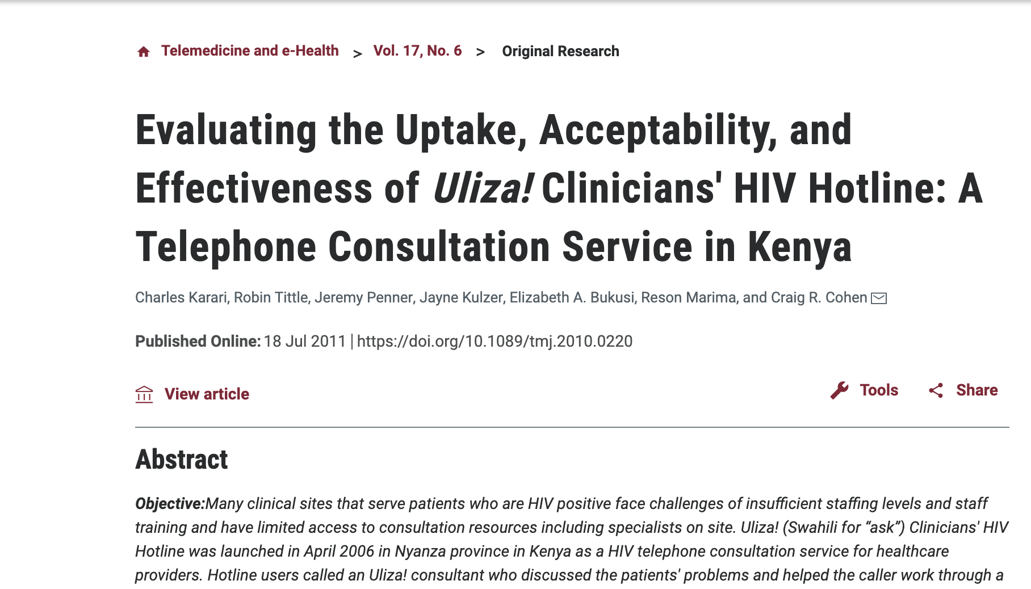

Slide 43
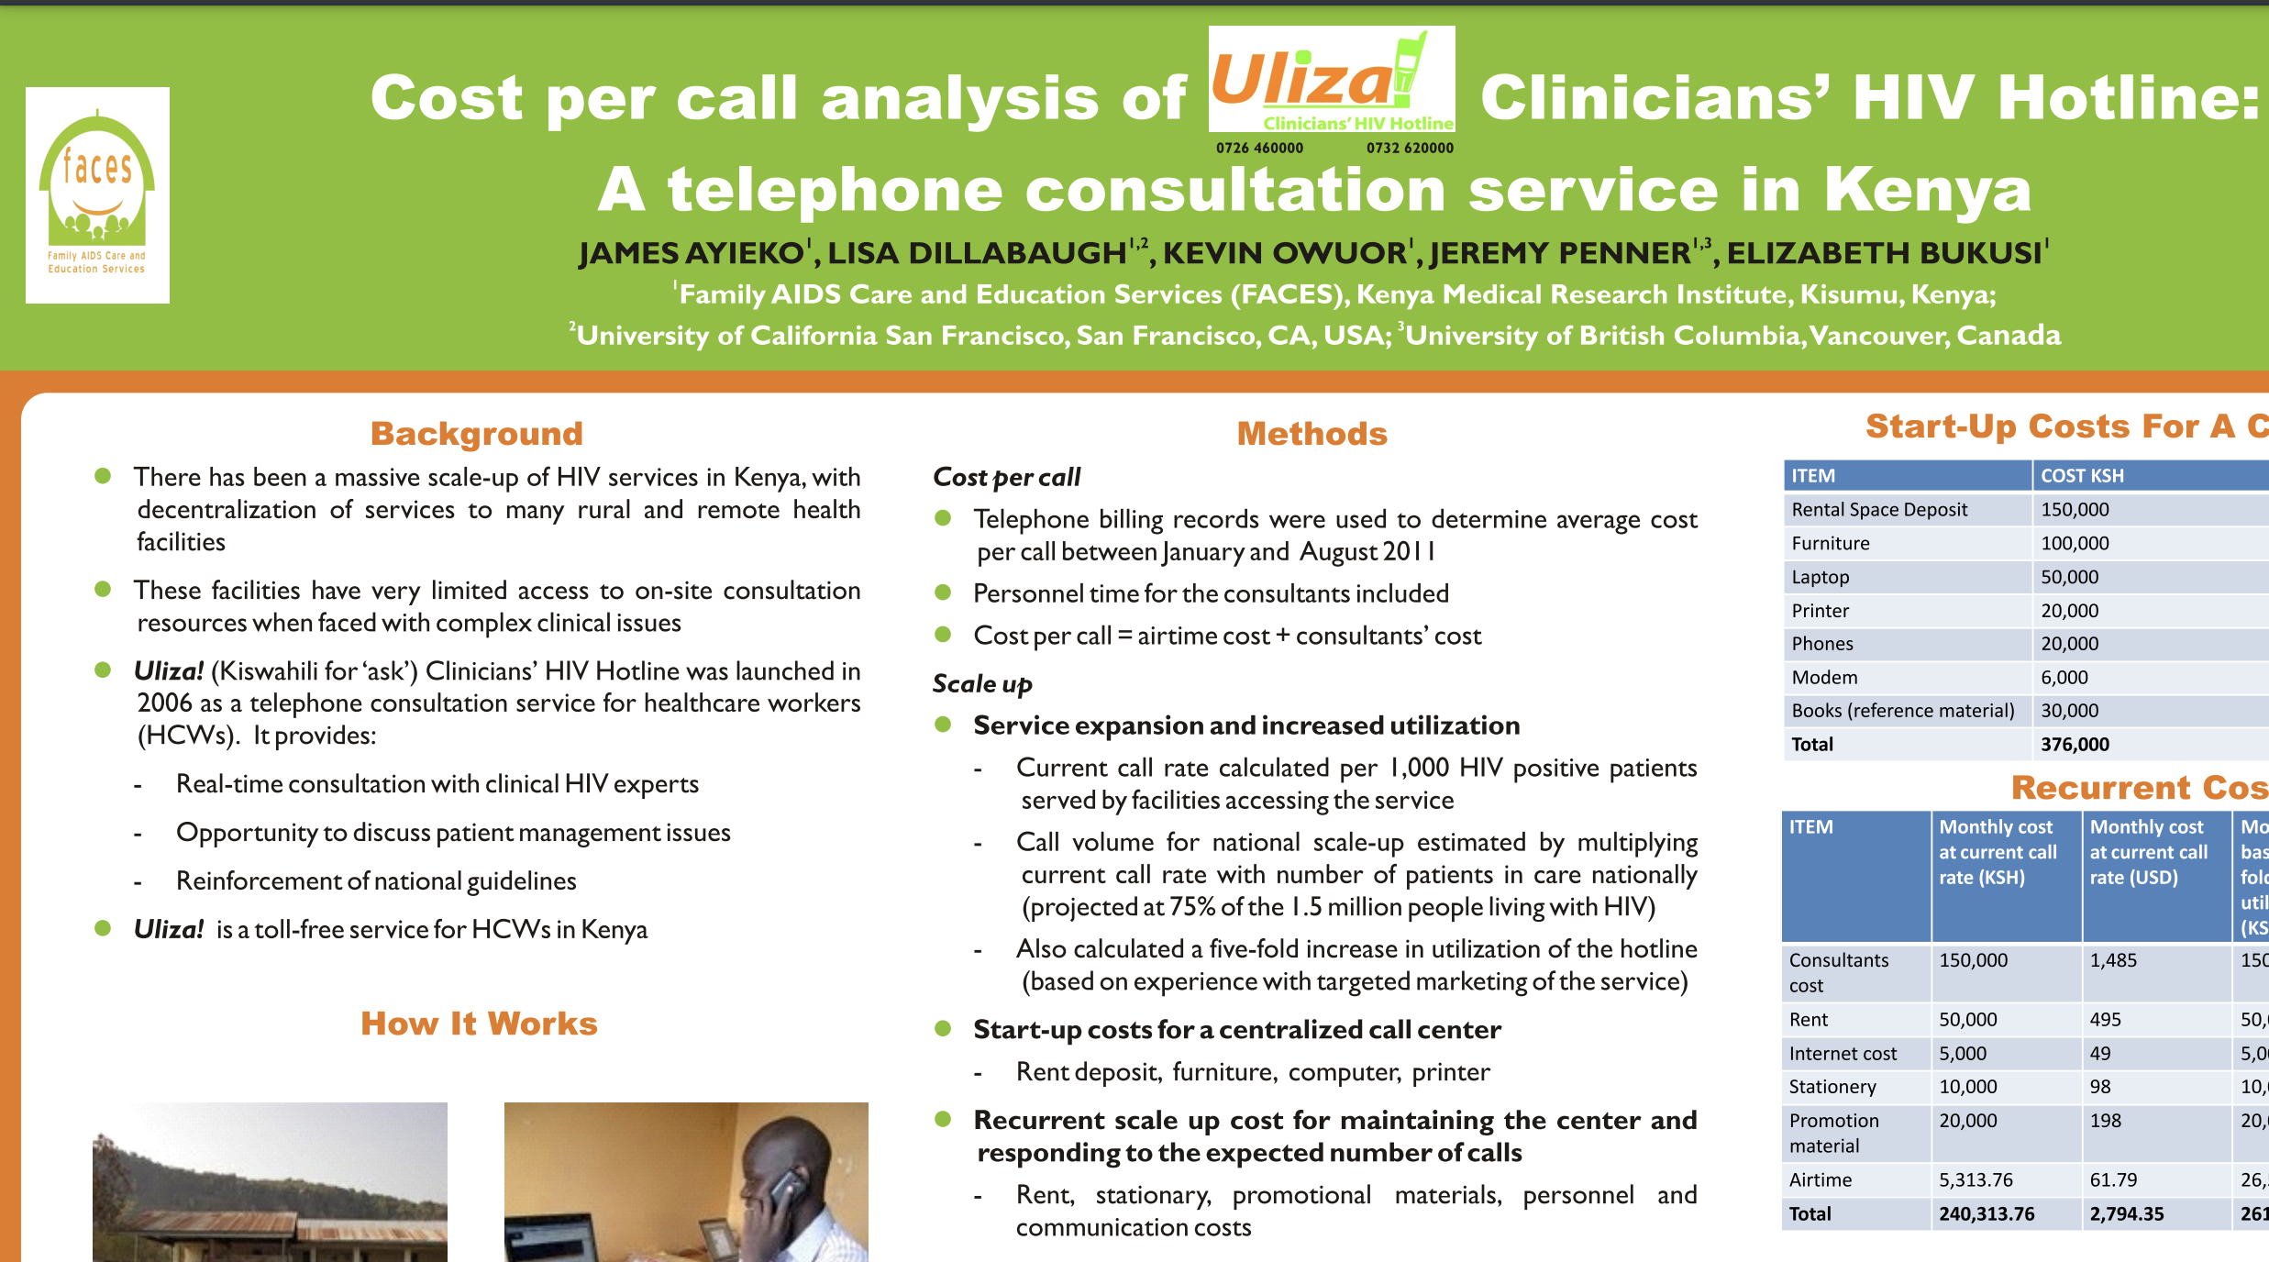

Slide 44
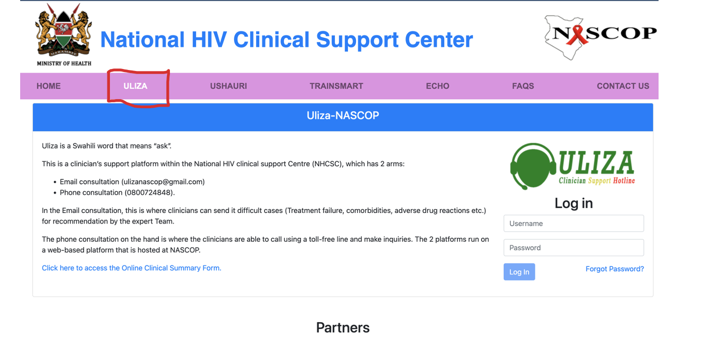

Slide 45

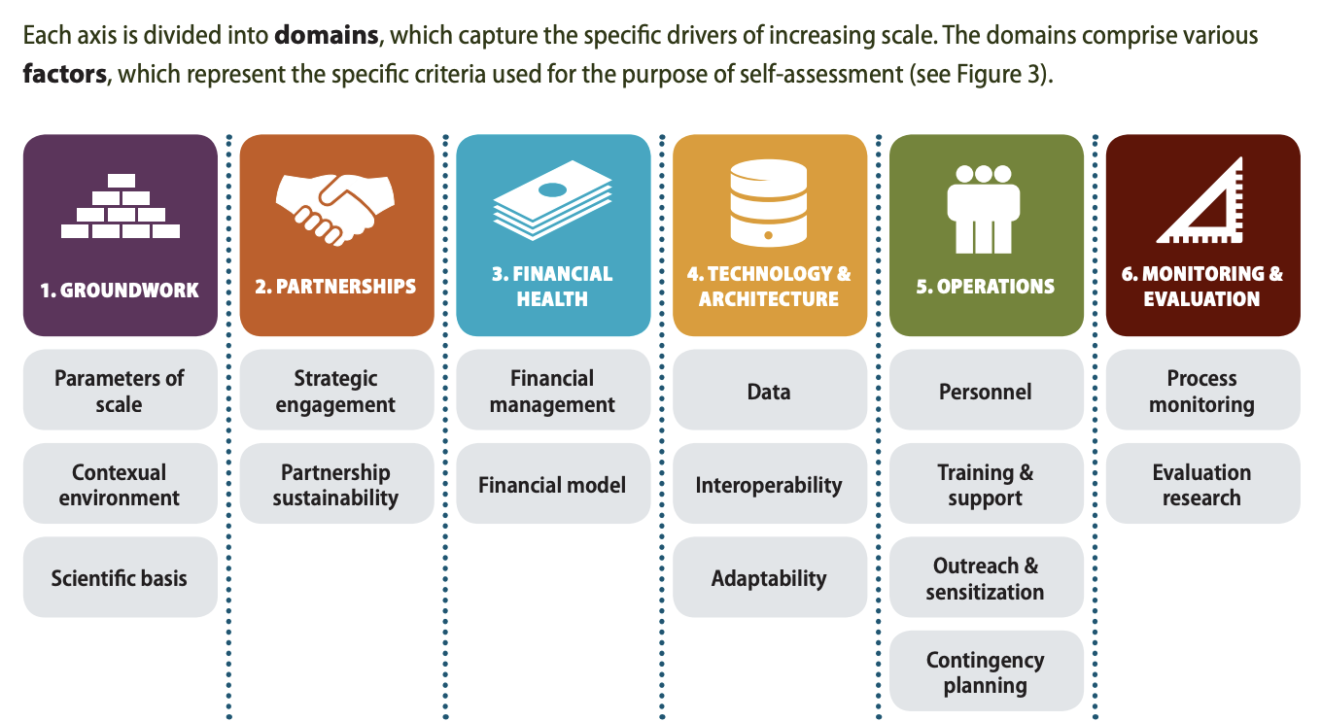

Slide 46
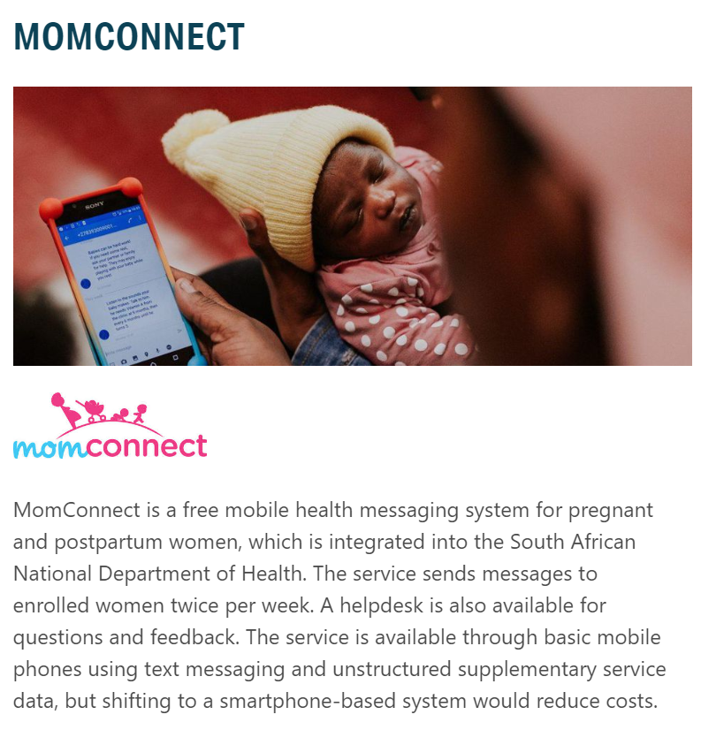
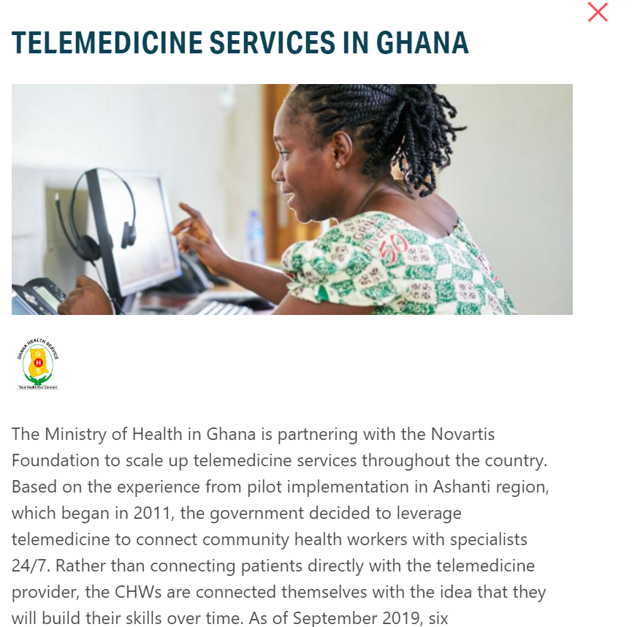

Slide 47
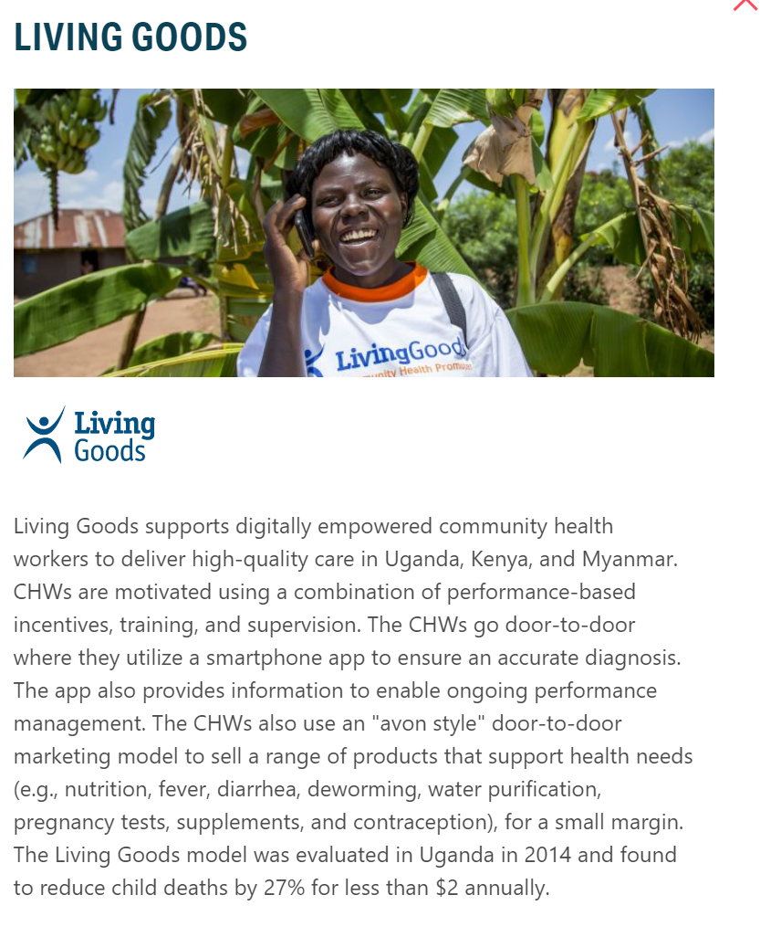
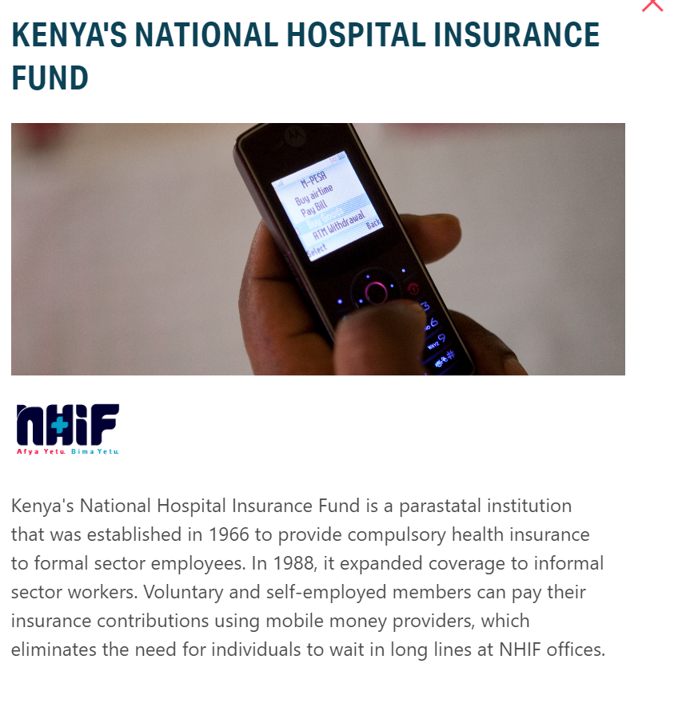

Slide 48

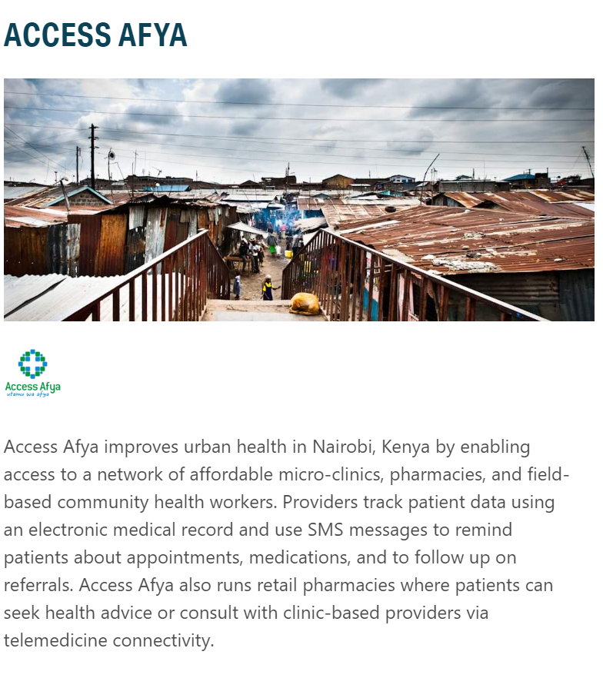
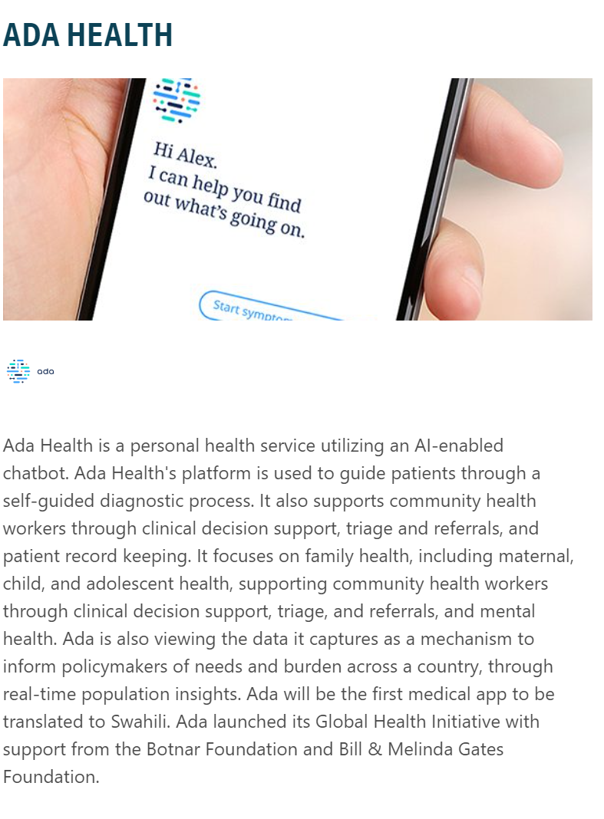

Slide 49
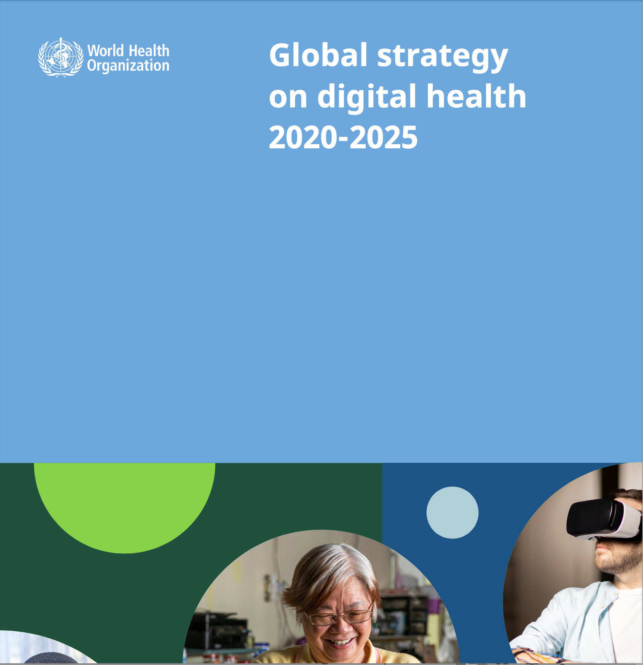

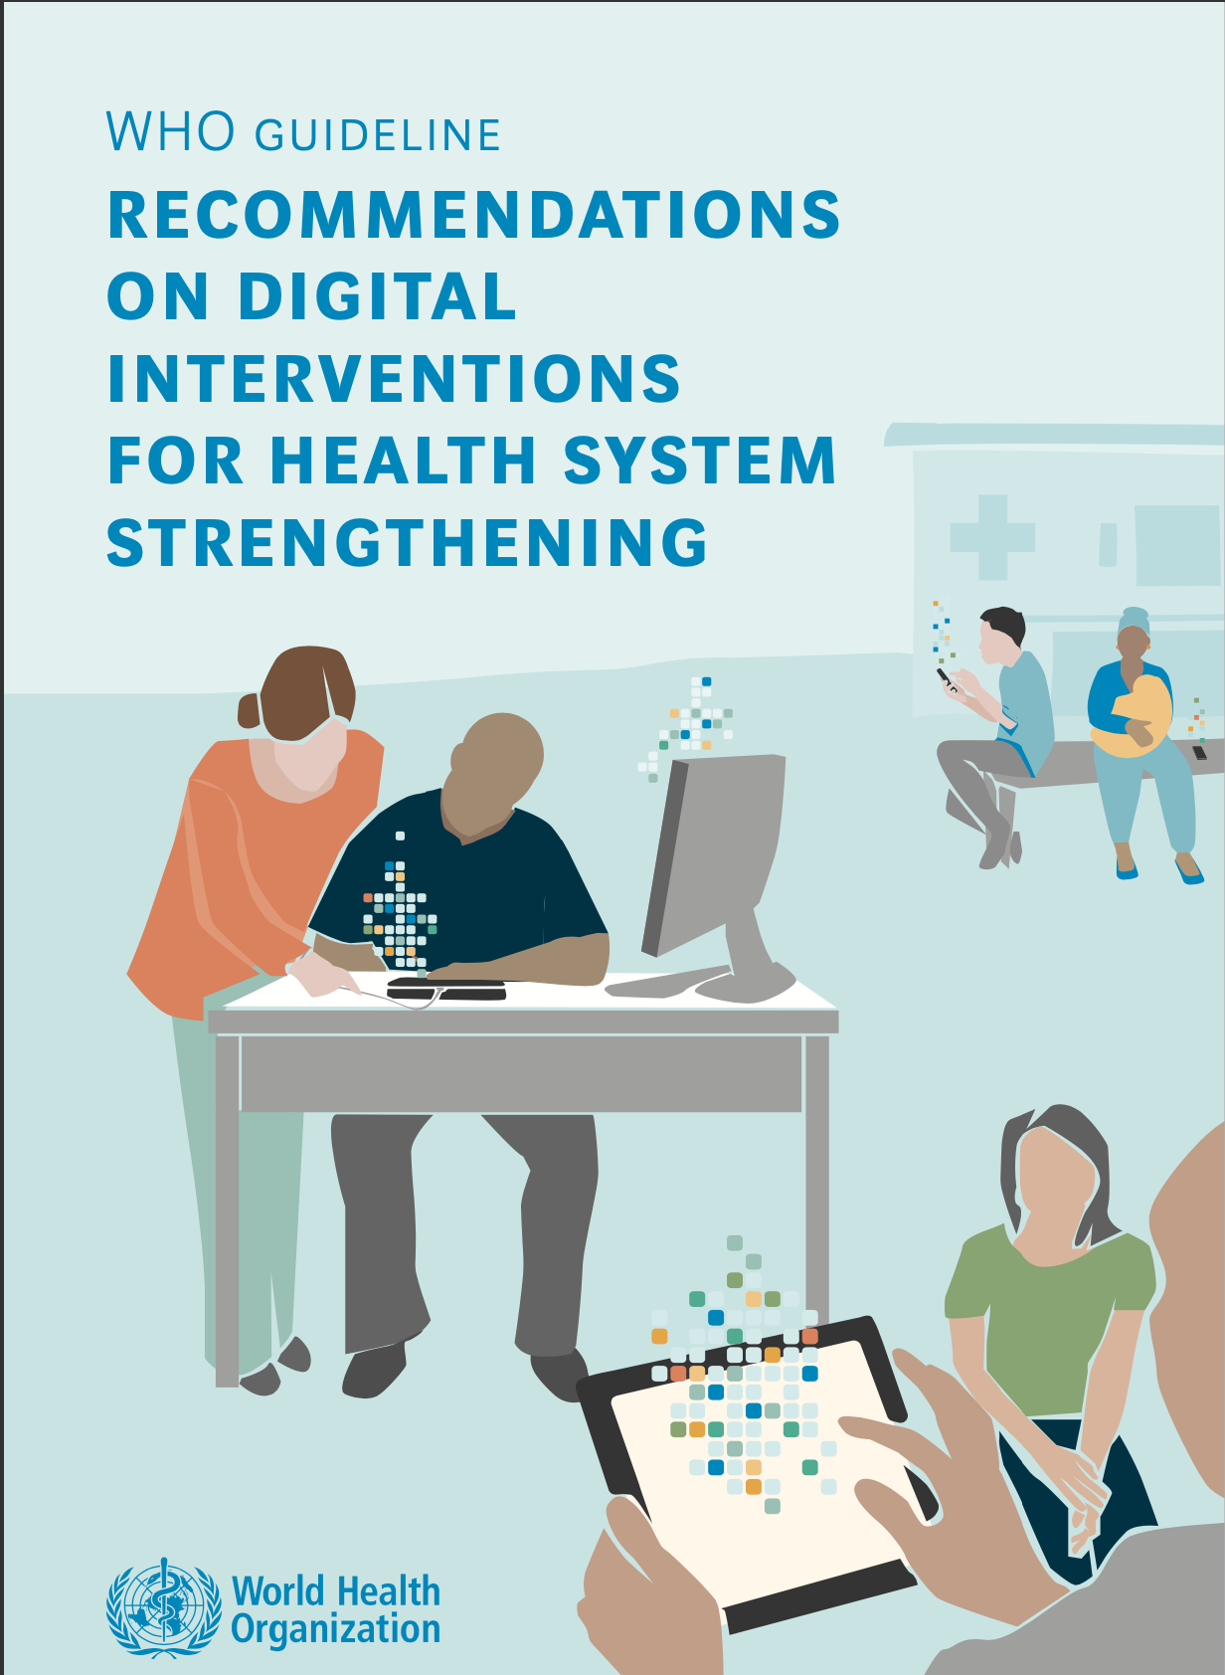
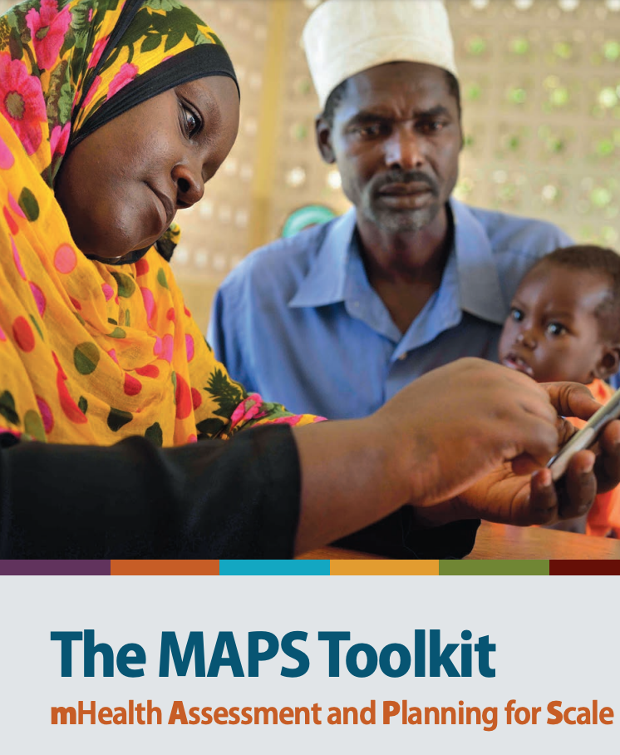
WHO resources for Digital Health for guiding implementation of Digital Health

Slide 50
Thank you

