Slide 1
Sex, Drugs, and Stigma: Key and Vulnerable Populations in the HIV Pandemic
Susan M. Graham, MD MPH PhD
Professor of Global Health and Medicine
Adjunct Professor of Epidemiology
University of Washington
Sustainable Development for HIV Health (SD4H) seminar, June 2, 2022

Slide 2


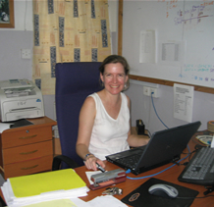
My Background
Undergradute degree in Biochemistry and French literature in 1989
MPH in health services then Peace Corps in Cameroon
Public health work at CDC
Medical school in 2000
PhD in epidemiology
Fellowship in infectious diseases

Slide 3
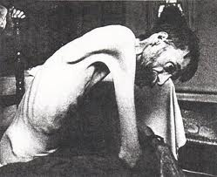
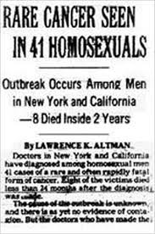
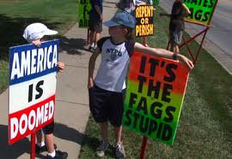
Early AIDS in the United States
HIV/AIDS first identified among MSM in the U.S. in the early 1980s
Routes of transmission initially unclear
Hysteria and homophobia common, gay men blamed for the epidemic

Slide 4
Trends in Annual Age-Adjusted* Rate of Death Due to HIV Infection by Sex, United States, 1987−2010
Note: For comparison with data for 1999 and later years, data for 1987−1998 were modified to account for ICD-10 rules instead of ICD-9 rules.
*Standard: age distribution of 2000 US population
Notes:
In the United States, the rate of death due to HIV infection among males has always been several times the rate among females, but the ratio of these rates has decreased from approximately 10-to-1 in 1987 to 3-to-1 in 1998 and later years.
For both sexes, the rates of death due to HIV were highest in 1994 and 1995. After 1997, the death rate among females has been stable at about 2.4 deaths per 100,000 population. The rate among males continued to decrease slowly every year: from 1998 through 2010, the average annual percentage decrease was about 6%.
The data for this slide come from death certificate data compiled by the National Center for Health Statistics.

Slide 5

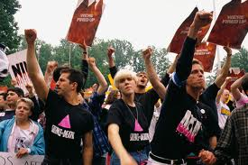
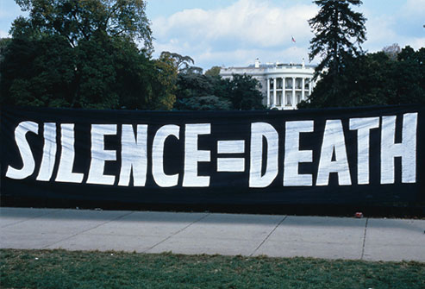
Advocacy and Response
Strong reactions from the gay community
raised awareness of both HIV and LGBT rights
increased funding for research, and
helped streamline the process of drug development
Notes:
Gay Liberation and Gay Rights were part of the 1960s Sexual Revolution, starting with the Stonewall Riots in 1969

Slide 6

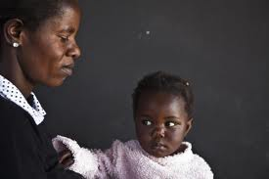
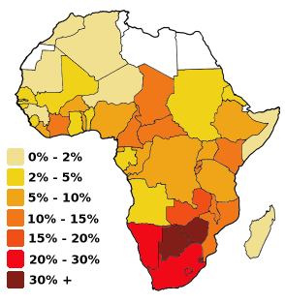
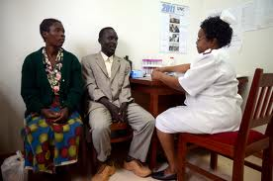
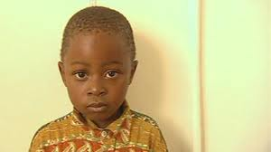

Slide 7
HIV in Sub-Saharan Africa
Globally, populations at highest risk for HIV infection include MSM, intravenous drug users, and female sex workers
HIV pandemic in Africa was “generalized” = spread to the general population of mostly heterosexual individuals
Emphasis put on broad programs
Neglect of targeted programs even for FSW
IVDU and MSM were initially not considered

Slide 8
What kinds of challenges make someone vulnerable to HIV acquisition?

Slide 9
Sociocultural/Policy
Institutional/Community
Inter-personal
Intra-personal

Slide 10
Sociocultural/Policy
Criminalization, Human rights, Funding
Institutional/Community
Service provision factors, GBMSM-friendly services,
Stigma and discrimination
Inter-personal
Trust in providers; Support from peers, friends, family;
Connection to community groups
Intra-personal
Access, Knowledge, Motivation,
Behavioral skills, Resilience
Information
Knowledge about HIV, ART/adherence, Co-trimoxazole, Positive living
Care Engagement
Entry in Care
ART Initiation
ART Adherence
Visit Adherence
Retention in Care
Access
Tailored information, Financial constraints
Behavioral Skills
Disclosure of HIV status, Pill-taking, Planning, Problem-solving
Motivation
Maintaining or recovering health, Physical appearance, Acceptance of HIV status, Belief in ART, Fear of gossip, Mental health, Substance abuse, Belief in alternative medicine, Side effects, Self-efficacy to adhere
Resilience
Self-worth, Social identity, Disclosure of GBMSM status, Connection to sexual minority group, Homophobia management, Goal-setting, Altruism

Slide 11
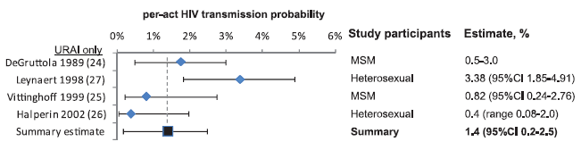
Risk of Sexual Intercourse
Pooled transmission estimates for heterosexual sex:
female-to-male (0·04% per act [95% CI 0·01—0·14])
male-to-female (0·08% per act [95% CI 0·06—0·11])
Estimate for unprotected receptive anal intercourse 18x-35x higher (1.4% per act [95% CI 0.2─2.5%]):
Boiley Lancet Infect Dis 2009
Baggaley Int J Epi 2010
Notes:
Of note, there is no difference in the risk of unprotected RAI for women than for men. ADD IMAGE ON RECTAL MUCOSA BIOLOGY

Slide 12
Role Versatility: Unique to MSM
MSM can take versatile roles in sex:
both receptive (high risk for acquisition) and insertive (high risk for transmission)
Role versatility and high risk from anal intercourse greatly increase risk for MSM
MSM would need rates of unprotected sex considerably lower than heterosexual individuals to eliminate transmission
Goodreau STI 2007
Beyrer Lancet 2012
Notes:
Not due to differences in partner numbers or condom use

Slide 13
Transmission Networks
FSW clients are often men with multiple partners and high rates of unprotected sex
MSM more likely to be included in large networks and clusters of recent infections
Rapid onward transmission due to high infectiousness and STI coinfections
High assortative spread among young MSM (not in care, not engaged in prevention programs)
Stigma and health care access can be problems for entire groups
Dennis Clin Infect Dis 2021
Jennings Sex Transm Dis 2021
Notes:
Martina said more concurrency, shorter relationships

Slide 14

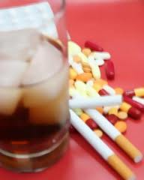
Syndemics
Increasing recognition of multiple vulnerabilities among MSM who engage in risky sexual behaviors
Substance abuse
Depression
Childhood sexual abuse
Intimate partner violence
Sexual compulsivity
Stall Am J Public Health 2006
Parsons Am J Public Health 2012
Satyanarayana JIAS 2020
Notes:
As the number of cofactors increased, so did reported risky behavior and HIV prevalence

Slide 15
Problems Faced by Kenyan MSM and FSW
Criminalization disempowers people and makes them afraid to ask for help
Lack of tailored information on risk and prevention
High levels of stigma related to same-sex behavior and to sex work
Barriers to HIV testing and accessing HIV prevention services, HIV treatment
Stigma compounded for HIV+ MSM and FSW
Connection to LGBTQ+ or sex worker advocacy groups is protective
Van der Elst JIAS 2020
Doshi Global Pub Health 2020

Slide 16
How do you think a stigmatized individual feels when seeking HIV testing, prevention or treatment services? What can the health system do to make them more comfortable?

Slide 17
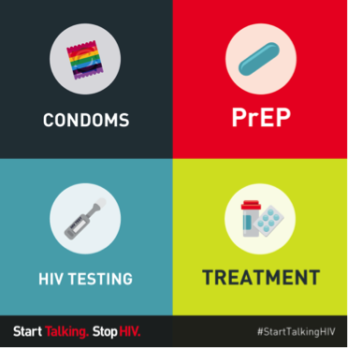
What strategies have worked for HIV prevention and care?

Slide 18
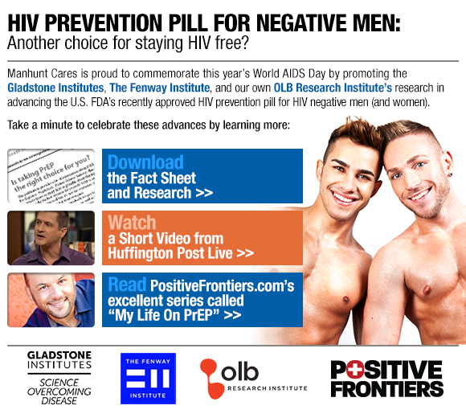
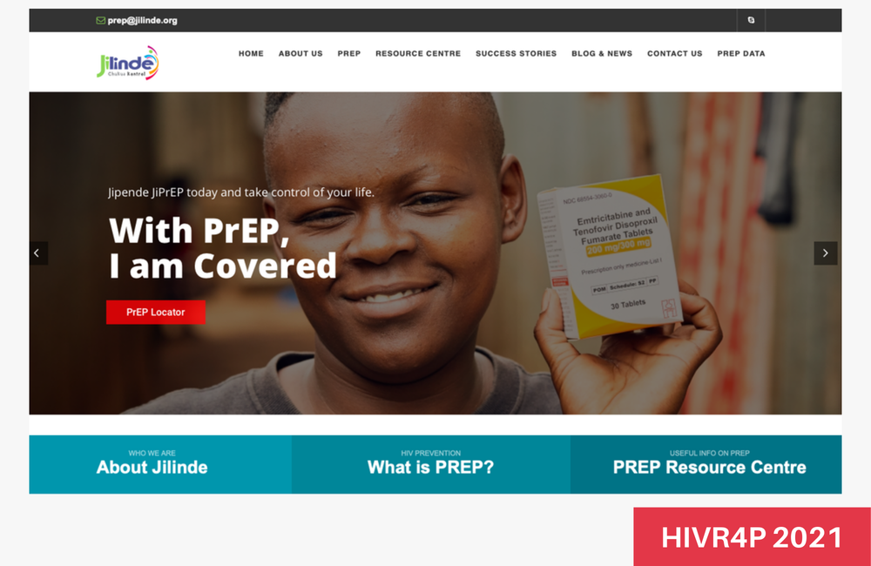
Pre-Exposure Prophylaxis
Daily oral PrEP with fixed-dose TDF/FTC is “safe and effective” in reducing risk of sexual HIV acquisition
US Public Health Service guidelines published 2014
Approval of Descovy (TAF/FTC) for PrEP in 2019
Increases in PrEP awareness, willingness to use PrEP, and actual use since guidelines available
Actual use still relatively low and adherence can be poor
Injectable cabotegravir approved in 2021 in the US, may help address adherence problems
Notes:
Tenofovir disoproxil fumarate vs. tenofovir alafenamide

Slide 19

Treatment as Prevention
“Serodifferent” couples not using condoms followed for linked transmissions, 14 European countries
PARTNER1 showed no linked transmissions among 1166 heterosexual couples where HIV-infected partner’s viral 200 copies/ml – despite more than 58,500 times without using condoms.
PARTNER2 showed no linked transmissions among 972 gay couples where HIV-infected partner’s viral load < 200 copies/ml – despite nearly 77,000 acts of condomless sex between them
PARTNER 2 tells us that U=U holds just as strongly for gay men (and for anal sex) as for heterosexuals
Rodger JAMA 2016
Rodger Lancet 2016
Rodger AIDS 2018

Slide 20
Early Diagnosis
Diagnosis is the first step in the HIV care cascade
Too many opportunities are missed: for example, PITC covers approximately 26% of eligible patients at health centers
Tambua Mapema Plus used a NAAT-based testing intervention (Gene Xpert HIV Qual) to detect acute and chronic HIV among adult outpatients with symptoms compatible with acute HIV infection
Compared to standard of care (i.e. PITC), we found twice as many newly diagnosed patients, identifying one chronic HIV infection for every 40 patients and one acute HIV infection patient for every 750 patients tested
Modeling showed that this approach would help Kenya reach its 95-95-95 targets and is cost effective when downstream costs of HIV are considered
Agutu PLoS One 2019
Sanders HIV Med 2022
Hamilton JAIDS 2022

Slide 21
Assisted Partner Notification Services
Cluster-randomized trial by tested immediate vs. delayed HIV assisted partner services in 18 clinics with 1305 participants
Six weeks after enrolment of index patients, 392 (67%) of 586 partners had tested for HIV in the immediate group and 85 (13%) of 680 had tested in the delayed group (incidence rate ratio 4·8, 95% CI 3·7–6·4)
Overall, 136 (23%) partners had new HIV diagnoses in the immediate group compared with 28 (4%) in the delayed group (5·0, 3·2–7·9) and 88 (15%) versus 19 (3%) were newly enrolled in care (4·4, 2·6–7·4)
Assisted partner services did not increase intimate partner violence
Cherutich Lancet HIV 2016

Slide 22

Couples Counselling
As for heterosexuals, up to 50% of MSM are in committed relationships, but two thirds of transmission occurs in this setting.
Support for main partnerships
Partner reduction
Rules about behavior in and out of relationships
Couples counseling and testing
Couples-based HIV prevention
Sullivan AIDS 2009
Hoff Arch Sex Behav 2010
Kahle AIDS Behav 2020
Notes:
Although HIV prevention may not be the #1 priority in a relationship, about half of gay men are in committed relationships in which unprotected sex is more likely. Two thirds (68%) of HIV transmission among MSM occurs in this setting, with the majority from partners believed to be seronegative.

Slide 23
What are the key questions for improving HIV prevention and care for MSM and FSW globally?

Slide 24
Care and service delivery
How to promote routine testing for MSM and FSW, and increase awareness of serostatus?
How to engage MSM and FSW in care?
How to improve service delivery?
How to ensure adequate resource allocation?
Role of STI treatment, screening interval?
Best way to package prevention and care interventions?
Notes:
Substance abuse and mental health interventions

Slide 25

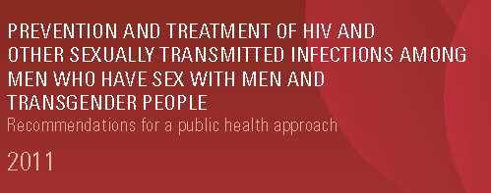




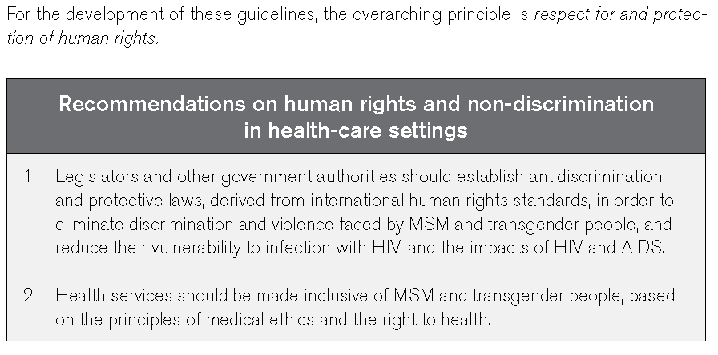

Slide 26
Challenges to Effective Scale-up: MSM
Lack of good evidence base in most countries about what works
Inadequate prevention messages with failure to target unprotected anal intercourse
Lack of engagement with MSM community
High levels of stigma and discrimination
Criminalization and abuse
Need options to address syndemic challenges such as depression and substance abuse
Sullivan Lancet 2012, Graham Lancet HIV 2017
Notes:
35 of 52 African countries unable to report any information about MSM populations in 2008

Slide 27
Challenges to Effective Scale-up: FSW
Lack of good evidence base in most countries about what works
Over-reliance on safe spaces and drop-in centers without addressing structural problems that lead to poverty and promote sex work
Lack of engagement with FSW community
High levels of stigma and discrimination
Criminalization and abuse
Failure to address problems for young women at risk
Need options to address syndemic challenges such as depression and substance abuse among FSW and young women at risk
Notes:
35 of 52 African countries unable to report any information about MSM populations in 2008

Slide 28
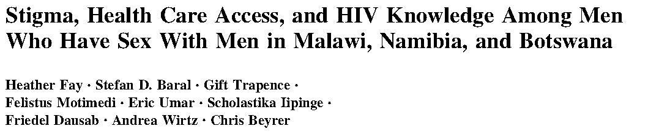
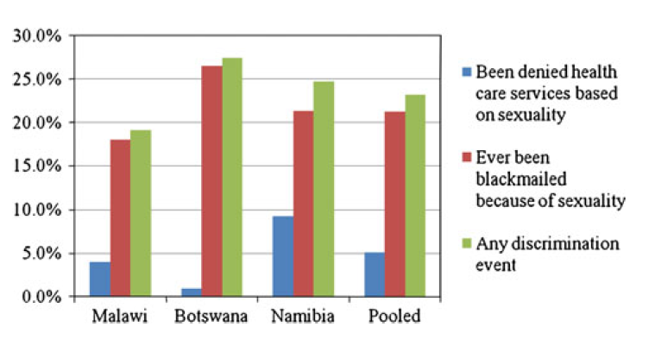
Discrimination and MSM

Slide 29
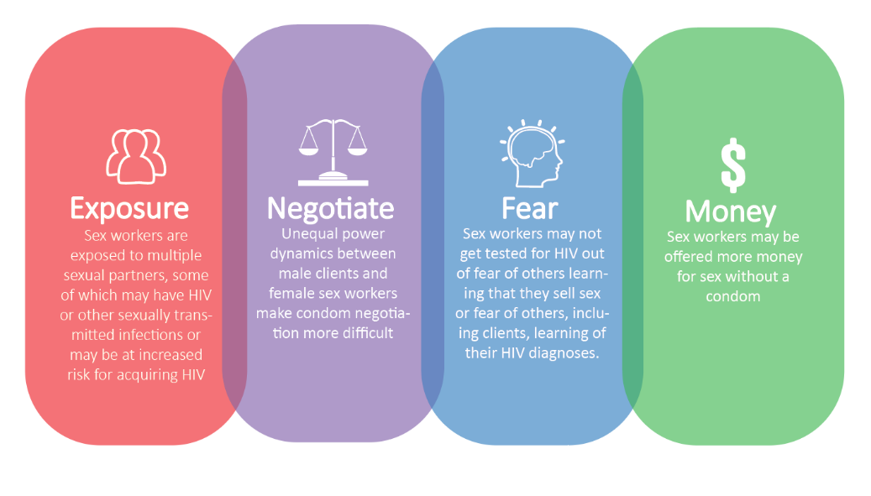
Discrimination and FSW
https://www.cdc.gov/globalhealth/stories/2020/decreasing-violence-among-female-sex-worker.html

Slide 30
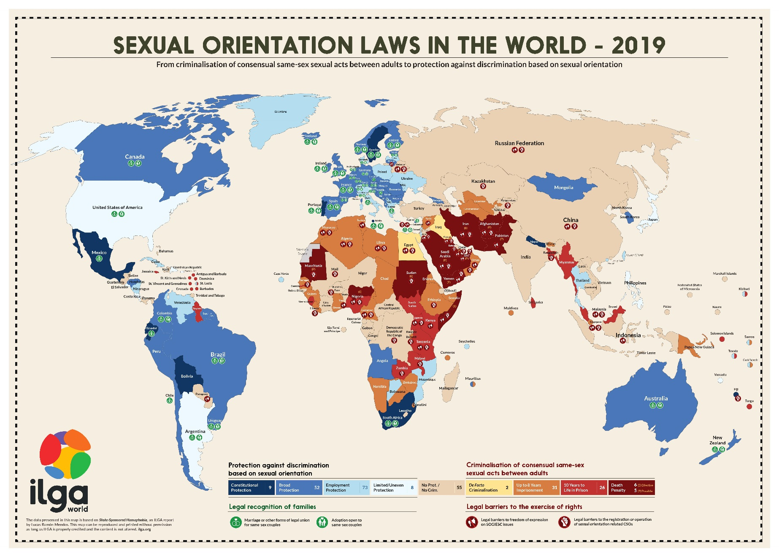
Advocacy Needs: MSM
Notes:
Discuss different penalties: ranging from death sentence in 2 countries and parts of Nigeria and Somalia to imprisonment/corporal punishment in 36 other African countries.
Some countries, like Kenya, are mostly tolerant and do not prosecute regularly.
Protection has been added in 6 countries, and South Africa recognizes gay marriage.
Most countries face difficulties knowing the size and health outcomes for their MSM populations due to difficulties collecting this data.
Source is International Lesbian, Gay, Trans and Intersex Association

Slide 31
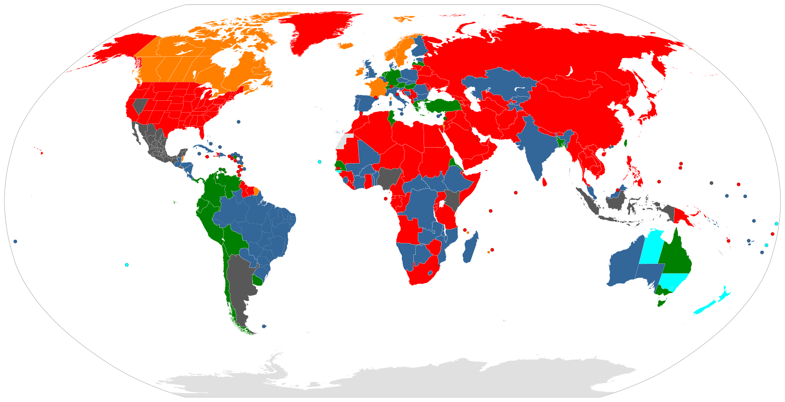
Advocacy Needs: FSW
Notes:
Discuss different penalties: ranging from death sentence in 2 countries and parts of Nigeria and Somalia to imprisonment/corporal punishment in 36 other African countries.
Some countries, like Kenya, are mostly tolerant and do not prosecute regularly.
Protection has been added in 6 countries, and South Africa recognizes gay marriage.
Most countries face difficulties knowing the size and health outcomes for their MSM populations due to difficulties collecting this data.
Source is International Lesbian, Gay, Trans and Intersex Association

Slide 32
Community Research Priorities
History and lived experiences of LGBTQ+ individuals or sex workers in different settings
Documentation of rights abuses and costs of non-inclusion
Development and testing of strategies to foster inclusion
Challenges and needs of LGBTQ+ individuals or sex workers
Implementation science on scale-up of effective health interventions

Slide 33
How can we do a better job of reaching out to stigmatized and vulnerable populations and improving their health outcomes?

Slide 34
What is Stigma?
HIV-related stigma and discrimination are defined as a process of devaluation of people either living with or associated with HIV and AIDS.
Discrimination follows stigma and is the unfair treatment of an individual based on his or her real or perceived HIV status.
Stigma and discrimination are now recognized as among the greatest challenges to tackling HIV infection and as major barriers to the delivery of quality services by health providers.
The pervasive effects of HIV-related stigma and discrimination, as documented in numerous studies, are devastating in many ways.

Slide 35
Effects of Stigma
Lower uptake of HIV preventive services, including testing and counselling services and mother-to-child transmission prevention programmes
Limited or delayed disclosure of HIV serostatus to partners and family members
Inadequate care and support, such as postponement or rejection of treatment, care and support
Travel outside local communities to seek medical and preventive care services because of fear of breaches of confidentiality and negative attitudes of health care providers

Slide 36
Response to Stigma
For an effective HIV response in any country, aspects of stigma and discrimination must be addressed through undertaking complementary and sustainable actions at national and local levels.
One of the most important actions is to implement regular participatory training for all health care staff with the aims of:
Increasing knowledge of HIV and universal precautions,
Increasing awareness about stigma and discrimination and their harmful consequences, and
Addressing misconceptions and underlying fears about HIV transmission

Slide 37
Stigma and discrimination in health care settings
Stigma is particularly pronounced when behaviour causing disease is perceived to be under individual’s control (sex work or injection drug use).
There are 3 key causes of HIV-related stigma in the community setting:
Lack of awareness of what stigma is and why it is damaging
Fear of casual contact due to incomplete knowledge about HIV transmission
Values linking people with HIV to improper or immoral behaviour.
Stigma and discrimination are major barriers to preventing HIV transmission and providing treatment, care and support and are a clear violation of human rights.

Slide 38
Interventions to Reduce Stigma
Interventions to reduce stigma and discrimination should focus on:
Individual level by increasing awareness among health care workers
Environmental level by ensuring availability to health workers of the information, supplies, and equipment necessary to practice universal precautions

Slide 39
Interventions to Reduce Stigma
Interventions to reduce stigma and discrimination should focus on:
Individual level by increasing awareness among health care workers and other facility staff
Interpersonal level by increasing support to colleagues and peers for interrupting stigma and bias
Community level by encouraging awareness of stigma, discrimination and their impacts
Environmental level by ensuring availability to health workers of the information, supplies, and equipment necessary to practice universal precautions and integrated HIV and mental health care

Slide 40
Shauriana Intervention for GBMSM in Kenya
Community-engaged meetings, interviews, and intervention development
Focus on sexual health, mental health, and physical health
Peer-delivered modules using motivational interviewing:
Introducations (self-reflection and rapport-building)
Sexual health basics
Stress and coping
Relationships
Healthy sexuality and empowerment
Harper Adolescents 2021
Jadwin-Cakmak Int J Environ Res Public Health 2022

Slide 41
Questions? Discussion?

Slide 42
Reference materials
https://www.youtube.com/watch?v=G_HMVZpSXIg
https://www.youtube.com/watch?v=2X1-4tHcikw
WHO handout on HIV and Stigma from the Middle East and North Africa region

