Slide 1
OVERVIEW OF BIOETHICS

Slide 2
Outline
What is Ethics?
What is Medical Ethics?
What is Bioethics?
What is Global Ethics?
Case study

Slide 3
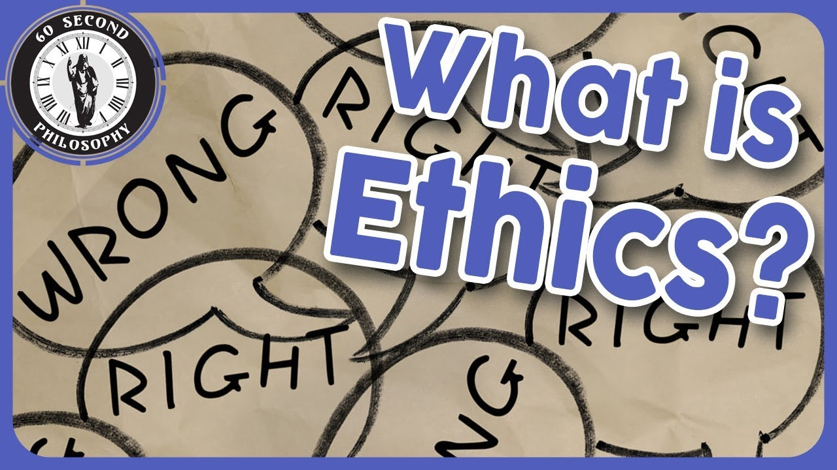

Slide 4
Branch of Philosophy
Morality & Moral principles in everyday life
Fundamental Question
“Right vs wrong”
“Good vs Bad”
We make many moral decisions daily basis
Ethics – Quality of decisions NOT Quantity
Tool to help make good decision vs bad decision
Leads to study of values, principles, beliefs & norms

Slide 5
Values - things dear to us & care about them deeply
Justice, family, equality, truth, honesty
Based on society, religion, culture, law etc.
Sometimes conflict e.g. faithfulness vs. caring
Helps us know what is good vs. what is bad
Principles
Determine acceptable way to get things we value
E.g. Keep your word; have people’s best interest
How do you select what values & principle to adopt?

Slide 6
How do we make choices when faced with conflict of values or principles?
Good vs good
Right vs right
Helps us define conditions under which we make choices
Helps us then determine which of available options is the best one

Slide 7
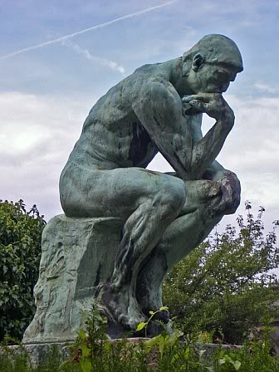
Greek philosophers
Socrates
Plato
Aristotle

Slide 8
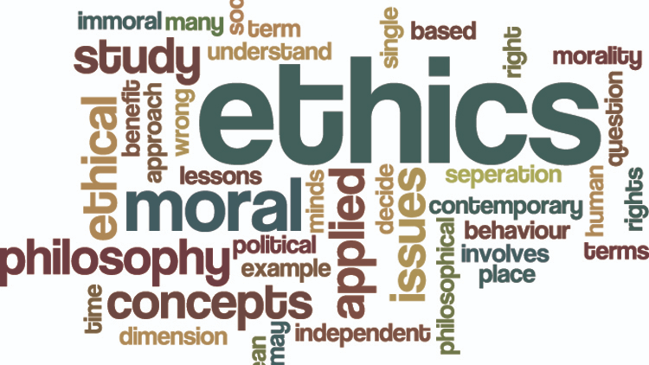

Slide 9
CASE STUDY
Kimani is one of your friends in a group of 8 friends
He has lately withdrawn from the group and does not show up at parties despite receiving invitations
Kimani confides to you that he is going through a depression & has had suicidal thoughts. He refuses to get medical help
3 days later one of the friends has a birthday party & invites all of you but Kimani does not show up
At the party, the friends discuss cutting links with Kimani as he seem to no longer care about the group and they ask you what you think. What should you do?

Slide 10
WHAT IS
BIOMEDICAL ETHICS?

Slide 11
1754 BC – Hammurabi Code - patients’ right
400 BC – Hippocratic Oath; good conduct of doctors
1947 – Nuremberg Code; Atrocities by Nazi doctors in 2nd World War; IC, unnecessary research; stop study
1948 – Declaration of Geneva; duties of a doctor
1964 – Declaration of Helsinki;
1978 – Belmont Report following Tuskegee study
1979 – Principles of Biomedical Research

Slide 12
Moral inquiry into issues relating to the practice of medicine & in research involving human participants
Ask the question “What is morally acceptable in the patient-physician relationship?”
Treatment/care & human research participants
Based on use of moral principles applied in practice of medicine
Principles non-hierarchical & may conflict

Slide 13
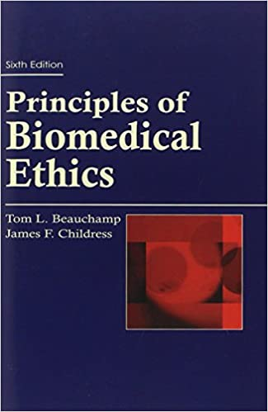

Slide 14
Autonomy
Competence; rights to choose; information; IC
Non-maleficence
“First do no harm”, patients & human participants
Beneficence
Duty to do good; benefit patient; benefits > harm
Justice
Fair treatment; no discrimination; equity

Slide 15
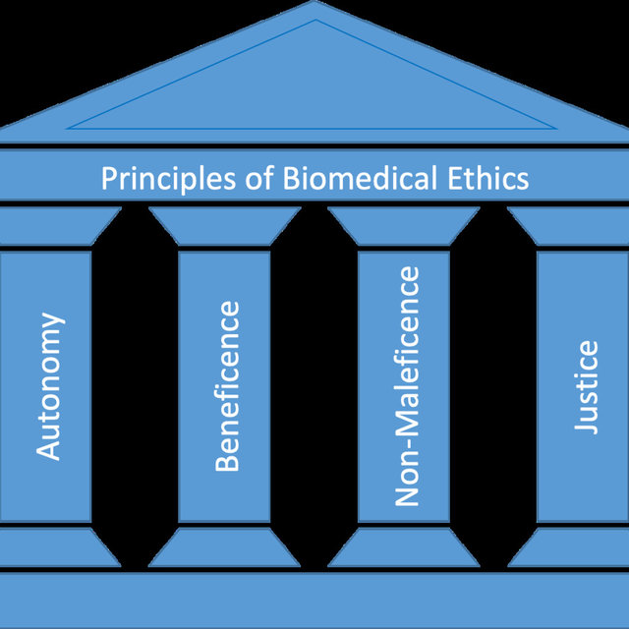

Slide 16
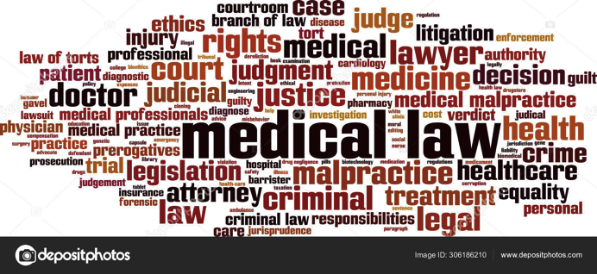

Slide 17
CASE STUDY
You are the doctor in-charge of the only hospital with ICU facilities in a county; only 1 ICU bed is currently available
4 COVID-19 patients needing ICU care arrive at the hospital within 5 minutes of each other
The first to arrive is an 90 year old man with late cancer of the prostrate; followed by a 38 year old female, mother of 6 and currently pregnant; next to come is a 28 year old newly married female engineer; last to come is the Governor, a 55 year old male. Who would you give the bed to? Why?

Slide 18
WHAT IS
BIOETHICS?

Slide 19
Term 1st used 1927 by German theologian Fritz Jahr
“Bio-Ethics: a review of the ethical relationships of humans to animals and plants”
Popularized 1970 - Van Potter, American oncologist
Ethic that is not just humans but entire biosphere
“Bioethics” has 2 Greek roots, “bio” & “ethikos”, meaning life & character (or custom), respectively
Bioethics - branch of applied ethics that deals with issues from biological & medical sciences

Slide 20
Unlike biomedical ethics, bioethics goes beyond the doctor-patient relationship
Emerged in response to rapid advance in biomedical knowledge & technology, which raised a host of new ethical questions
Technologies - mechanical ventilation, renal dialysis, in-vitro fertilization, organ transplantation
Increased awareness on human rights, Universal Declaration on Bioethics & Human Rights (2006)

Slide 21
Evolved into interdisciplinary field – philosophers, healthcare providers, lawyers, social scientists, biomedical researchers, engineers, biologists etc.
Contemporary bioethics deals with newer areas of ethical concern as technology continue to develop

Slide 22
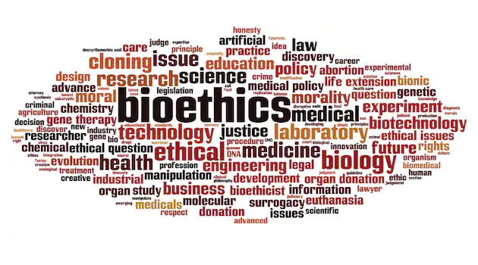

Slide 23
CASE STUDY
You are consulted for an ethical opinion in a matter
The government wants to build a road to open up access to farmers in a remote part of the country which although is very productive, food products rot on the farms due to lack of access to foreign markets with a potential of bringing to the country a lot of foreign currency
The only available access is through a national park and will block access for the animals to their only source of water
What would you advice should be done? Why?

Slide 24
WHAT IS
GLOBAL BIOETHICS?

Slide 25
Realization bioethics affects people across borders
Some bioethical issues can’t be solved within borders
Issues such as – global warming, air pollution, water pollution, terrorism, disease pandemics, organ trafficking etc. need similar ethical standards globally, so called global bioethics
Governments not able to make impact unless they worked within a global mandate

Slide 26
In addition to other biomedical principles
Intergenerational ethics – we are custodians of what we inherited; preserve globe for future generations
International social justice – poverty, exploitation, human trafficking, toxic dumping etc.
Equity – justice for all; brain drain of health workers from poor to rich countries

Slide 27
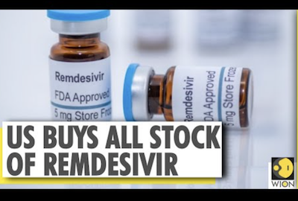

Slide 28
CASE STUDY
Remdesivir a drug used for treating Ebola is manufactured by Gilead Pharmaceuticals
During COVID-19 pandemic, researchers conduct clinical trials on it to see if it can be used to treat the disease
Results show that it is useful in lowering COVID-19 viral load and shortens duration of hospitalization in the severely sick
After the results of the study, the US government orders all the available stock of Remdesivir clearing it and making it unavailable to any other country needing the drug. Does this raise any ethical issues? Explain

Slide 29
RESEARCH INTEGRITY (falsification, fabrication, plagiarism)

Slide 30
Outline
What is Integrity?
What is Research Misconduct?
What is Falsification?
What is Fabrication?
What is Plagiarism?
Office of Research Integrity
Case studies

Slide 31
Outline
What is Integrity?
What is Research Misconduct?
What is Falsification?
What is Fabrication?
What is Plagiarism?
Office of Research Integrity
Case studies

Slide 32
WHAT IS INTEGRITY?

Slide 33

http://www.singaporestatement.org/downloads/singpore%20statement_A4size.pdf
www.singaporestatement.org

Slide 34
Preamble
The value & beneﬁts of research are vitally dependent on integrity of research. While there can be national & disciplinary diﬀerences in the way research is organized & conducted, there are also principles & professional responsibilities that are fundamental to the integrity of research wherever it is undertaken

Slide 35
INTEGRITY
Researchers should take responsibility for the trustworthiness of their research
4 Principles for research integrity
Honesty; Accountability; Professionalism; Stewardship

Slide 36
Outline
What is Integrity?
What is Research Misconduct?
What is Falsification?
What is Fabrication?
What is Plagiarism?
Office of Research Integrity
Case studies

Slide 37
RESEARCH MISCONDUCT

Slide 38
Research misconduct means falsification, fabrication, or plagiarism in proposing, performing, or reviewing research, or in reporting research results

Slide 39
Research misconduct DOES NOT include honest error or differences of opinion

Slide 40
FALSIFICATION

Slide 41
Falsification is manipulation of research materials, equipment, or processes or changing or omitting data or results
such that the research is not accurately represented in the research record

Slide 42
FABRICATION

Slide 43
Fabrication is making up data or results and recording or reporting them

Slide 44
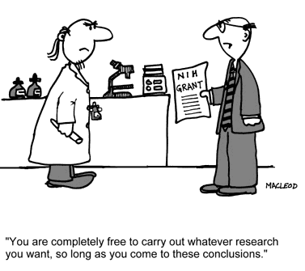

Slide 45
PLAGIARISM

Slide 46
Plagiarism is appropriation of someone else’s ideas, processes, results, or words without giving appropriate credit
(seize, adopt, assume ………)

Slide 47
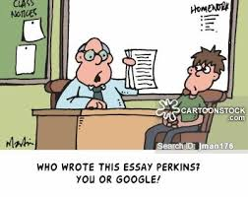

Slide 48


Slide 49
OFFICE OF RESEARCH INTEGRITY

Slide 50
ROLE
To guide research community to sustain and enhance responsible conduct of research and ensure compliance with the highest applicable national and international ethical and legal standards

Slide 51
ORI functions
Provide advice on research ethics & integrity
Provide tools & resources to help researchers
Advise ERCs on best practice but respecting their decision-making autonomy
Advise management on processes to respond to allegations of research misconduct
Training on responsible conduct of research, human research ethics, animal research ethics

Slide 52
Summary
Scientific Integrity bar – Singapore statement
We have described what Integrity involves
We have defined Research Misconduct
We have defined Falsification
We have defined Fabrication
We have defined Plagiarism
Functions of Office of Research Integrity

Slide 53
CASE STUDIES

Slide 54
COVID-19 TREATMENT
Mehra M et al. studied Hydroxychloroquine or Chloroquine use for COVID-19 treatment
Analysis of data from a multinational registry
Researchers weren’t involved in data collection
Data: 671 hospitals in 6 continents; hospitalised 20.12.2019 to 14.4.2020; chloroquine with or without macrolide, hydroxychloroquine with/without macrolide); control - none of the drugs

Slide 55
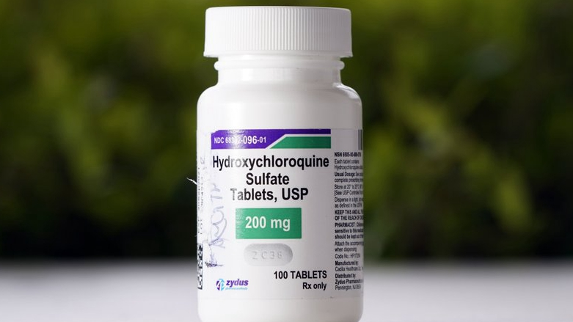

Slide 56
COVID-19 TREATMENT
Main outcomes – deaths, arrhythmias (irregular & fast heart beats)
Results: deaths lower in controls; arrhythmias more in hydroxychloroquine or chloroquine
Interpretation: Unable to confirm a benefit of hydroxychloroquine or chloroquine, when used with/without macrolide in COVID-19 treatment
Results published in The Lancet May 22, 2020

Slide 57
COVID-19 TREATMENT
Raised alarms on safety of drugs for Covid-19
Researchers called for scrutiny of data used
Authors requested Journal to retract article: “We can no longer vouch for the veracity of primary data sources & due to this unfortunate development, we request paper be retracted”
Lancet retracted the article on 4th June 2020

Slide 58
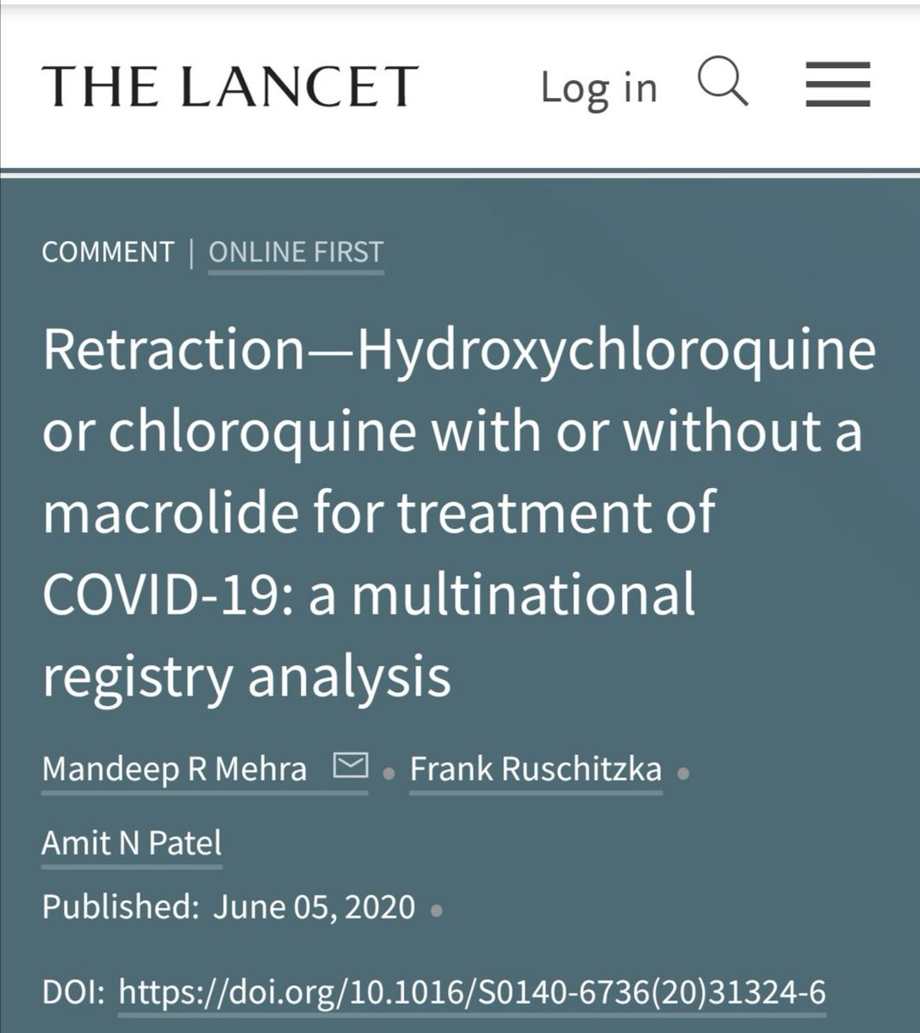

Slide 59
Falsification? Fabrication?

Slide 60
DR DAVID BRIDGES
Dr. Robert Rando et al. from Harvard Medical School sent a manuscript on their research to Proceedings of National Academy of Sciences
Journal sent article to Dr. Bridges, a professor at Bayor College of Medicine for peer review
After 1M, returned paper, saying was working on same subject & therefore couldn’t review it
After publication of his finding in Science, Dr. Rando complained to NIH, the funding agency

Slide 61
NIH findings
Dr. Bridges altered date to suggest "falsely” he begun research before reviewing Dr. Randol’s
Did not acknowledge source of information
Conclusion was that Dr. Bridges had plagiarised Dr. Randol et al.’s work
Recommended sanctions: article withdrawn, current NIH grant withdrprohibited from federal grants, excluded from peer review programmes for 10 years

Slide 62
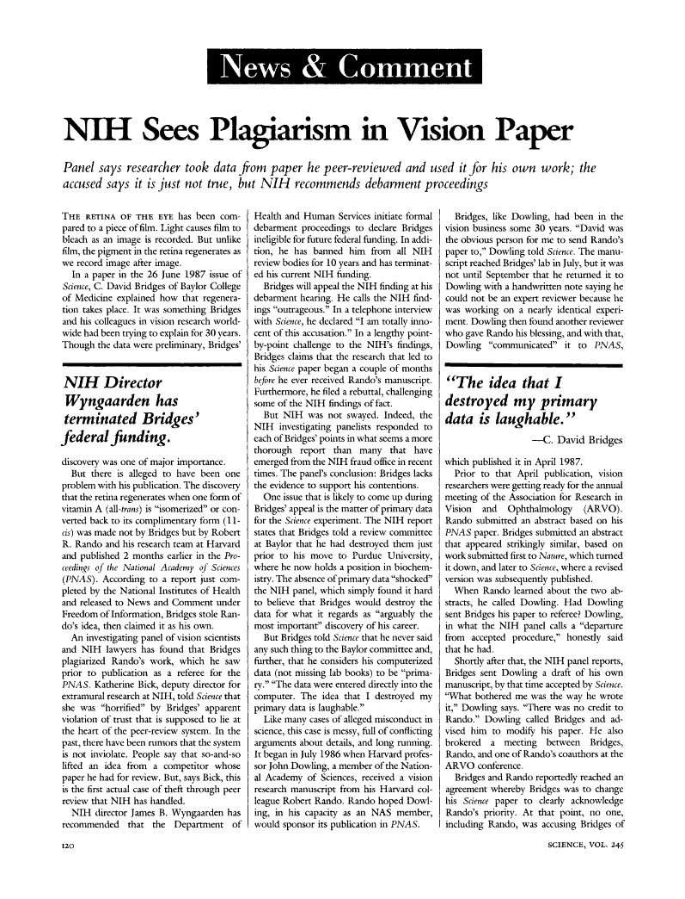

Slide 63
Acknowledgements
Prof. Walter Jaoko
Research Administration Certificate Course KEMRI, NAIROBI

Slide 64


