Slide 1
NIMH Division of AIDS Research
Susannah Allison, PhD
Training Director
D43 Co-Funding Presentation
January 27, 2022

Slide 2
NIMH Division of AIDS Research (DAR)
Supports research to reduce the incidence of HIV worldwide and to decrease the burden of living with HIV/AIDS
DAR-supported research includes:
basic & clinical neuroscience to understand and alleviate the consequences of HIV on the central nervous system (CNS)
basic & applied behavioral science to prevent HIV transmission and limit morbidity and mortality among those living with HIV
High priority on interdisciplinary research across multiple populations, including racial and ethnic minorities, over the lifespan
DAR
Behavioral Science
Clinical Neuroscience
Mental Health

Slide 3
NIMH DAR Research -- From Cell to Society
Neuropathogenesis, Neuroimaging, Genetics, Therapeutics
Cell
Mental Health, Neurocognition, Adherence, Retention
Individual
Maternal-child, Couples, Interpersonal Partner Violence
Interpersonal
Community- and healthcare system-level interventions
Community
Intersectional Stigma & Discrimination, Policy
Society

Slide 4
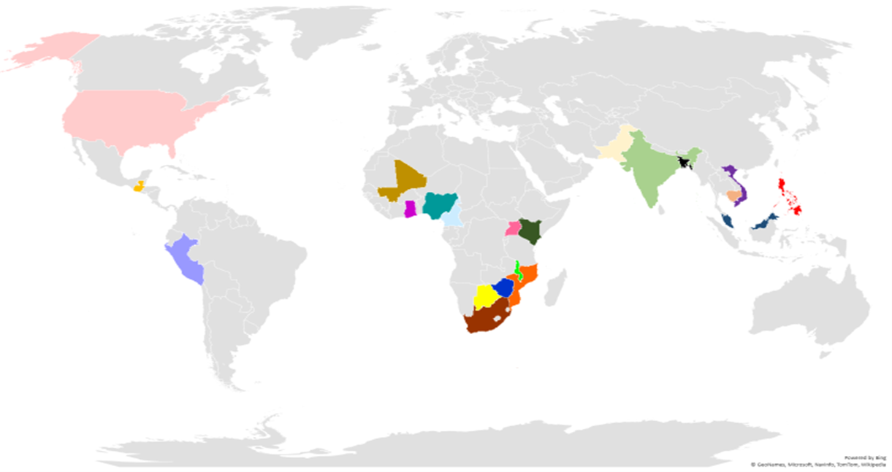
NIMH DAR Supports Global HIV Research

Slide 5
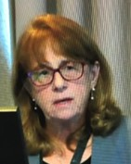
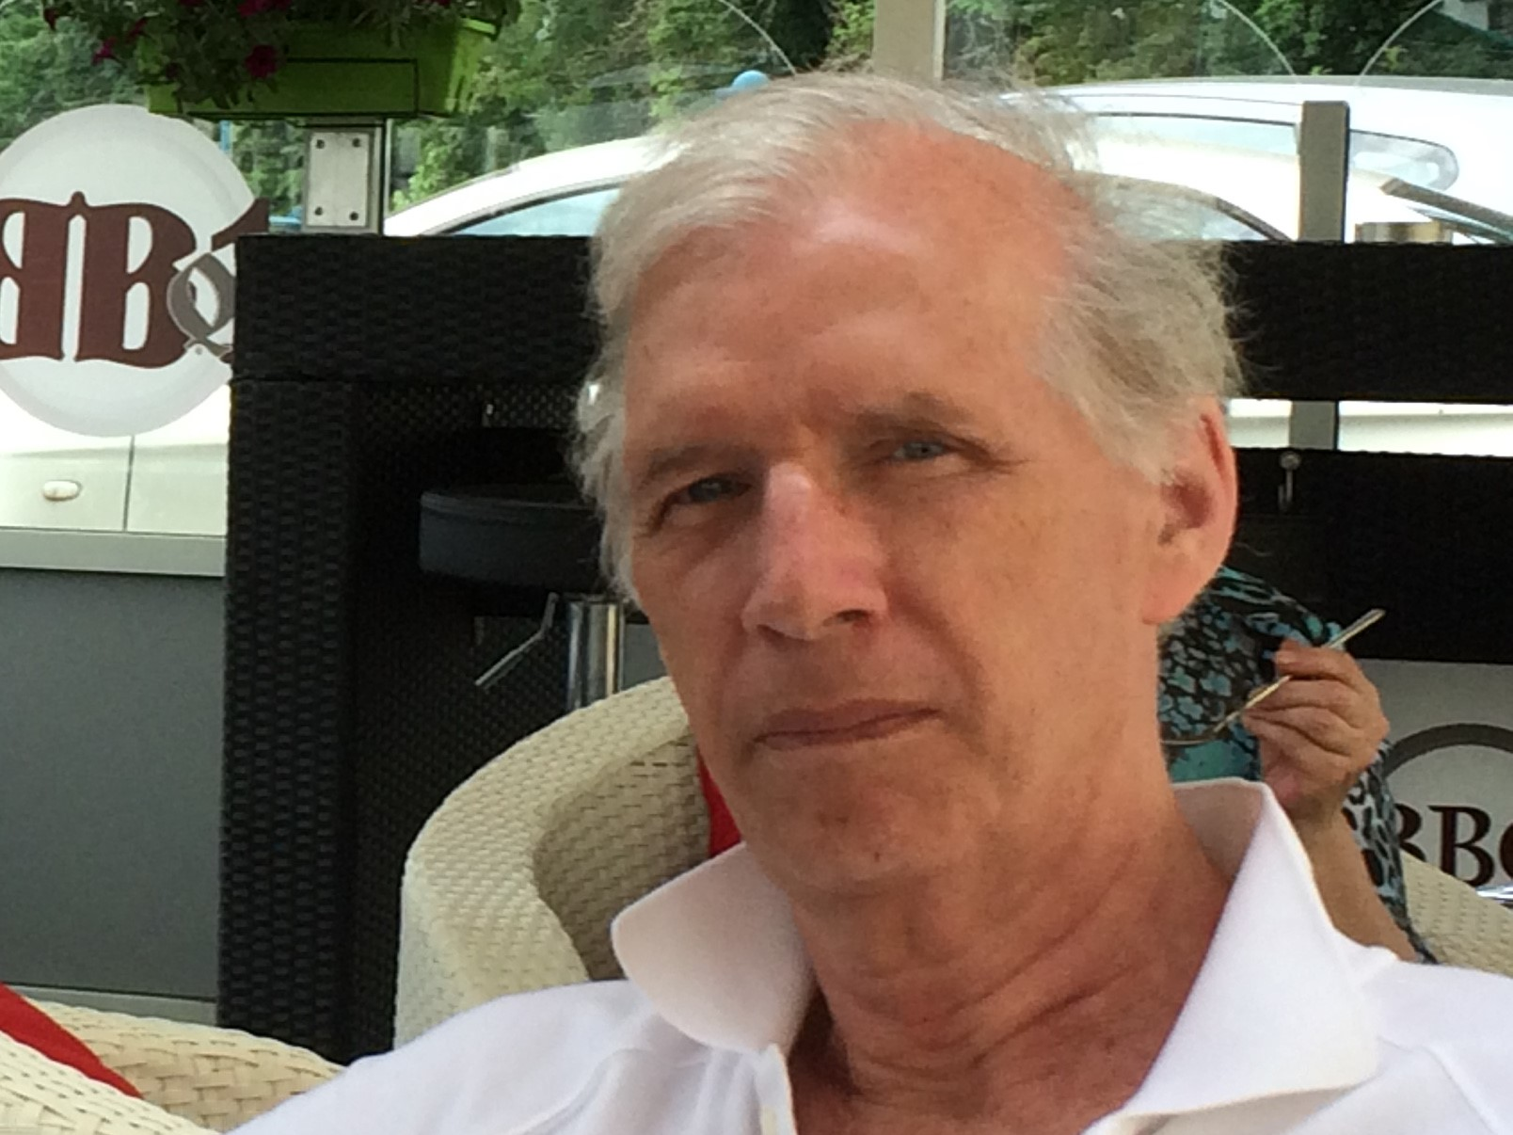
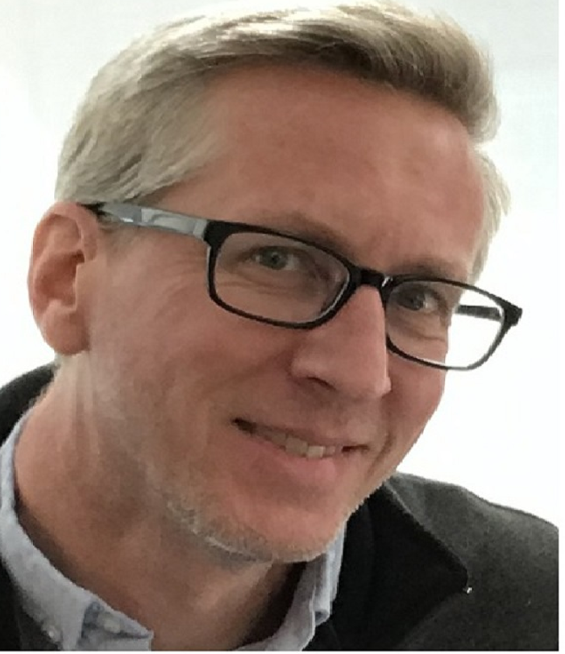
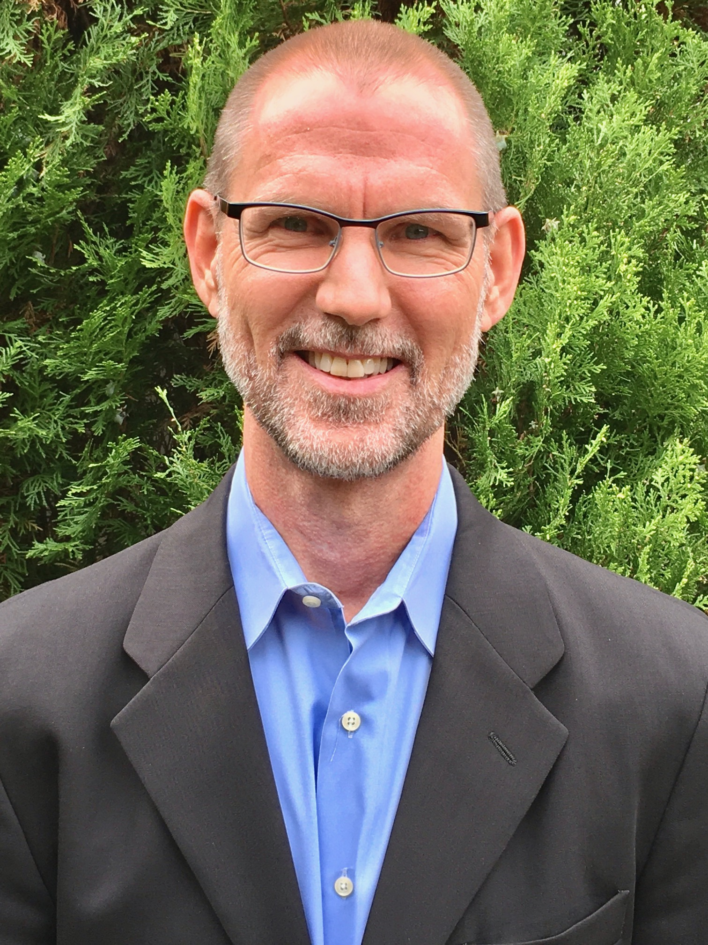
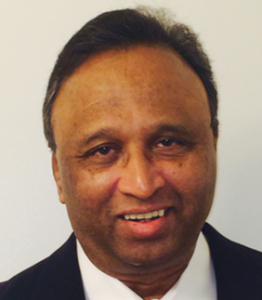
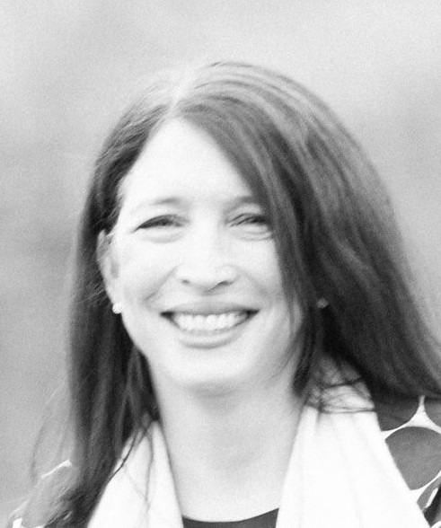
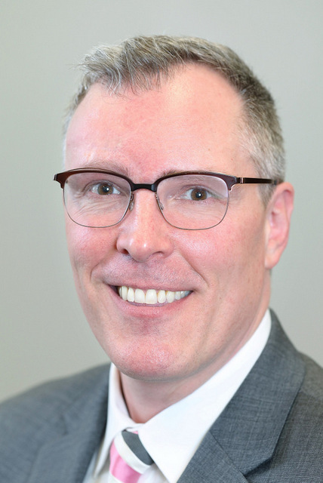
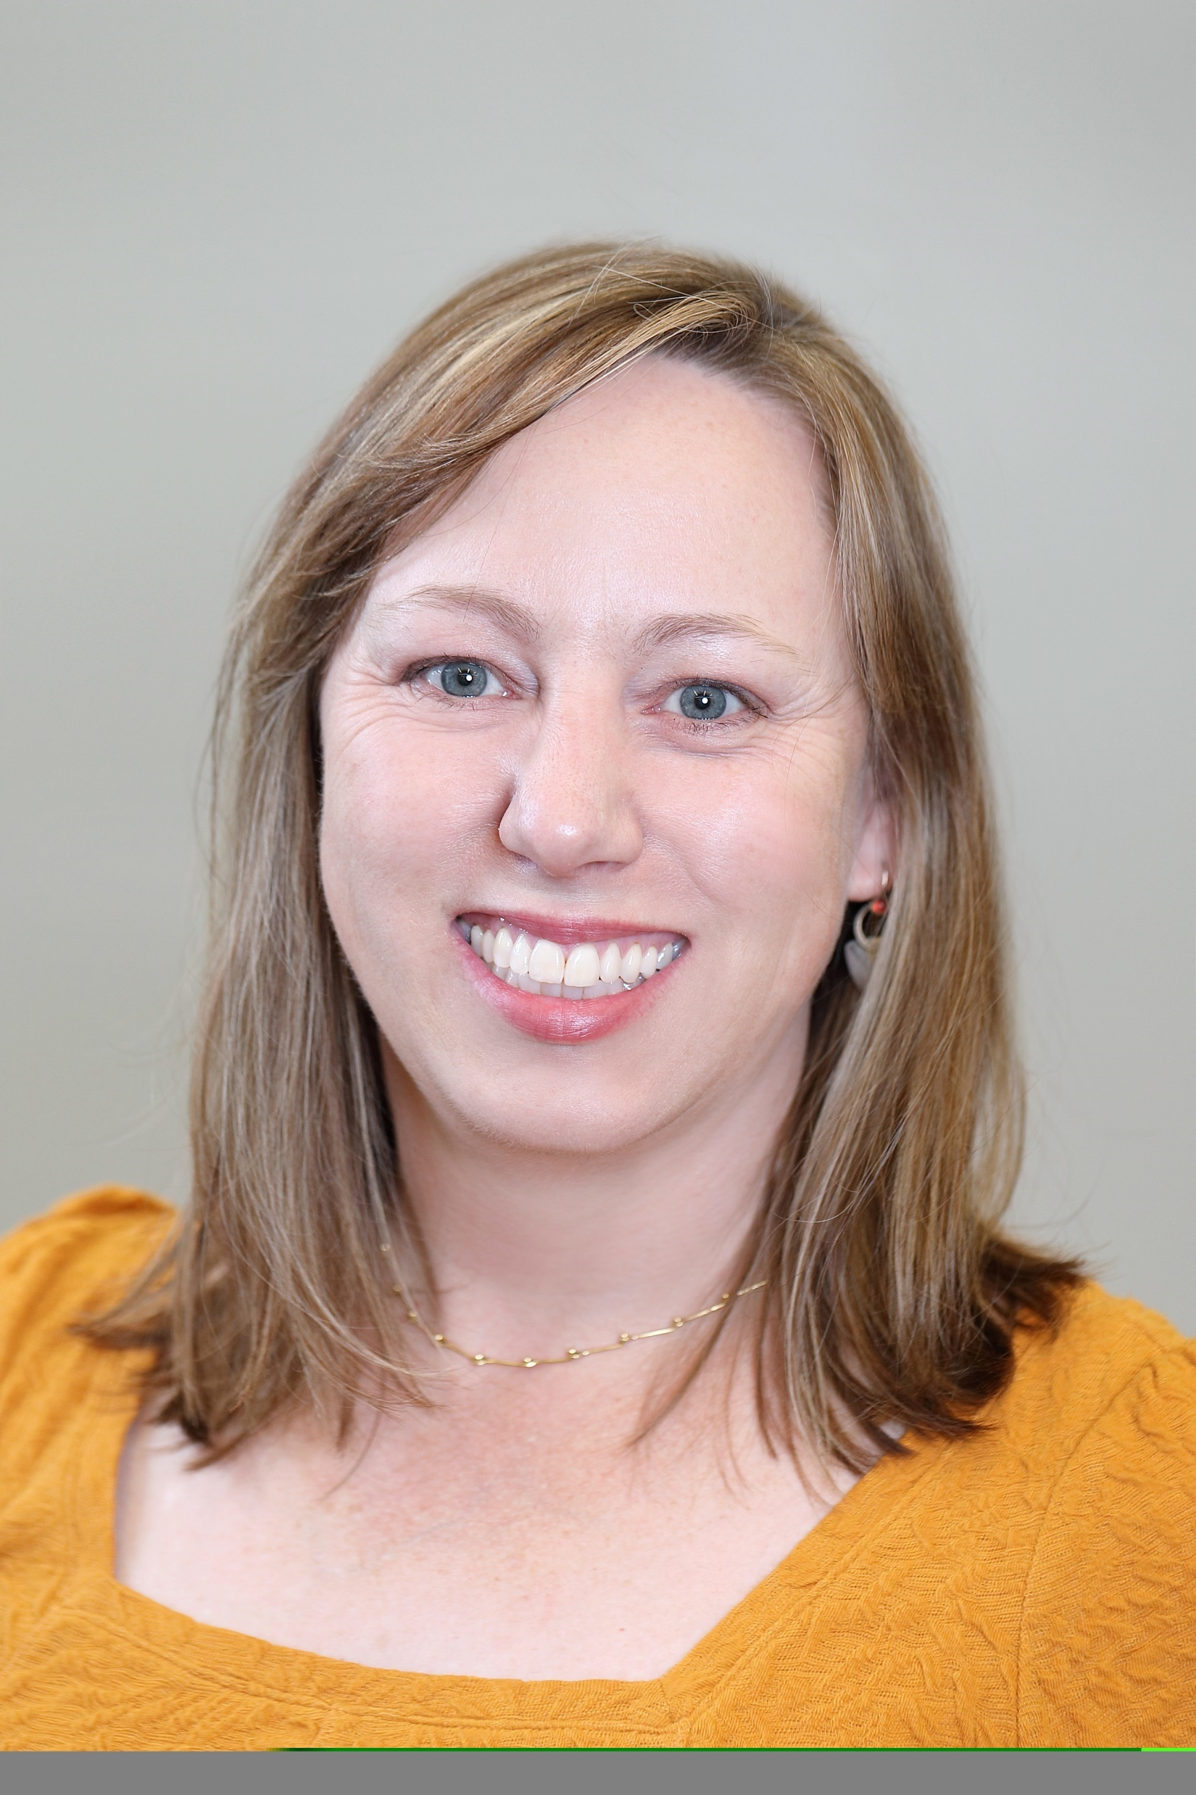
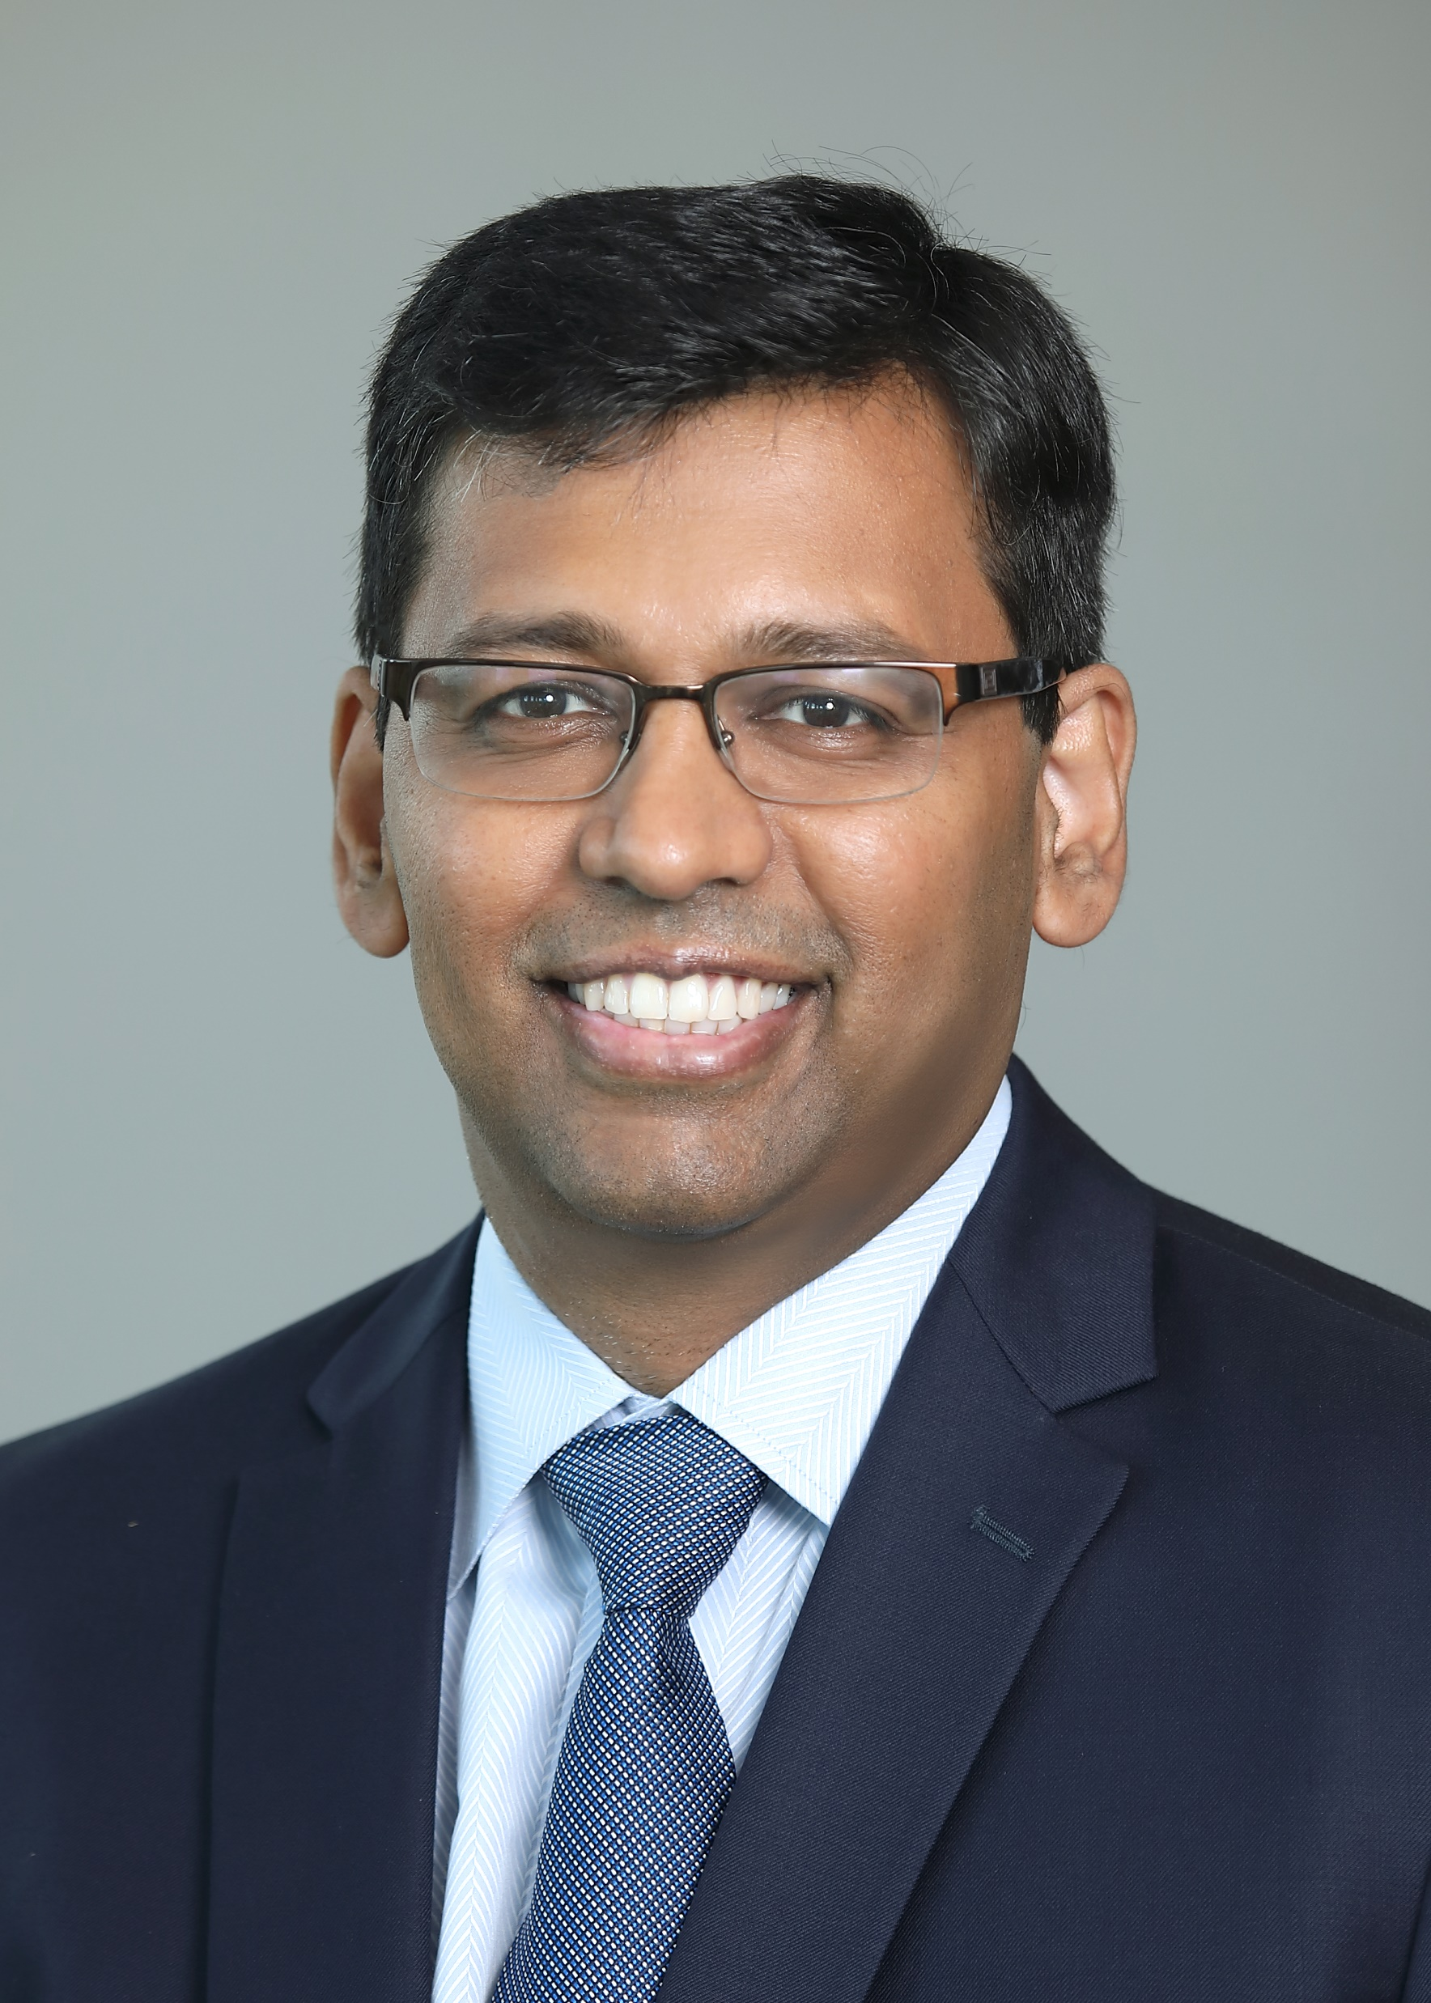
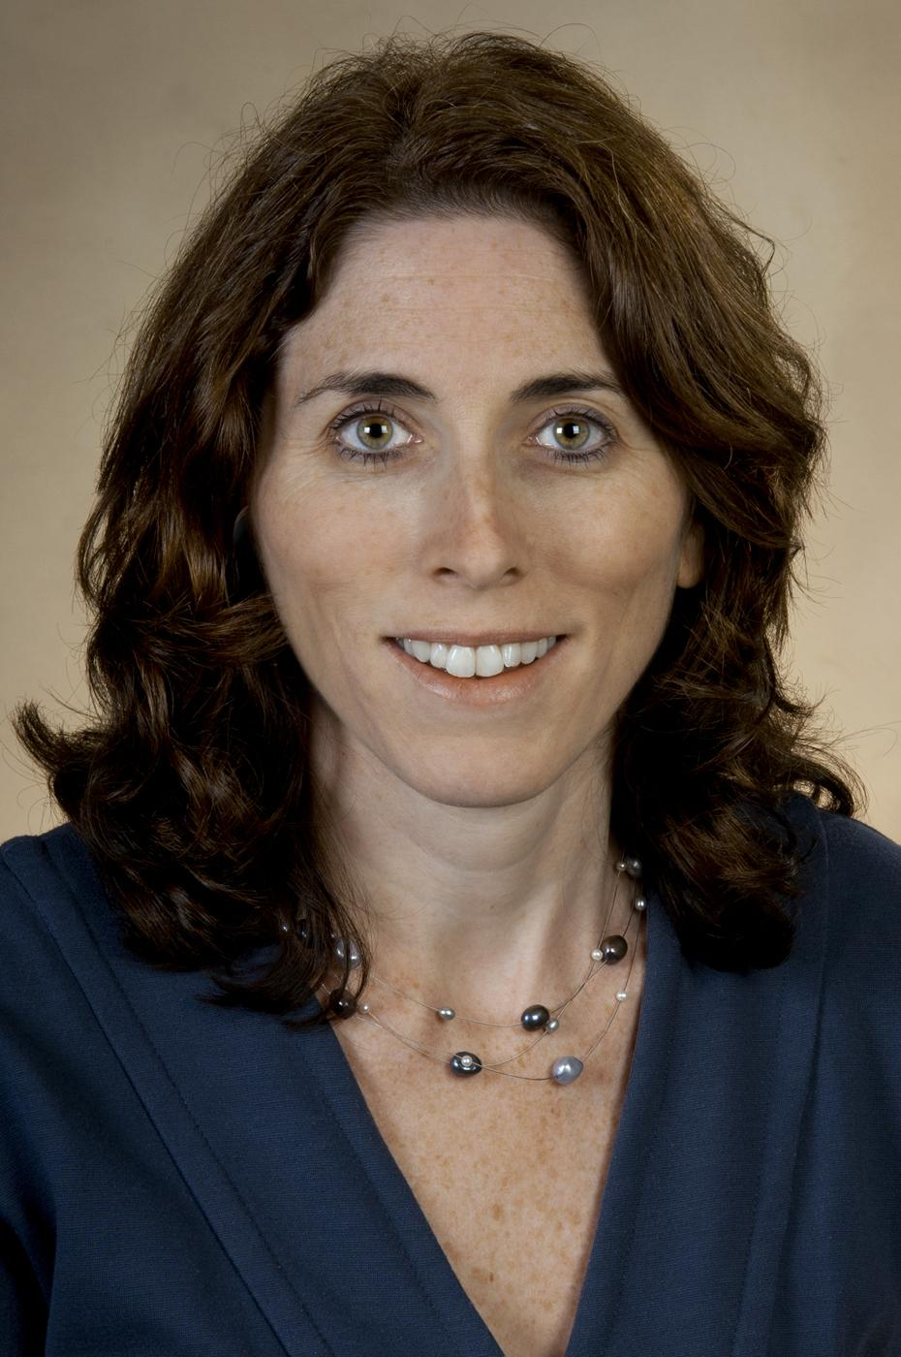
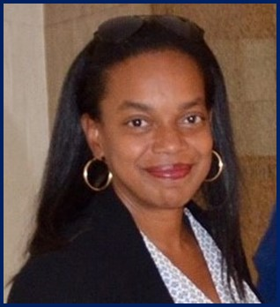
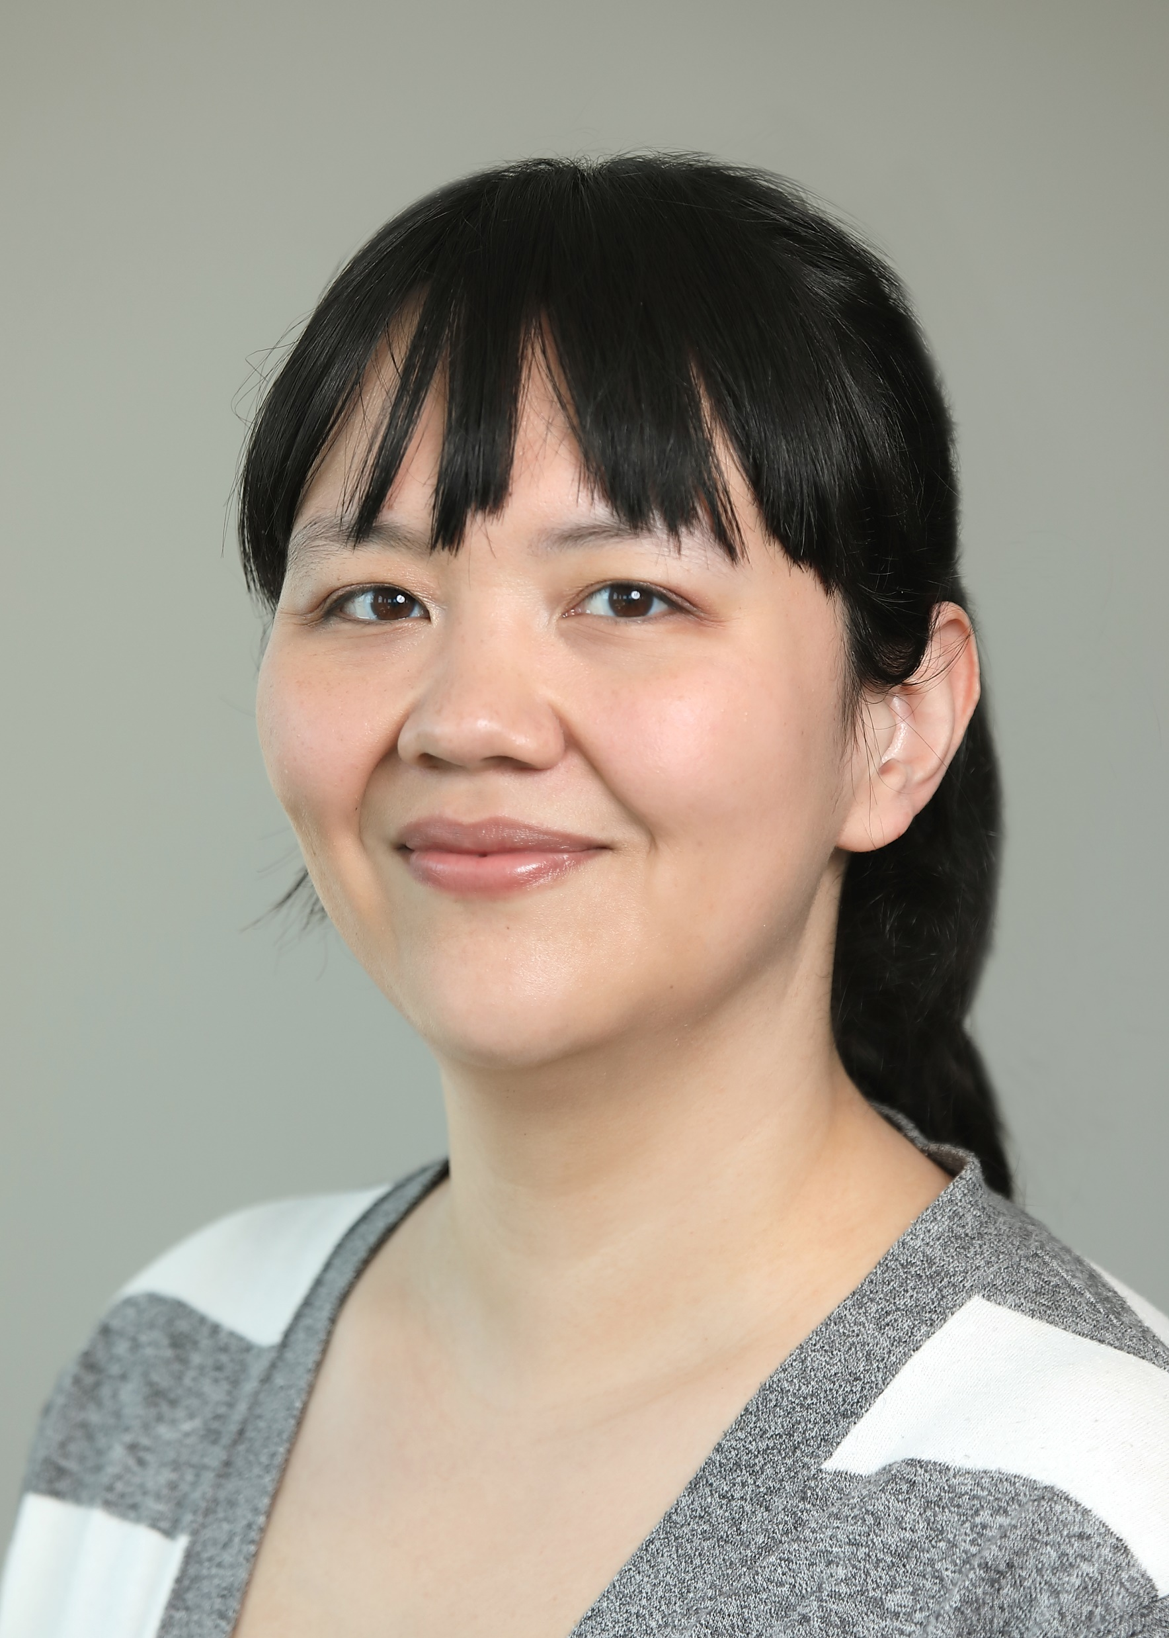
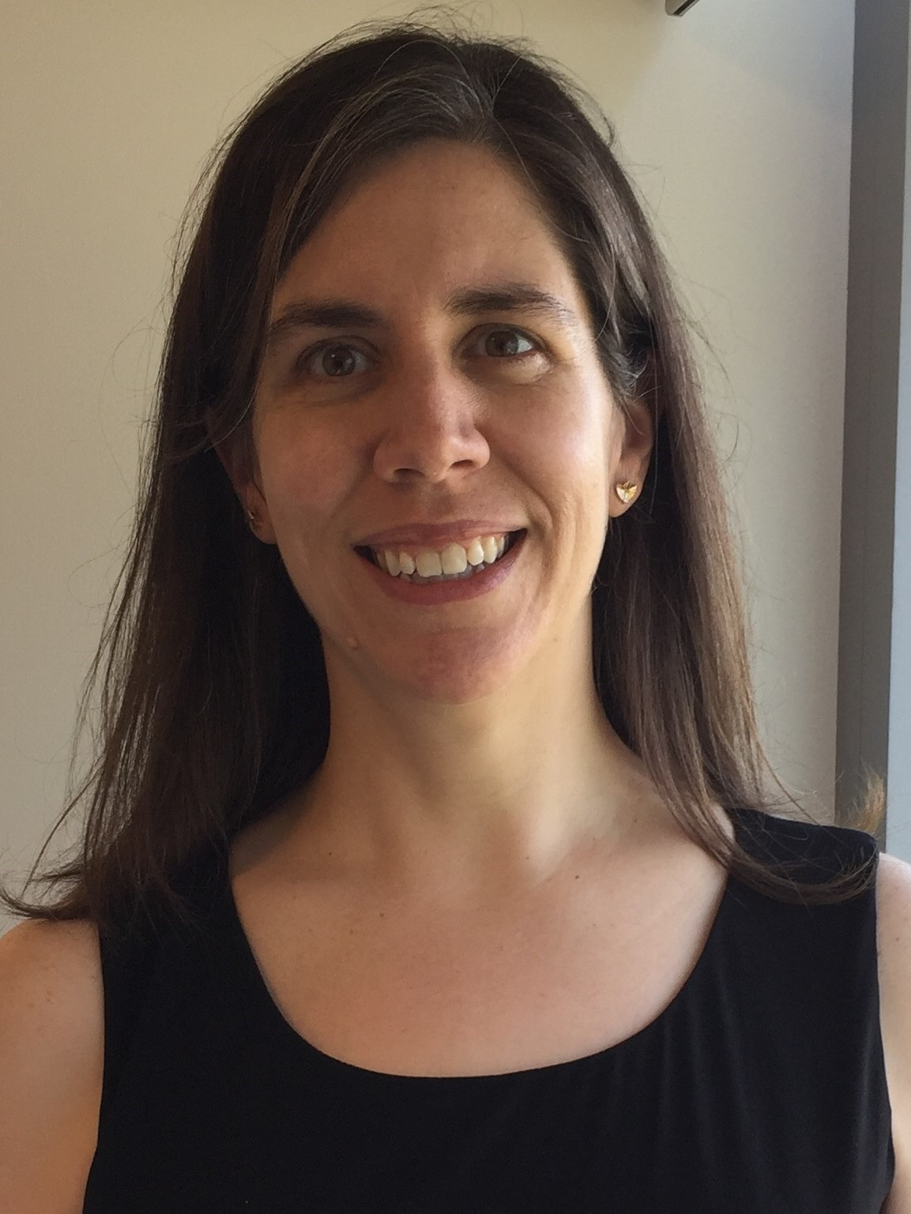
Division of AIDS Research Program Staff
Dianne Rausch PhD
DAR Director
Pim Brouwers PhD
DAR Deputy Director
Division Branch Chiefs & Senior Staff
Christopher Gordon, PhD Branch Chief
Gregory Greenwood, PhD Branch Chief
Jeymohan Joseph, PhD Branch Chief
Susannah Allison, PhD
Director of Research Training and Career Development
Michael Stirratt, PhD
Senior Behavioral Scientist
Program Officers
Holly Campbell-Rosen, PhD
Global Mental Health & Human Mobility Research Program
Vasudev Rao, MD PhD
HIV Neuro AIDS Therapeutics /Mechanisms of HIV Neuropathogenesis Programs
Lori A. J. Scott-Sheldon, PhD
Division of AIDS Research & Methodology Program
Collene Lawhorn, PhD Communication, Dissemination, and Engagement Research Program for the Prevention, Treatment and Cure of HIV
Suzy Pollard, PhD.
Program in Implementation Science to Advance Health Equity for HIV.
Teri Senn, PhD
Psychosocial Co-Morbidities of HIV Prevention and Treatment

Slide 6
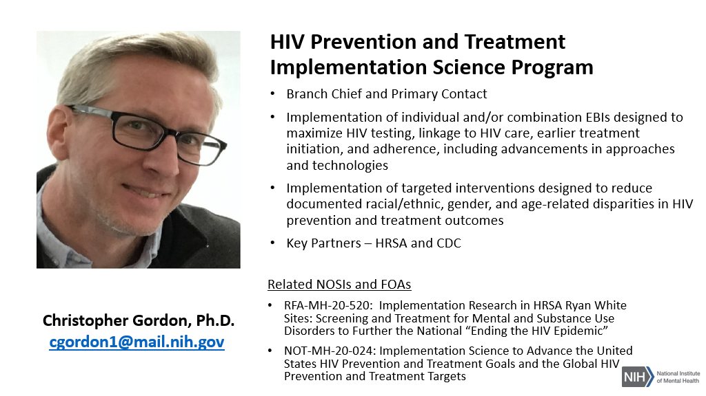

Slide 7
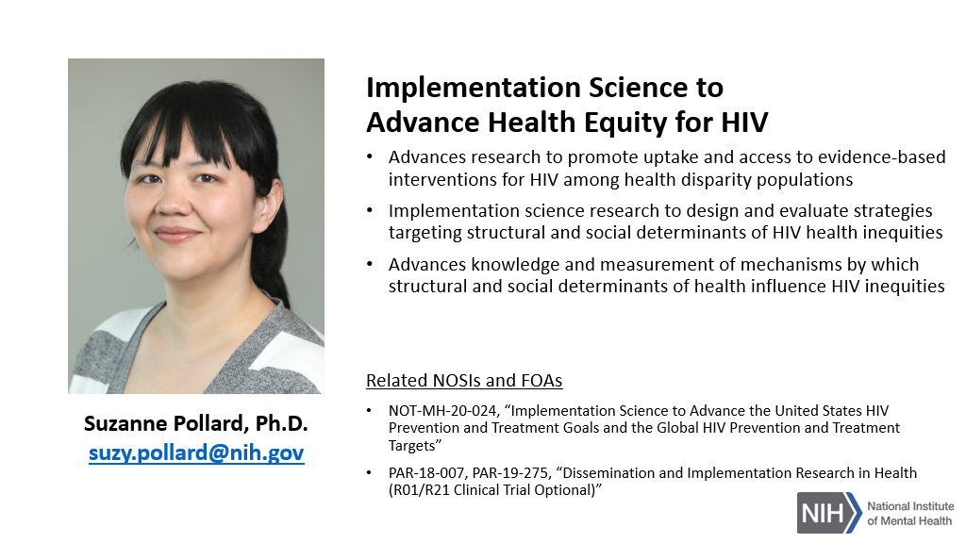

Slide 8
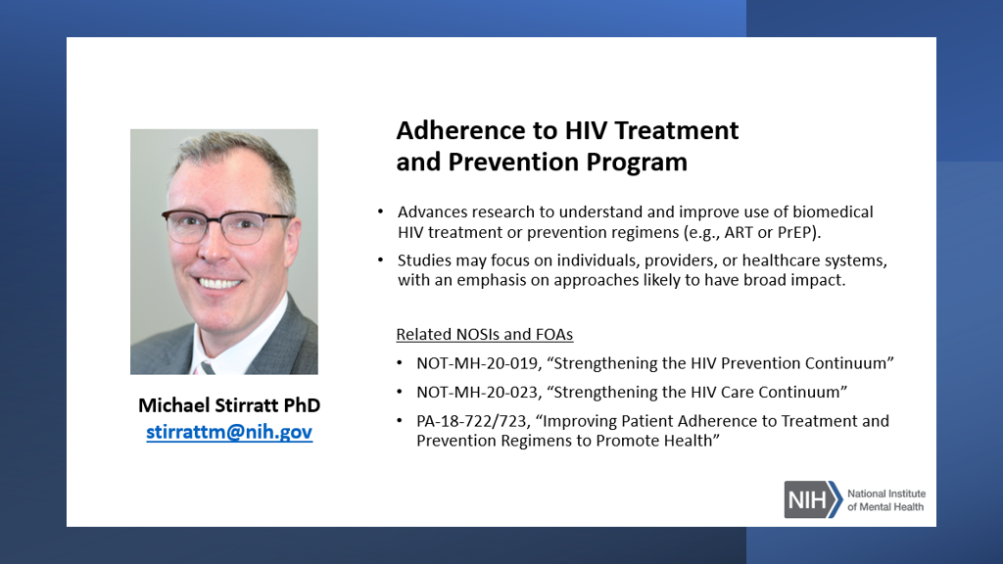

Slide 9
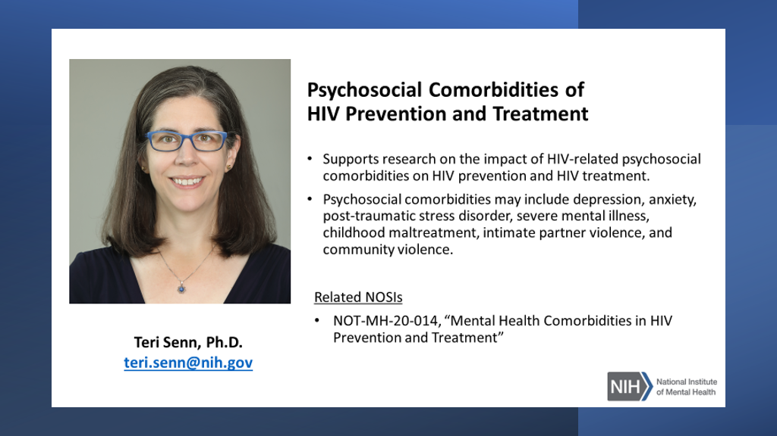

Slide 10
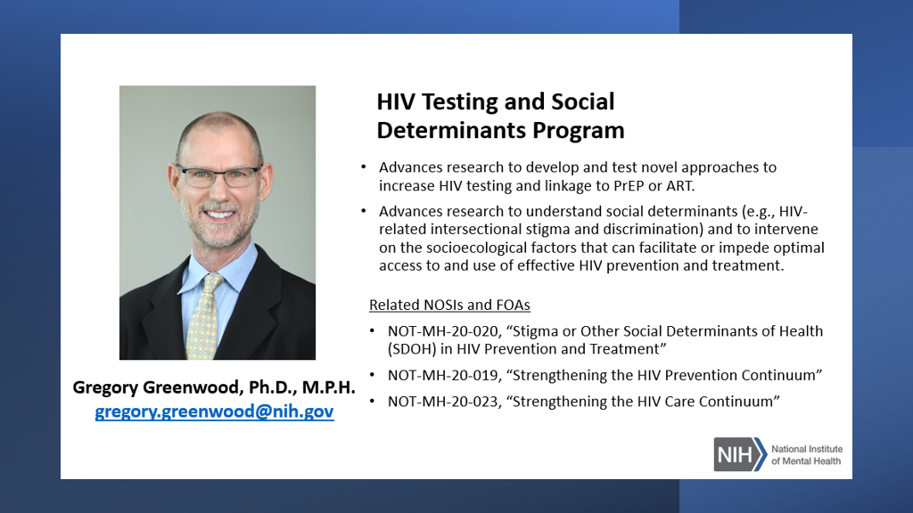

Slide 11
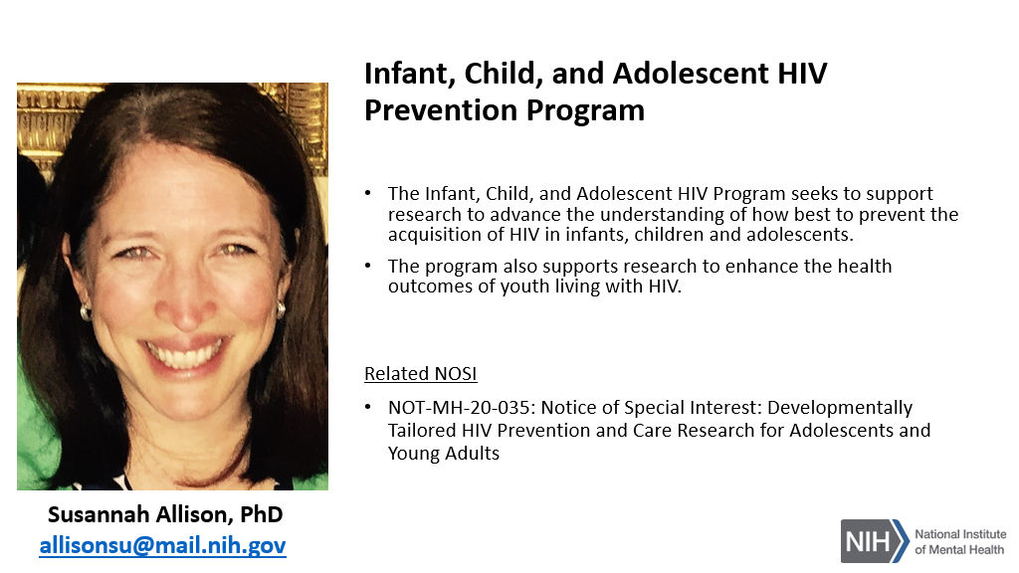

Slide 12
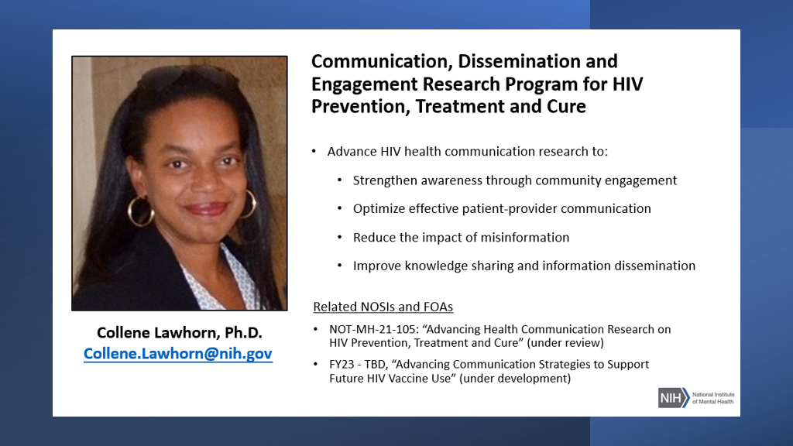

Slide 13
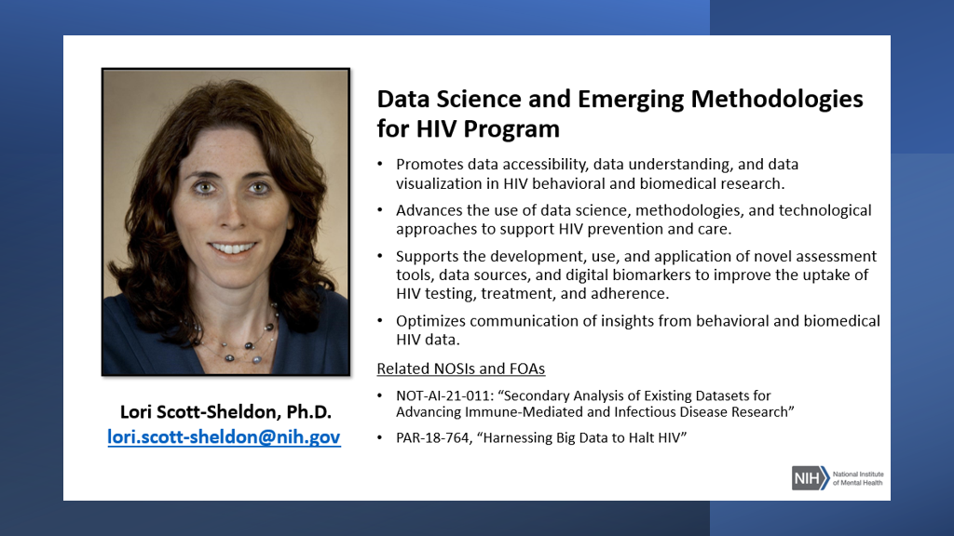

Slide 14
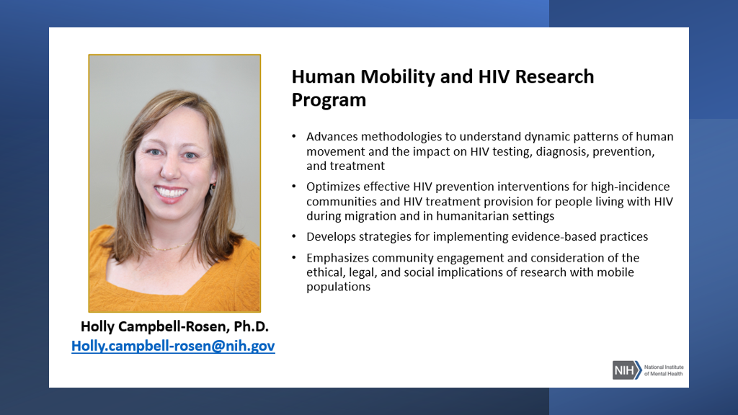

Slide 15
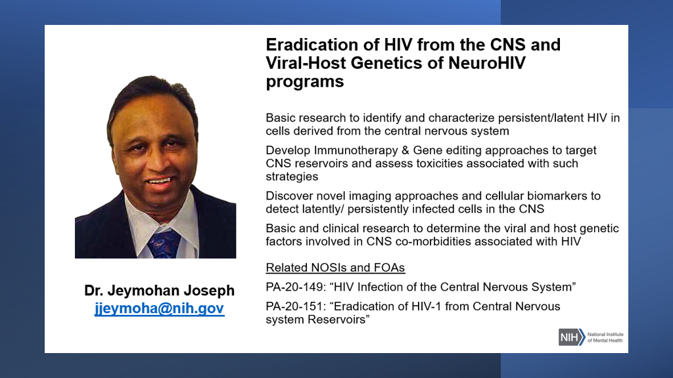

Slide 16
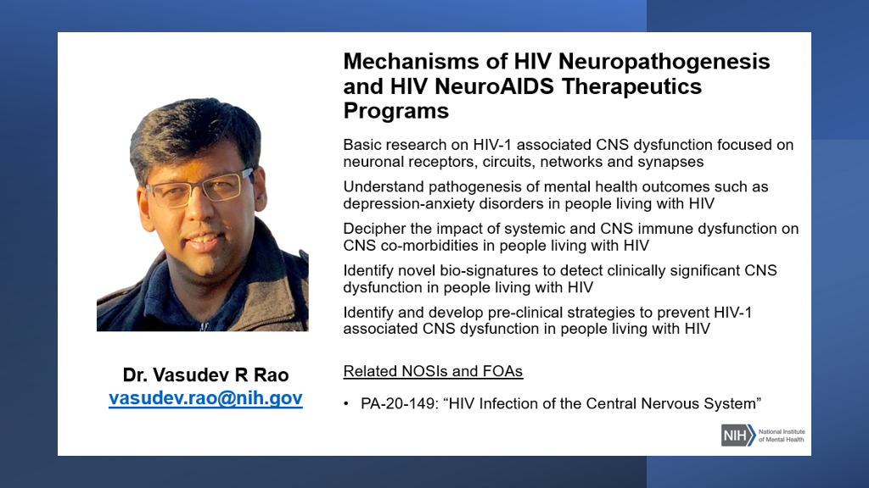

Slide 17
Current DAR Research Priorities
Emotional and Mental Health
Individual Behavior
Mental Health Comorbidities in HIV Prevention and Treatment
Implementation Research for Screening and Treatment for Mental Disorders
Development, Testing, Use, and Impact of Biomedical HIV Prevention, Treatment, and Cure Strategies
Advancing Differentiated Care for Adolescents and Young Adults
Interpersonal Factors and Structural Determinants
Advanced Epidemiological Modeling
Addressing the Impact of Violence on HIV Prevention and Treatment
Understanding and Reducing Stigma to Improve the HIV Prevention and Care Continua
Link to DAR’s List of HIV-related Funding Opportunity Announcements (FOAs)
https://www.nimh.nih.gov/about/organization/dar/aids-related-funding-opportunity-announcements-foas

Slide 18
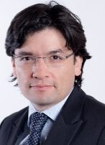
Leonardo Cubillos, MD, MPH
Director
Andrea Horvath-Marques, MD,
MPH, PhD Dissemination and Implementation Research program
Holly Campbell-Rosen, PhD Global Mental Health & Human Mobility Research Program
Rhonda Moore, PhD Mobile Technology Program
Center Global Mental Health Research Program Staff
Susannah Allison, PhD Director Research Training and Career Development
Program Officers

Slide 19
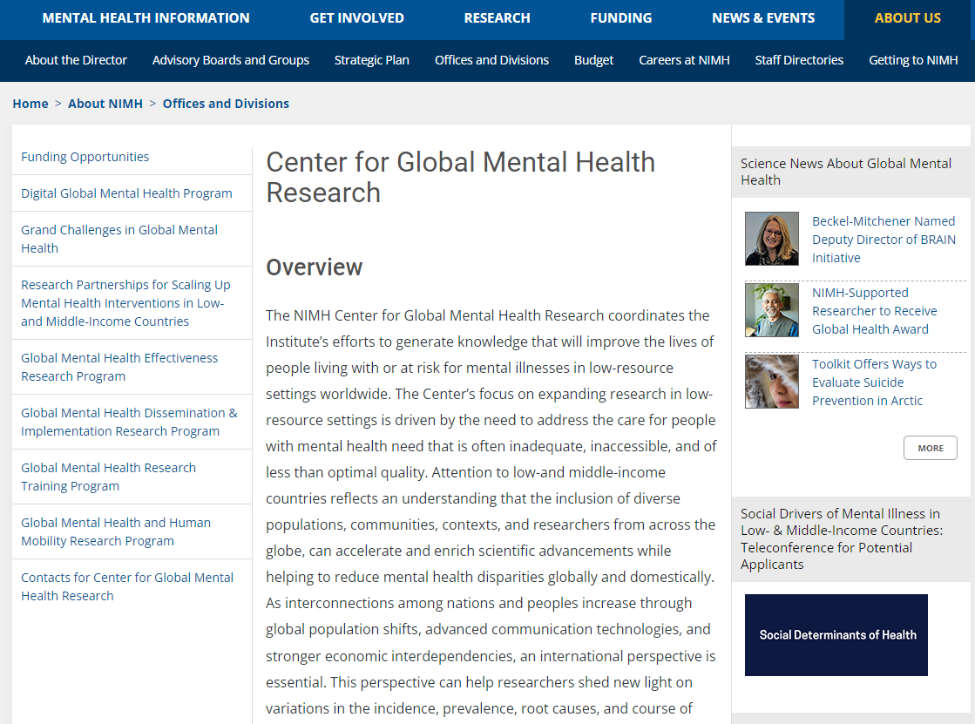
Center for Global Mental Health Research
https://www.nimh.nih.gov/about/organization/cgmhr

Slide 20
Program Officers can help you determine…
The relevance of a research concept to Institute/Center mission and priorities
The best research mechanism for your project (R01, R21, R34, K awards, etc.)
The Funding Opportunity Announcement (FOAs: PAs, RFAs, etc.) under which to submit – including whether it meets the NIH definition of a clinical trial (Demo)
The Study Section or group to which the application would likely be assigned for review

Slide 21
NIMH Supported Training Across Career Stages
Graduate/Medical Student
Dissertation Grant: R36 NRSA Fellowships: F30, F31 Institutional Training Grant: T32
Research Residency (MDs): R25 Diversity Supplements
Early Career Faculty
K-Awards: K01, K08, K23
Research Education Grant: R25
Diversity Supplements
Loan Repayment Program
Post-Doctoral Fellow
NRSA Fellowship: F32
K-Awards: K99/R00 Institutional Training Grant: T32 Research Education Grant: R25
Diversity Supplements
Loan Repayment Program
3 Funding Pathways
1. Individual NIMH Awards (R36, F, K)
2. Institutional NIMH training awards (T32, R25)
3. Diversity supplement to a mentor’s NIMH grant

Slide 22
Individual Mentored K Awards
Support protected time for intensive, supervised career development experience : expectation for transition to an independent Research Intensive position
K01 Research Scientist: Biomedical or behavioral sciences
K08 Clinical Scientist: Individuals with clinical doctoral degrees pursuing translational research—application of basic research discoveries toward the diagnosis, management, and prevention of human disease
K23 Patient Oriented: Investigators committed to Patient-Oriented Research (POR – direct interaction with human subjects; research on mechanisms of human disease, therapeutic interventions, clinical trials, and development of new technologies)
K43 Emerging Global Leader: Individuals from a low- or middle-income country (LMIC) with a junior faculty position at an LMIC academic or research institution*
K18 Enhancement Award: Provides full-time or part-time support for experienced scientists who wish to broaden their research capabilities.
K99/R00 Pathway to Independence: Facilitates rapid transition from a mentored postdoctoral position to independent research position (No more than 4 years from doctorate or residency at the time of application)* * career development awards for which non-US citizens or nationals are eligible
Notes:
Non-US citizens can apply for K99/R00 but have to be from a US institution

Slide 23


Fogarty Career Development Programs
K Awards
Fogarty offers two mentored global health research career development programs:
Since 1999 – K01 for US investigators
International Research Scientist Development Award (IRSDA)
PAR-18-539 (Independent Clinical Trial Not Allowed)
PAR-18-540 (Independent Clinical Trial Required)
New program – K43 for Low- and Middle-Income Country (LMIC) investigators
Emerging Global Leader Award (K43)
PAR-19-098 (Independent Clinical Trial Not Allowed)
PAR-19-051 (Independent Clinical Trial Required)
K01
K43

Slide 24
Program Features Fogarty Career Development Programs
K01 International Research Scientist Development Award (IRSDA) | K43 Emerging Global Leader Award
US Citizen or permanent resident, US Institution | LMIC Citizen (see exceptions),LMIC Institution
Provides 3-5 years of mentored research and career development in global health | Same
Minimum 75% effort (min. 9 person-months) | Same
Up to $75,000 salary, $30,000 research costs/year | Same
Postdocs and Junior Faculty | Junior Faculty or Research Scientist position
Cannot have independent funding | Same
Must have both US and LMIC mentors | Same
Must spend 50% time in LMIC | Majority of work in home country
Scope: any area covered by NIH in LMIC context and highly relevant to collaborating LMIC | Same
Partners: FIC, NCI | Partners: FIC,NCI, NHGRI, NIDCR, NIEHS, NIMH, NINDS, ORWH

Slide 25
Research Focus of Fogarty Ks
Any therapeutic or scientific area of health priority and scientific importance to the LMIC

Slide 26
Additional Information Fogarty Career Development Programs
K01
K43
Program Information Page
http://www.fic.nih.gov/programs/Pages/research-scientists.aspx
FAQs
http://www.fic.nih.gov/Programs/Info/Pages/irsda-faqs.aspx
Program Information Page
http://www.fic.nih.gov/Programs/Pages/emerging-global-leader.aspx
FAQs
http://www.fic.nih.gov/Programs/Info/Pages/faqs-emerging-global-leader.aspx
NIH Research Career Development Award Programs
Listing of all NIH K programs; many allow Foreign Components
https://researchtraining.nih.gov/programs/career-development
Program Contact: Dr. Christine Jessup, Program Director, Fogarty International Center,
National Institutes of Health, Email: Christine.Jessup@nih.gov

Slide 27
Preparation Timeline
Submission Phase
Planning Phase
Writing Phase
Months before receipt date
9
8
7
6
5
4
3
2
1
First create an outline of your application; then write your application
Receipt date
Assess yourself, your field, and your resources
Get feedback;
Edit and proofread
Brainstorm;
Research your idea;
Call NIMH program staff
Meet institutional deadlines
Set up your own review committee; Determine human and animal subject requirements

Slide 28

Questions?
Susannah Allison
allisonsu@mail.nih.gov

