Slide 1
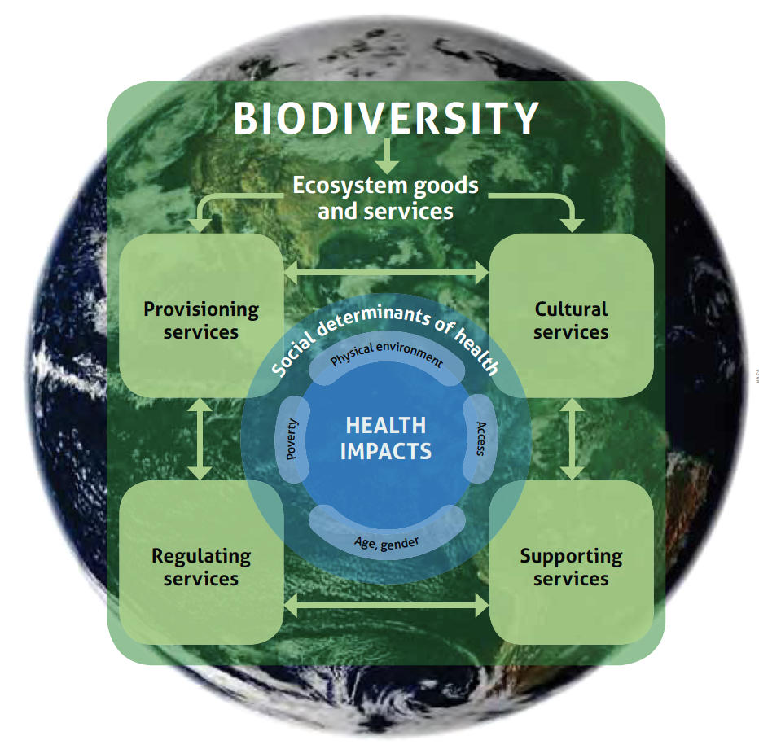
Biodiversity, Ecosystem Services and Human Health
Kate Scow, Prof. of Soil Science and Microbial Ecology
Dept of Land, Air and Water Resources
University of California, Davis, USA
kmscow@ucdavis.edu

Slide 2
Outline
Learning objectives
Reflection—your experiences
Biodiversity and Ecosystem Services—definitions
How biodiversity and ecosystem services impact human health--general
Global threats to biodiversity/ecosystem services: planetary boundaries
Biodiversity in agricultural systems, particularly below ground
Solutions (3 examples)
  Case study—agroforestry (Rosenstock paper): small group discussion
Integrating biodiversity and ecosystem services into public health and nutrition policy and practices
  Conceptual framework—6 building blocks
  Public health interventions
  Indicators

Slide 3
Learning Objectives
Demonstrate understanding of the relationship between sustainable development and health | Assess social and economic determinants of HIV health and their impact on access to and quality of health services and on differences in morbidity and mortality between and within different geographic areas.
 | Describe the relationship between food insecurity and poverty on HIV/AIDS prevention and treatment
 | Explain the role of climate change and sustainability in food security, nutrition and HIV health
 | Analyze knowledge of economic strengthening and food security interventions for HIV health. These include: 1) Conditional and unconditional cash transfers, microfinance and savings interventions) 2) Agriculture, agroforestry, and livestock interventions 3) Food supplementation and other food support interventions 4) Training and other livelihood interventions
 | Discuss the role of women’s empowerment and gender transformative interventions as parts of S4DH approaches
 | Evaluate policies, development frameworks, and case studies of interventions designed to improve HIV health
 | Integrate thinking and practice in different health settings for sustainable development

Slide 4
Reflection
Share an example of a relationship between human health and biodiversity that you have observed/experienced personally

Slide 5
Definitions of Biodiversity and Ecosystem Services
Poll: What is best definition of biodiversity?
Biodiversity is the variability among living organisms from all sources, including terrestrial, marine, and other aquatic ecosystems and the ecological complexes of which they are part; this includes diversity within species, between species, and of ecosystems (UN Convention on Biodiversity)
“Biodiversity" is totality of genes, species and ecosystems of a region. Presents unified view of traditional levels at which biological variation is identified: species, ecosystems, morphology, genetic diversity. Now molecular diversity too.

Slide 6
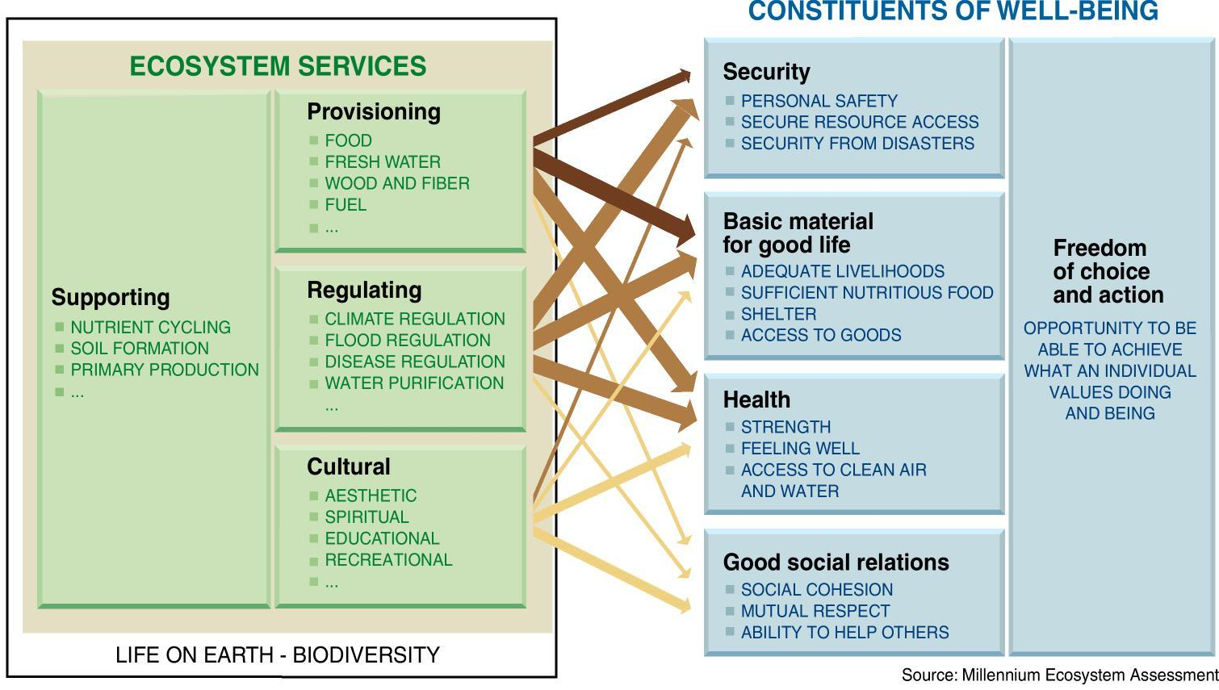
Ecosystem Services (ES) are the other part of the story.
Relation of ES to Human Well-Being
(from Millenium Ecosystem Assessment)
Bio
Biodiversity underpins and is driving force of many ecosystem services
Notes:
Reference: Millennium Ecosystem Assessment, 2005. Ecosystems and Human Well-being: Synthesis. Island Press, Washington, DC.
This chart connects ecosystem services to well-being. It looks more complex than it is.

Slide 7
Ecosystem services
Provisioning
Food production
Fresh water availability
Fuel wood production
Biochemicals
Genetic resources
Regulating
Climatic regulation
Disease regulation
Flood regulation
Detoxification
Cultural
Spiritual
Recreational
Aesthetic
Inspirational
Educational
Communal
Symbolic
Supporting
Soil formation
Nutrient Cycling
Primary production
Critique: Good focus on environment but less so on humans and how biodiversity is integrated
Notes:
Let’s come back a little bit to the concept of Ecosystem service of soil biota that was previously explained by Kate. The Ecosystem service provide by an organism is defined as the benefits that people directly or indirectly obtain from ecosystems. We have already seen this slide and I showed just to remind you guys about the different defined categories for ecosystem services, which are PROVISIONING (can be also understand as direct benefit that we obtain) REGULATING (regulate environmental cycles), CULTURAL (indirect benefits) and SUPPORTING (support life or auto-preservation)

Slide 8
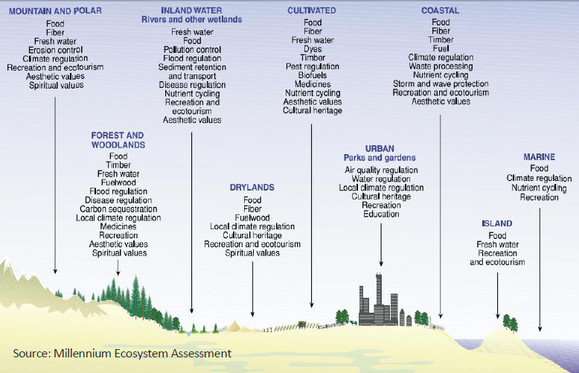
Different ecosystems and the services they provide
Notes:
Reference: Millennium Ecosystem Assessment, 2005. Ecosystems and Human Well-being: Synthesis. Island Press, Washington, DC.
The Millenium Ecosystem Assessment classifies ES into four broad categories, represented here: Supporting, Provisioning, Regulating, and Cultural. These are worth memorizing.
*

Slide 10
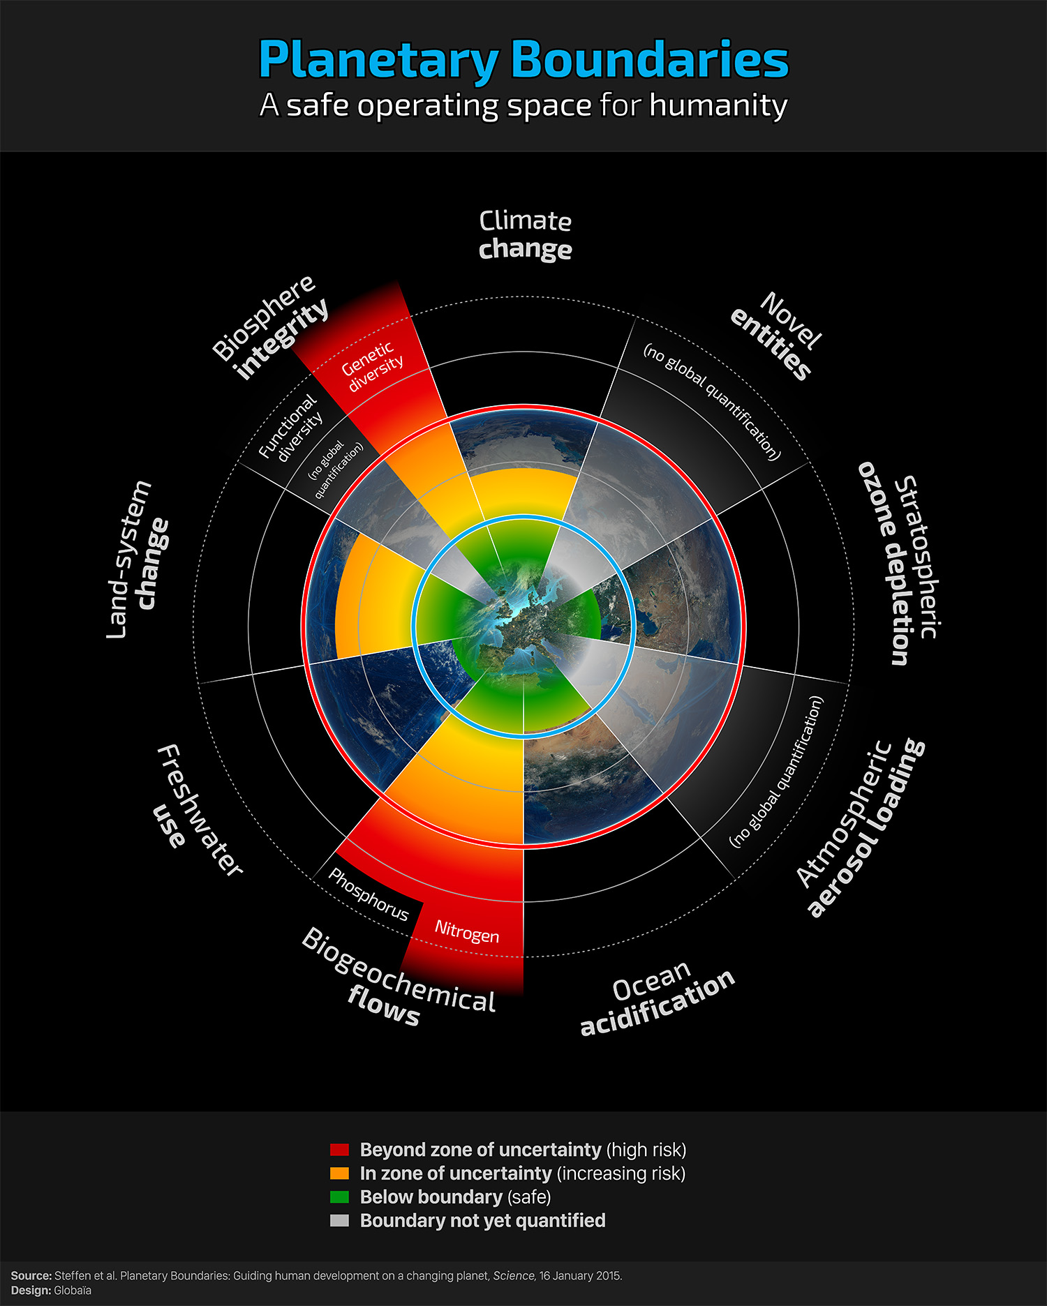
Global Threats

Slide 11
Climate Change and Human Health
Three kinds of health impacts have been identified:
  Relatively direct impacts, usually caused by weather extremes
  Indirect impacts: consequences of environmental change and ecological disruption in response to climatic change
  Consequences that occur when populations are demoralised and displaced by the following climate change induced factors:
    economic dislocation,
    environmental decline and conflict situations including traumatic, infectious, nutritional, psychological and other health consequences.
World Health Organisation (WHO). 2003. Climate change and human health: risks and responses.

Slide 12
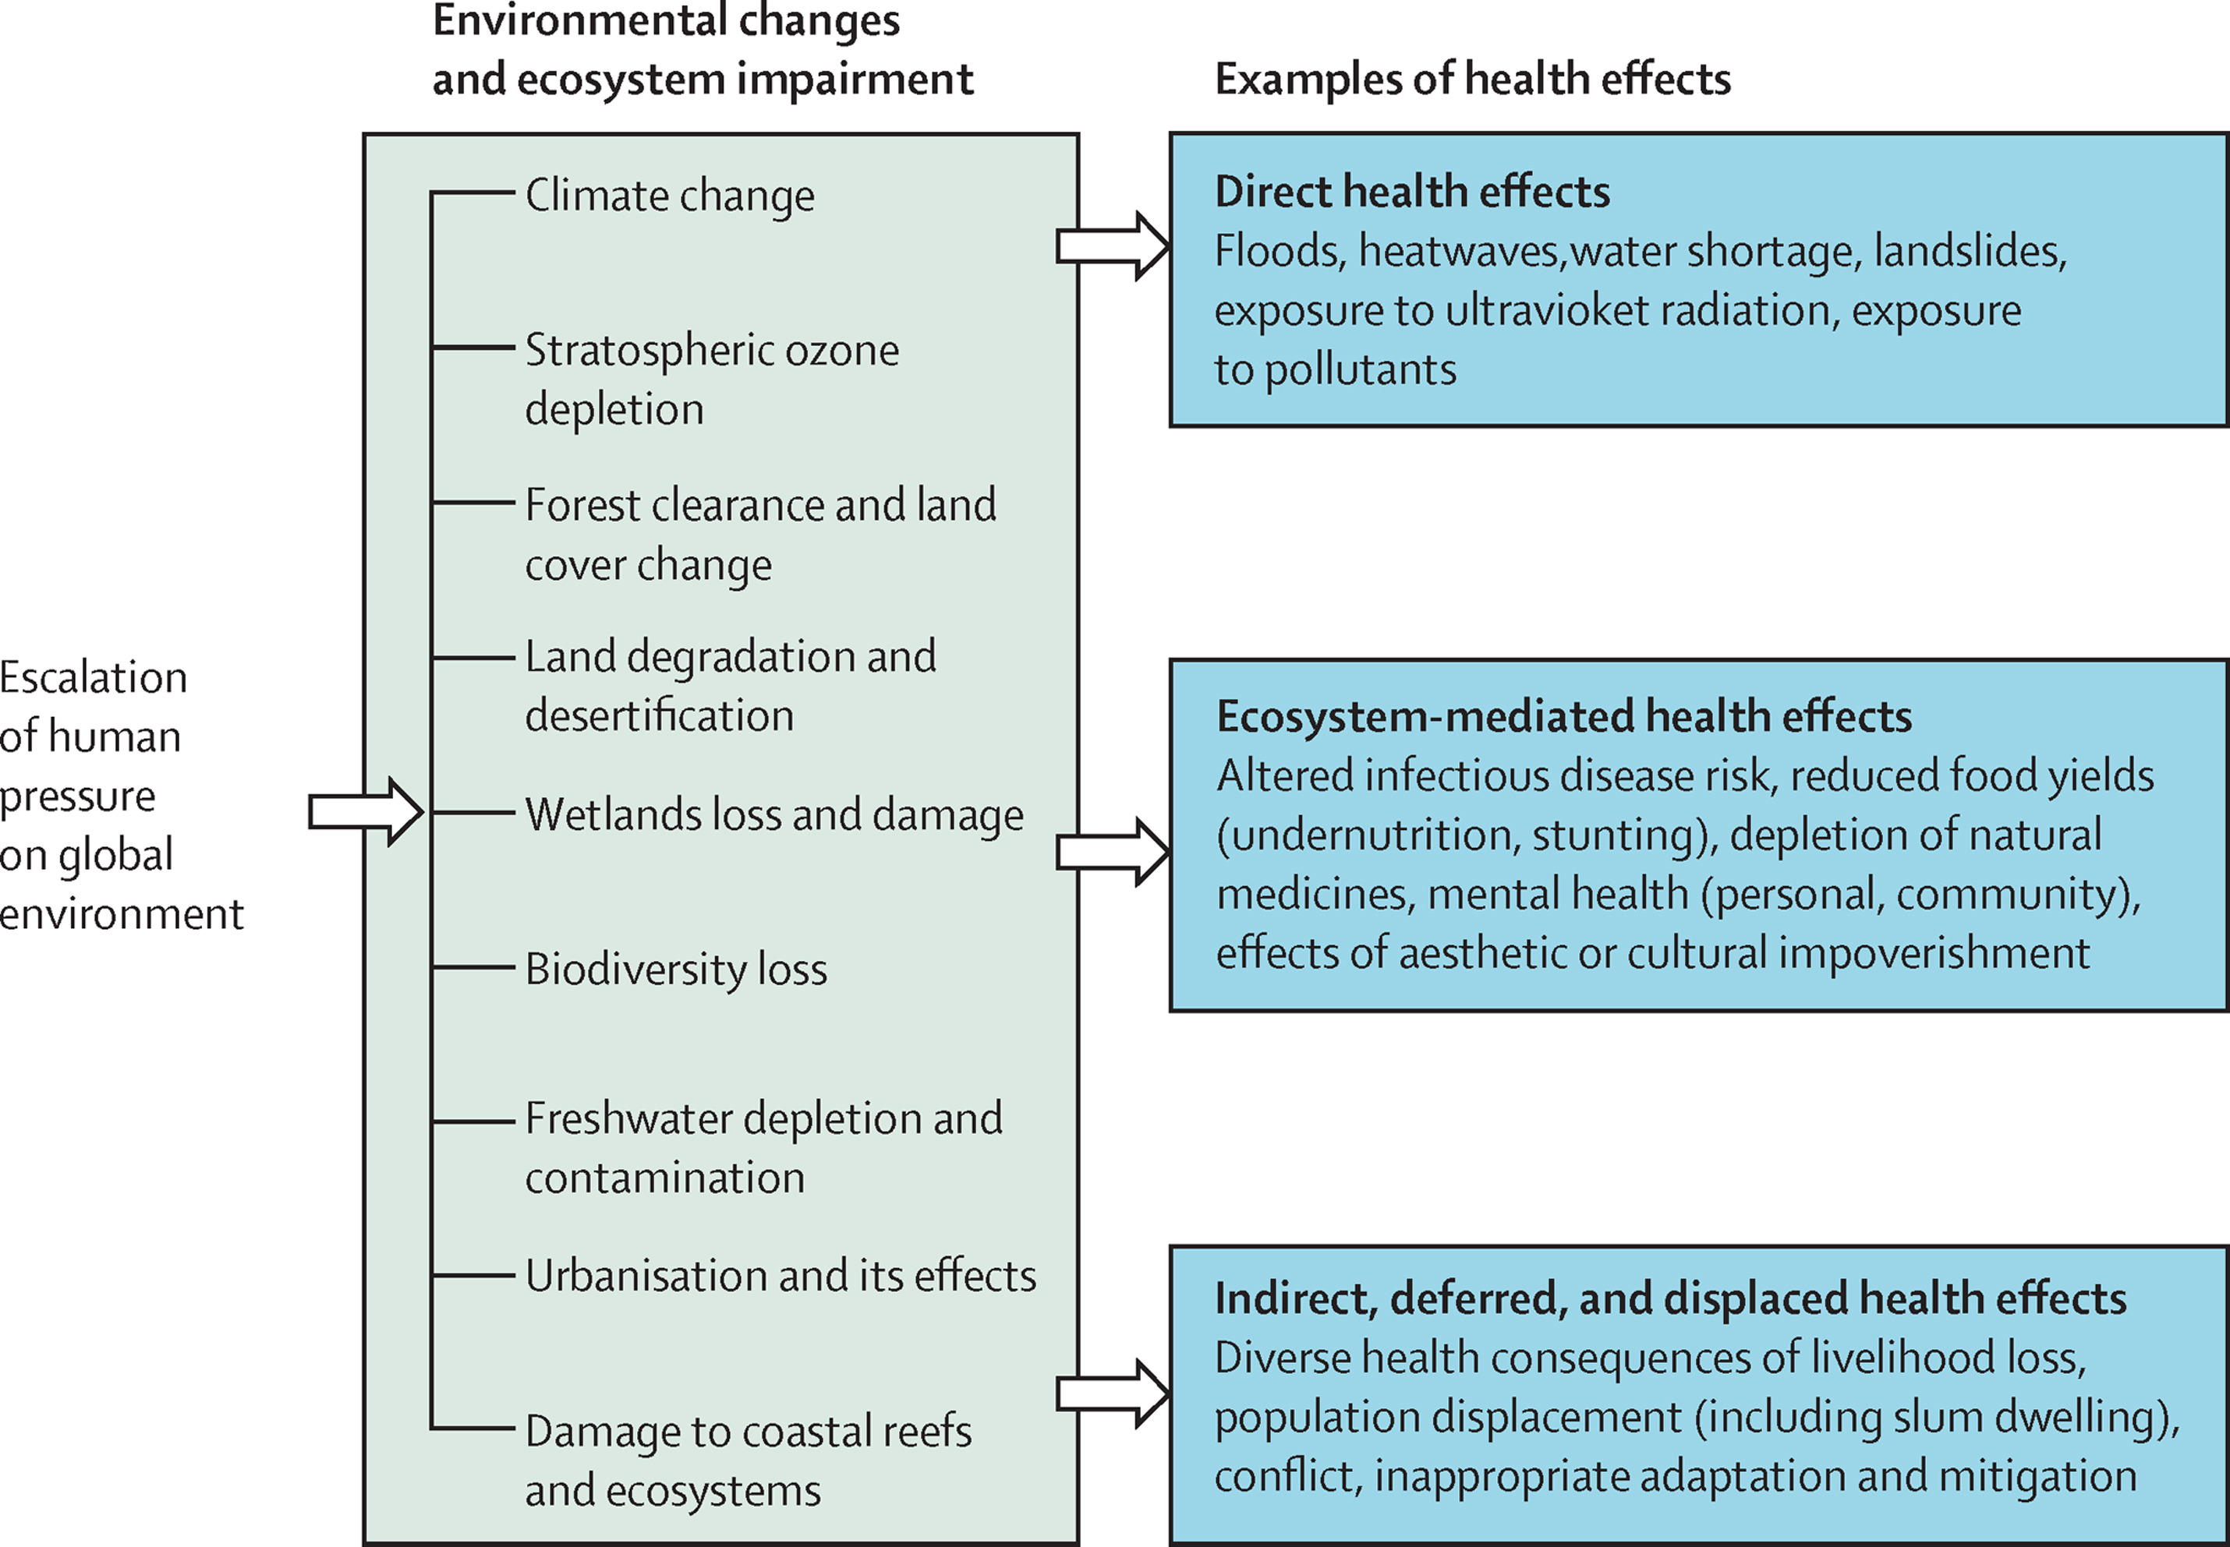
How impacts on biodiversity and ecosystem services can affect human health
Whitmee, S., Haines, A., Beyrer, C., Boltz, F., Capon, A.G., de Souza Dias, B.F., Ezeh, A., Frumkin, H., Gong, P., Head, P. and Horton, R., 2015. Safeguarding human health in the Anthropocene epoch: report of The Rockefeller Foundation–Lancet Commission on planetary health. The lancet, 386(10007), pp.1973-2028.

Slide 13
Group Discussion
Are you experiencing losses of biodiversity around you? Give some examples.
Do you think these losses are impacting human health and particularly HIV?

Slide 14
Lets shift our focus to agricultural ecosystems
Poll: what is your experience with farms and farming?

Slide 15
Biodiversity and agroecosystems
Agroecosystems are by nature, managed systems, so humans are actively manipulating biodiversity by selecting plant species, modifying the abiotic environment, adding amendments
Despite the intensive management, we’re still dependent on ecosystem services (we can’t replace everything with fossil fuel or labor inputs!)
How much biodiversity can be compromised and still retain function (thresholds)? And how about in a changing environment?

Slide 16
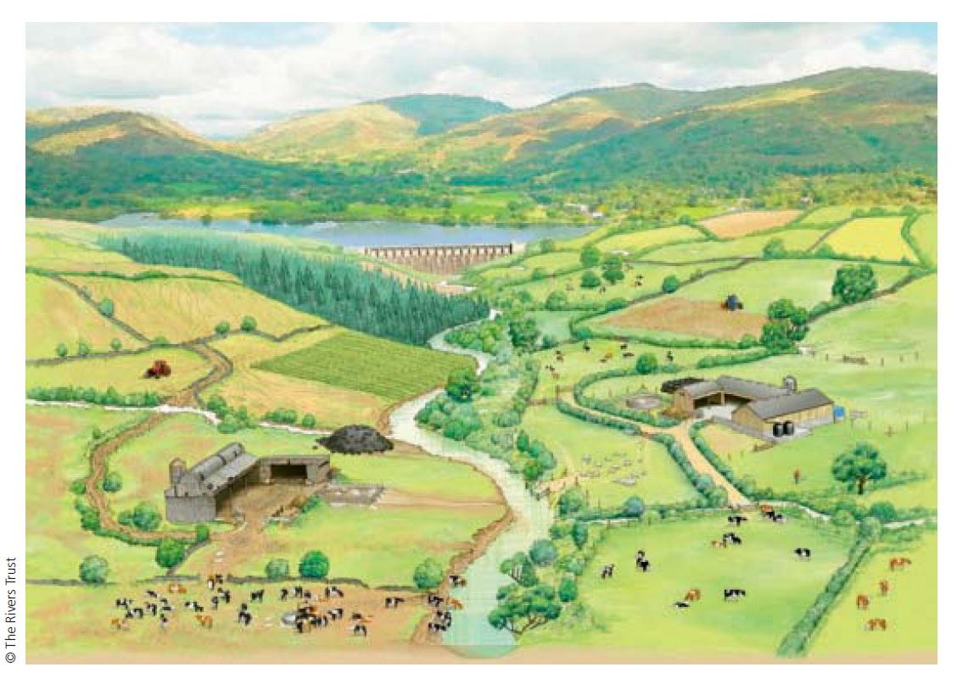
Examine this image
What ecosystem services associated with biodiversity are depicted here?
How are different services interrelated?
Are any of these in conflict with one another?
Answer in comments section
Notes:
Reference: The Rivers Trust
Examine this image: What ecosystem services are depicted here? How are they related? Are any of these in conflict? What impacts might diminish these services? How might climate change affect the services?

Slide 17
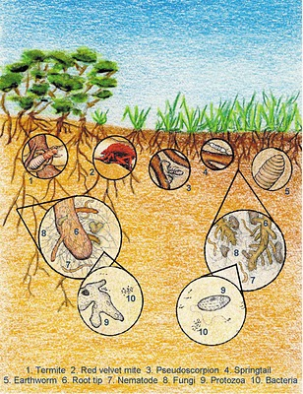

The below-ground part of ecosystems: Soil is one of most diverse microbial habitats: Thousands of taxa can be detected in gram of soil. Most not yet identified nor their function(s) known.
Microbes include: Bacteria, Archaea, and Fungi. Micro and macrofauna also are diverse and abundant.
archaea
archaea

Slide 18
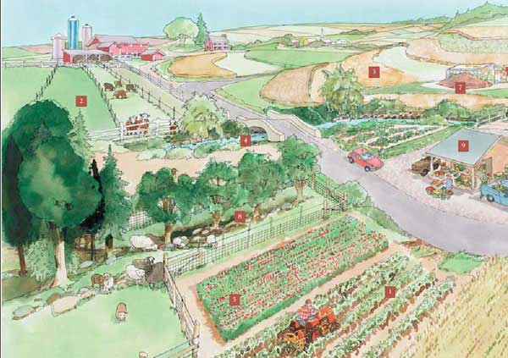
Breakdown wastes, make compost
Produce and consume greenhouse gases
Remove pesticides and nutrients in buffer strips
Build soil structure
Contribute to
biodiversity=resilience
Develop antibiotic resistance (or not)
Contaminate food (or not)
Support plant and
animals via
mutualism
Sequester
carbon
Fix nitrogen
Biodegrade
pesticides in field
http://images.google.com/imgres?imgurl=http://www.sare.org/publications/explore/images/scenewide2.jpg
Build soil organic matter
Fight/suppress
pests
Control and cycle plant nutrients
Support farmer’s digestion and immunity
What does soil biodiversity do?
Notes:
How do microbes contribute to SUSTAINABLE ag? Concept that they are the catalysts and perpetuators. If we keep them satistified (the good ones) then it will sustain the system.

Slide 19
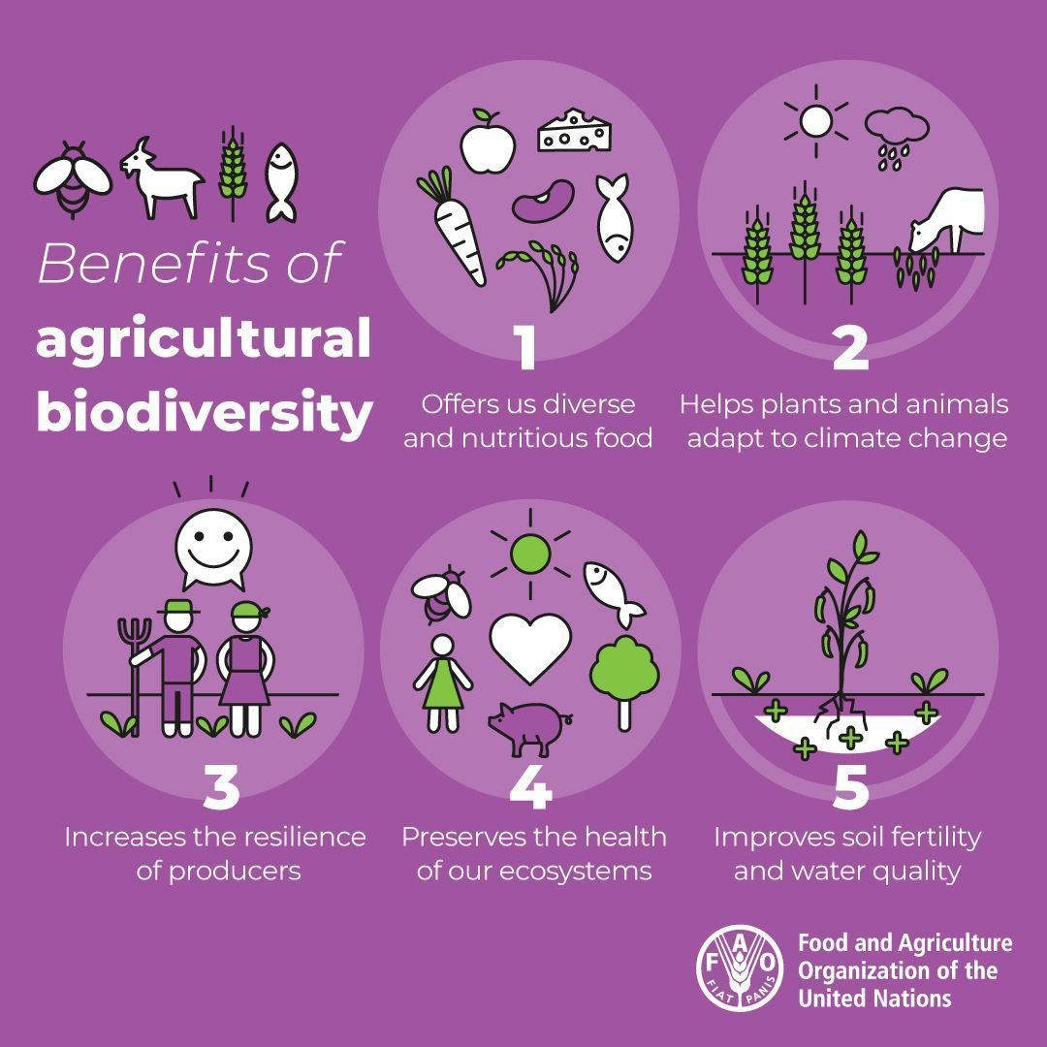

Slide 20
Poll: Do you think Kenya or USA have greater biodiversity in their agricultural systems?

Slide 21
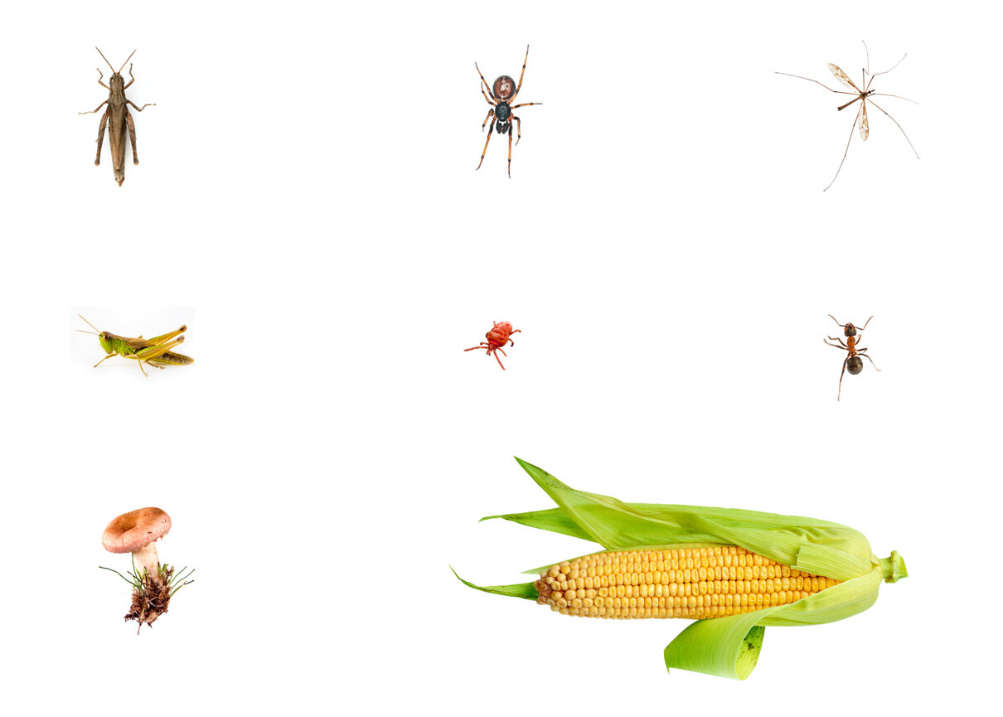
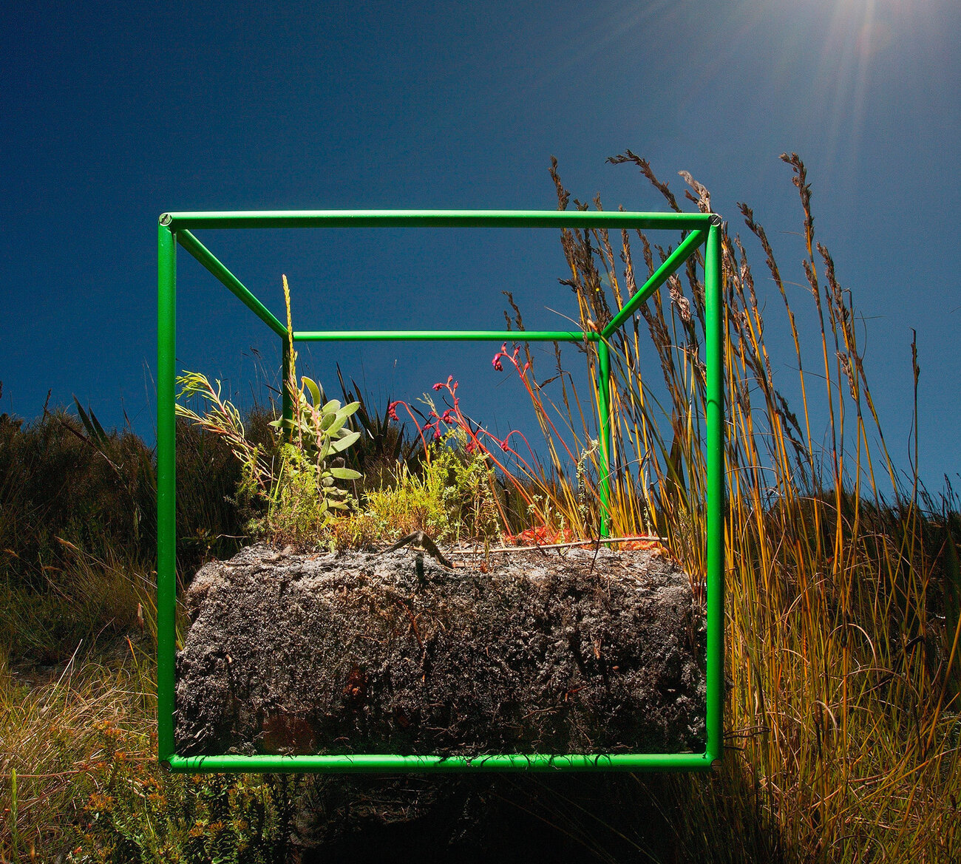
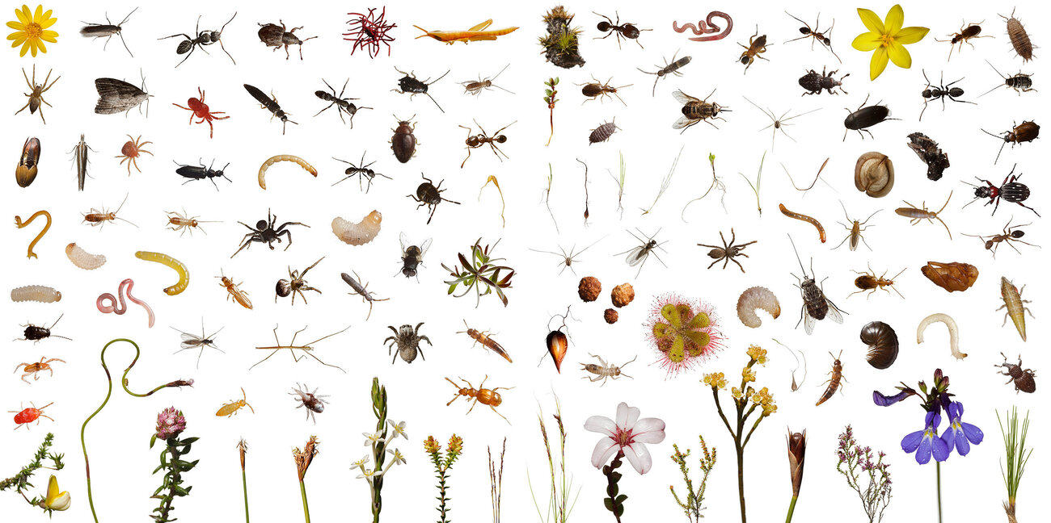
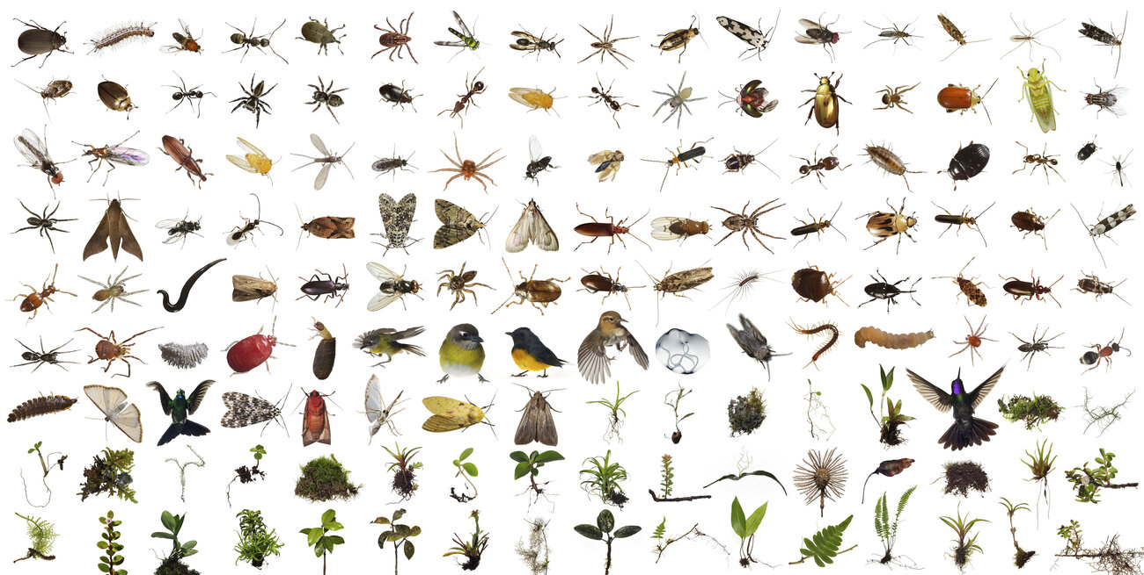
https://www.npr.org/sections/krulwich/2012/11/29/166156242/cornstalks-everywhere-but-nothing-else-not-even-a-bee
Impact of agriculture on biodiversity
US Corn Field
WHAT ARE CONSEQUENCES?
Park in Cape Town, South Africa
Forest in Costa Rica, South America

Slide 22
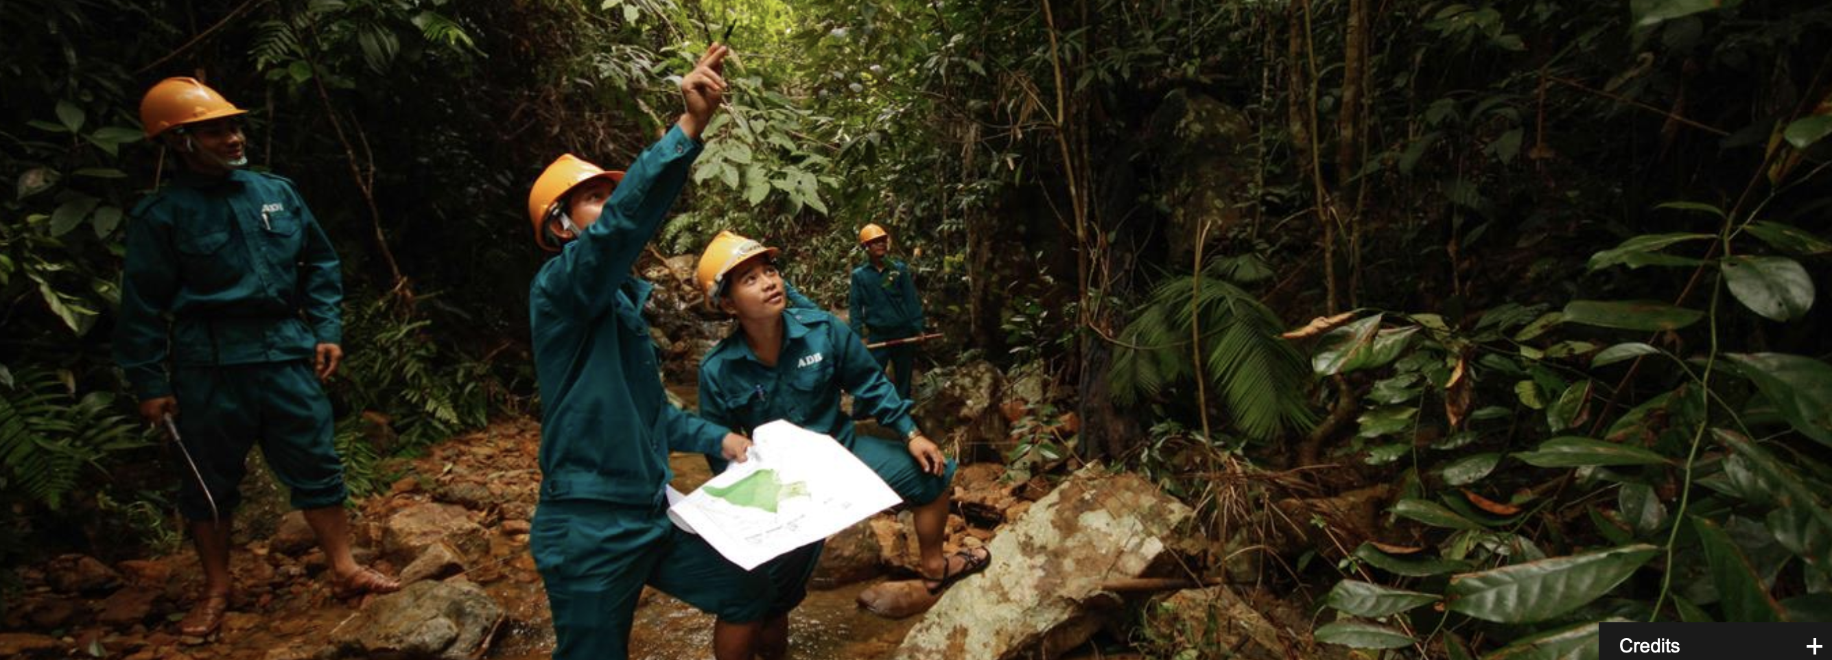
Finding solutions: 3 examples

Slide 23
Example--Health Impact Pathway and interventions: local scale
Extreme rainfall and flooding
Overflow of waste from septic tanks into flood waters
Human contact with flood water
Gastro intestinal diseases
Prevent/reduce flooding
Good soil management
Prevent/reduce overflow of waste
Avoid human contact with water
Landscape managed to capture or divert water
Develop immunity: e.g. exposure to nature
Correct medical treatment
Notes:
Prevent flooding – HOW ?? flood zones, flood risk management
Prevent overflow of waste HOW??- risk assessment of waste water infrastructure to flooding, better designed systems
Avoid human contact with water HOW?? – Evacuate, public education – minimise contact, hygiene practices.
Correct Medical Treatment. HOW – Public education/ first aid training/ health professionals - recognition of symptoms and immediate treatment can reduce severity of symptoms,
- recovery promoted by adequate follow up treatment.

Slide 24
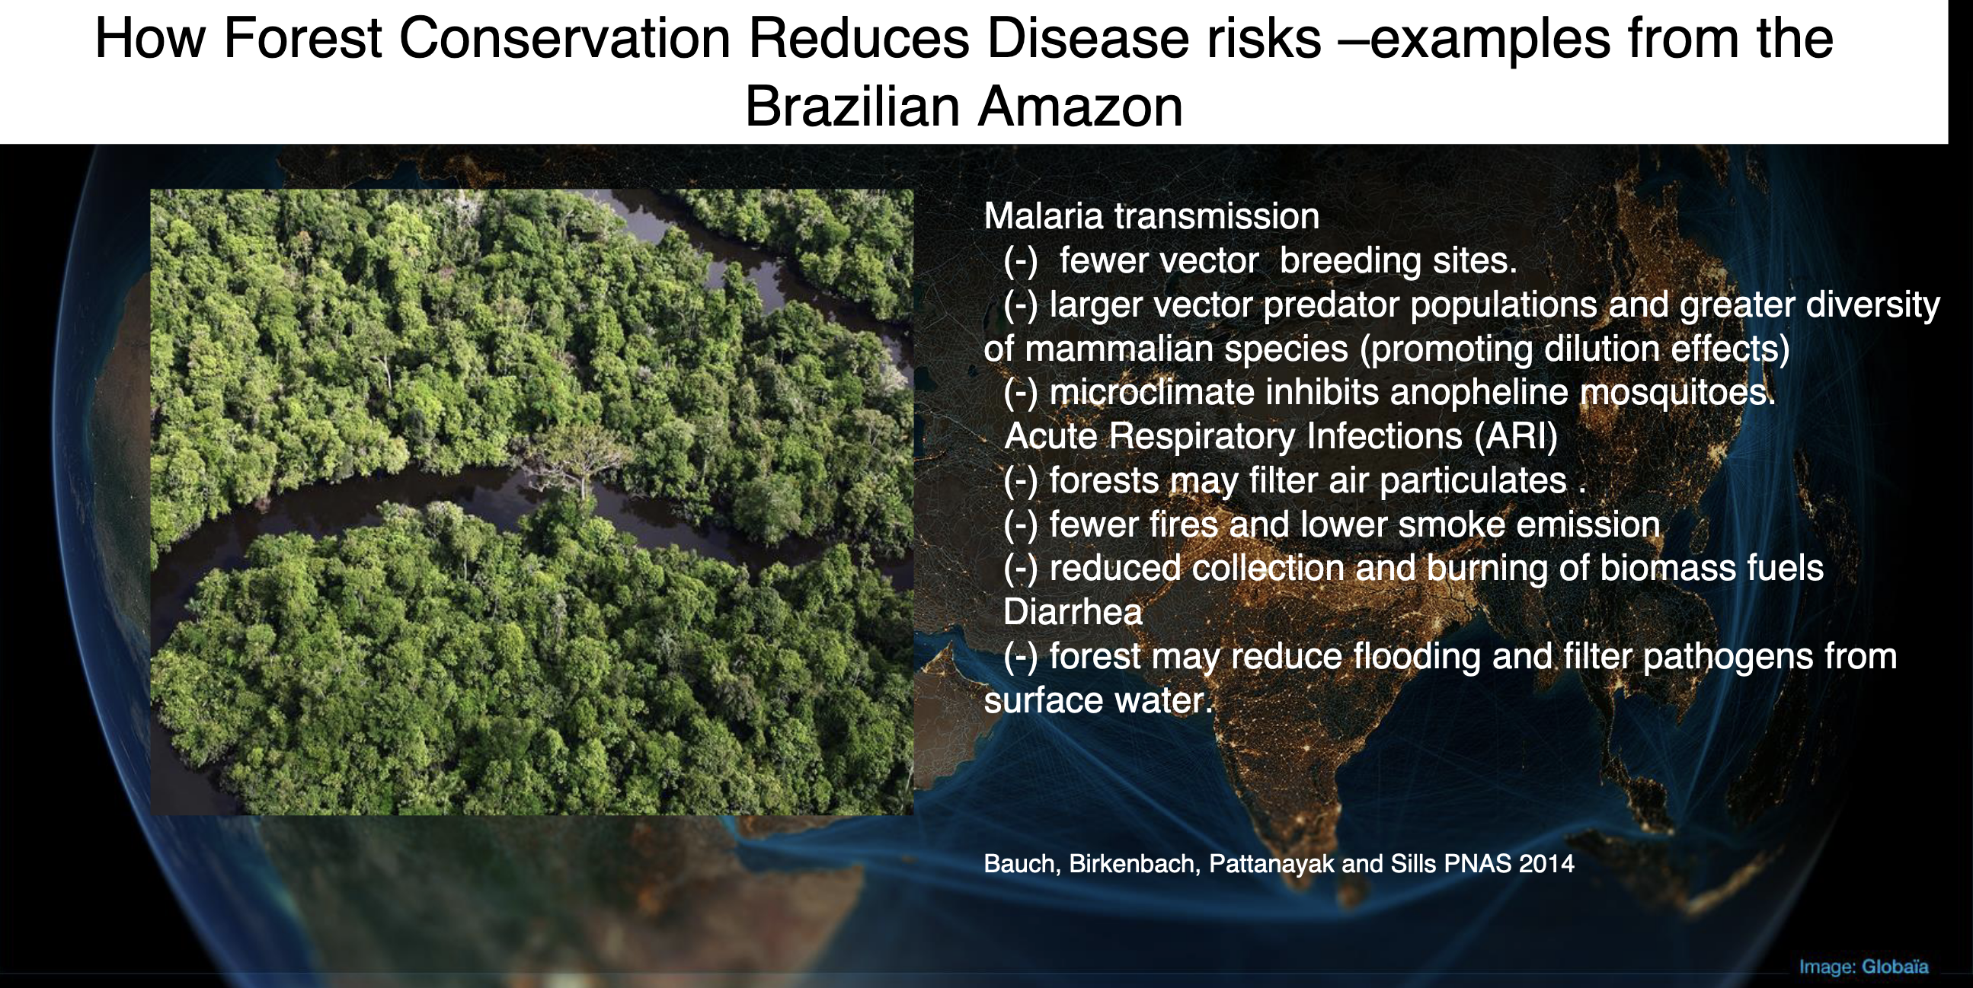
Malaria transmission
--few vector breeding sites
--larger vector predator populations and greater diversity of mammalian species (=dilution)
--microclimate inhibits anopheline mosquitoes
Acute Respiratory infections (ARI)
--forests may filter air particulates
--fewer fires and lower smoke emissions
--reduced collection and burning of biomass fuels
Diarrhea
--forest may reduce flooding and filter pathogens from surface water

Slide 25
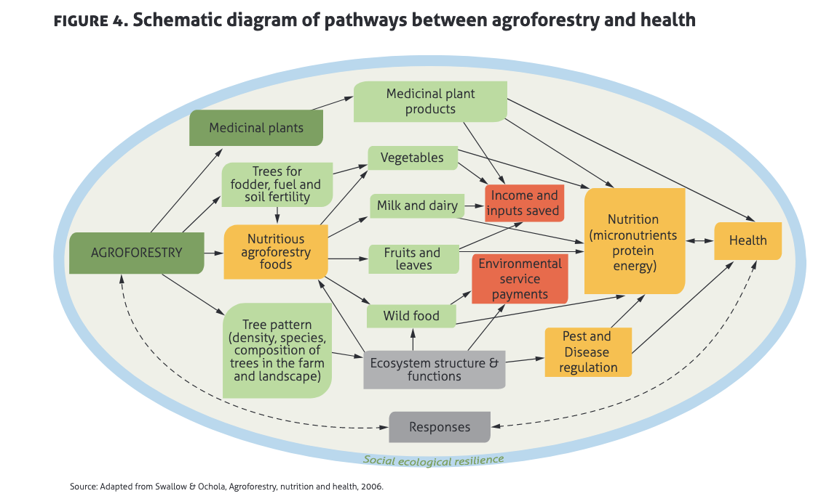
Reading #2: “A Planetary Health Perspective on Agroforestry (AF) in Sub-Saharan Africa”—discussion
What are four ecosystem services impacted by AF’s?
Contrast how AF affects food availability and access and stability
How does AF impact infectious diseases in humans? (p. 335-336)
How does AF impact non-communicative diseases in humans? (p. 336-338)
How does AF interact with human migration? (p. 337-338)
Discuss the 3 drivers of agroforestry (p. 338-340 “AF’s Outlook”)

Slide 26
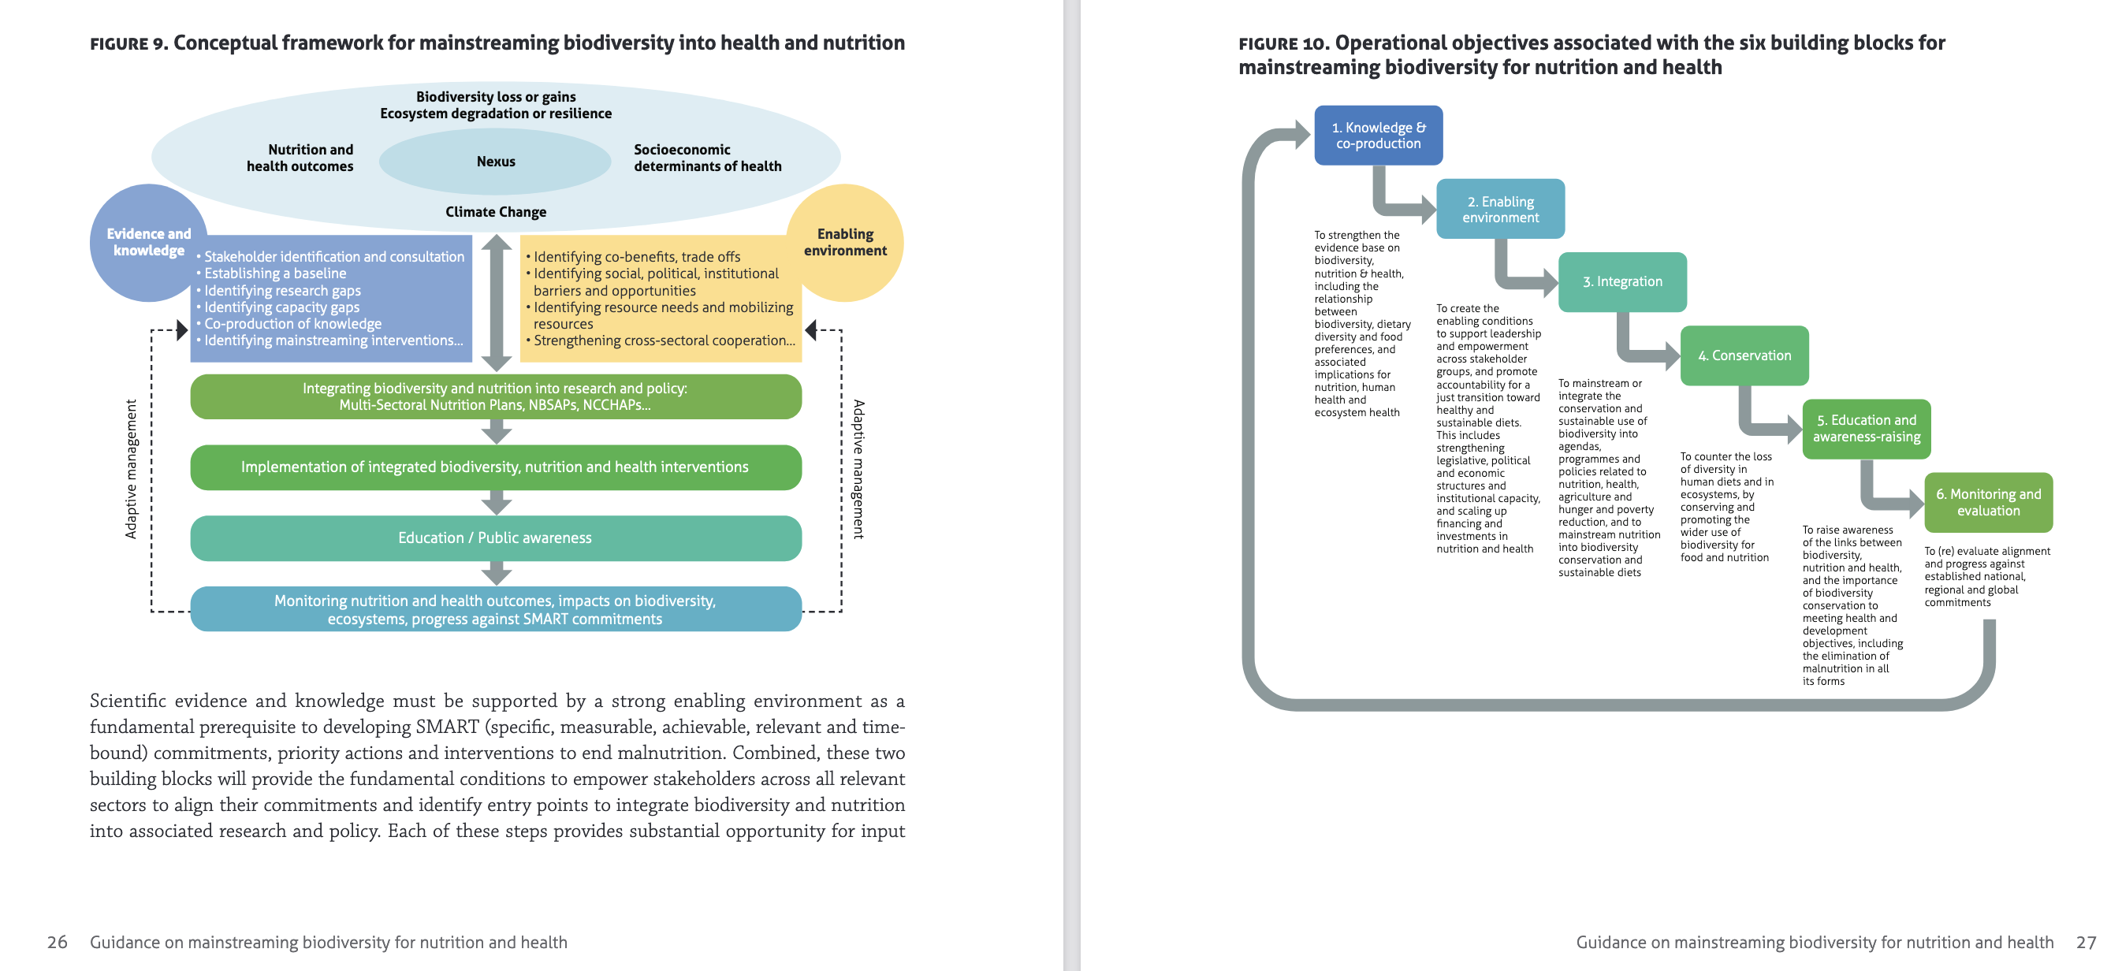
https://www.who.int/publications/i/item/guidance-mainstreaming-biodiversity-for-nutrition-and-health

Slide 27
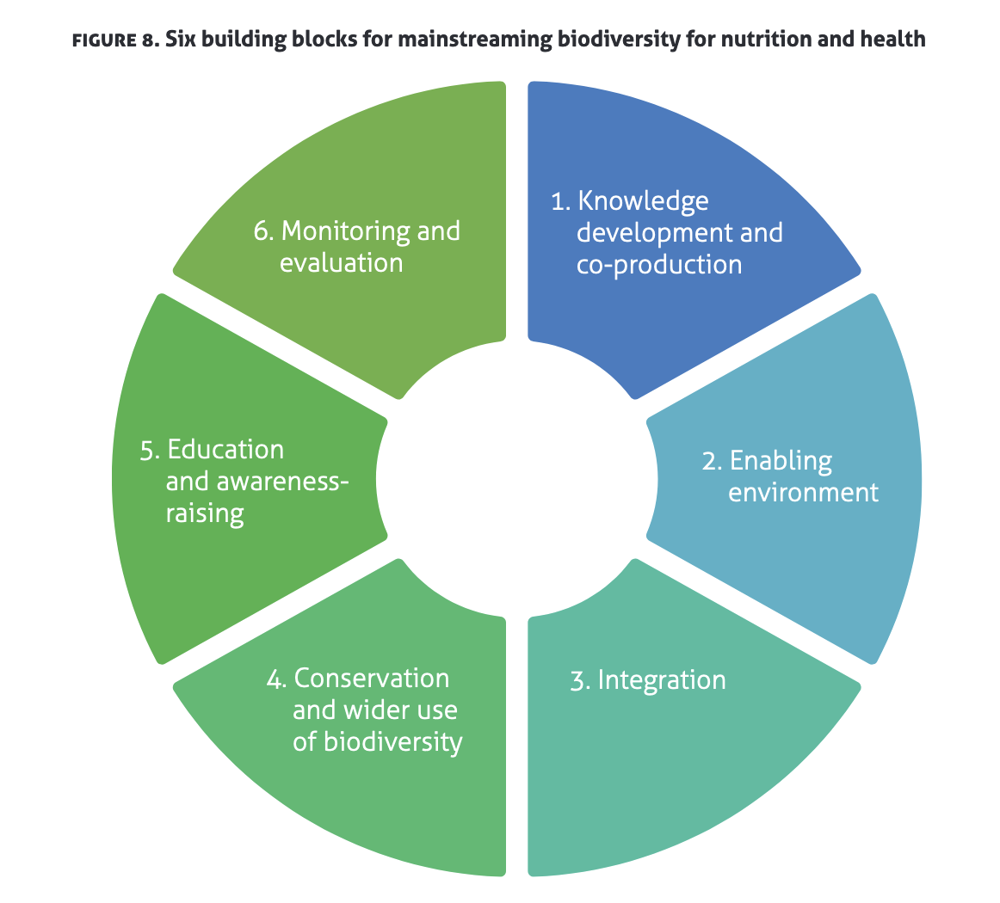
Six Building Blocks for Mainstreaming Biodiversity for nutrition and health
1) Knowledge development and co-production: Through cross-sectoral scientific knowledge and enabling the co-production of knowledge.
2) Enabling environment: Through evidence-based policies and measures that empower and enable stakeholders to mainstream biodiversity in food systems and health systems, promote equity and accountability.
3 ) Integration: Integrating biodiversity and nutrition into research and policy instruments, with due consideration for the social determinants of malnutrition and health.
4) Conservation and wider use of biodiversity: Into production landscapes and seascapes to support nutrition and health.
5) Education and awareness-raising: As well as communications, awareness raising and advocacy.
6) Monitoring and evaluation: Policy alignment and monitoring of progress against national, regional and SMART commitments and measuring progress toward global goals and objectives (e.g. SDGs).
https://www.who.int/publications/i/item/guidance-mainstreaming-biodiversity-for-nutrition-and-health

Slide 28
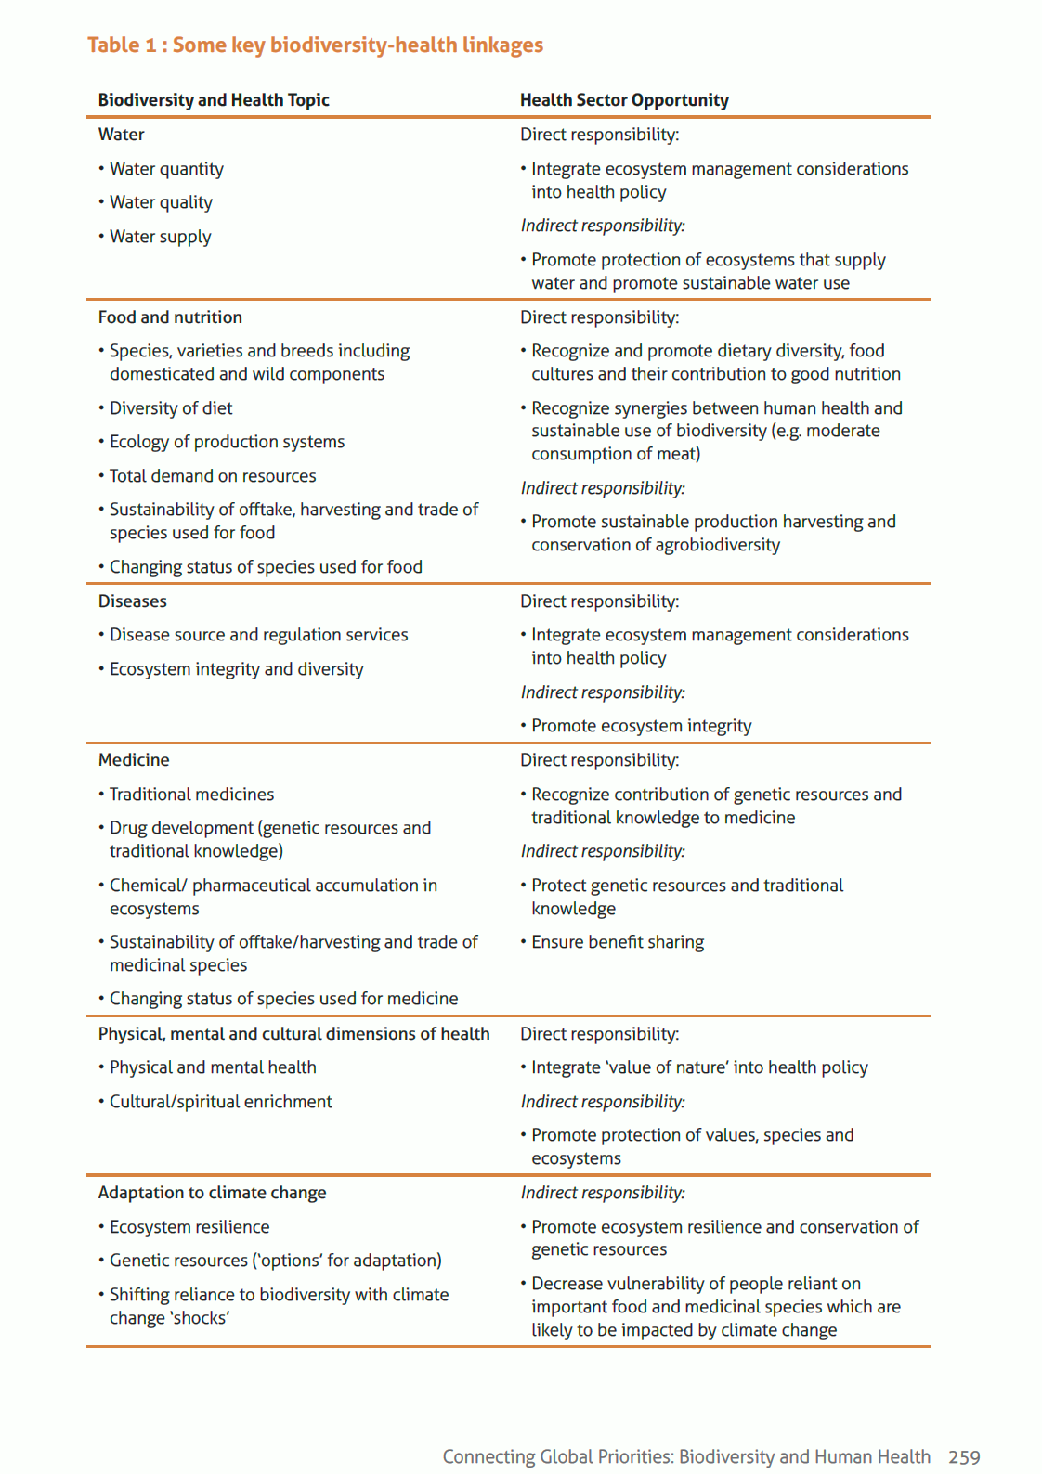
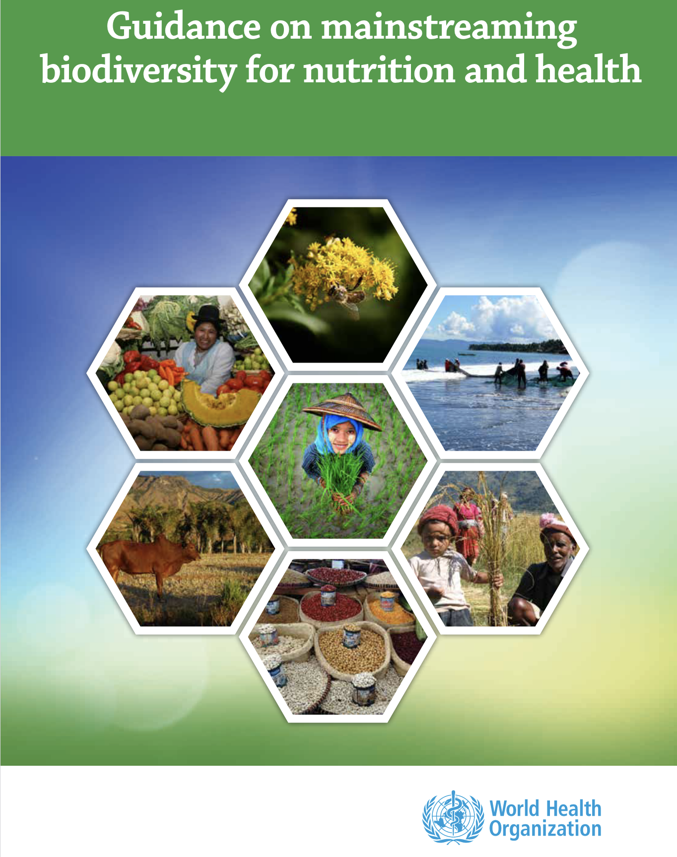
The various interlinkages between biodiversity
and human health and how potential responses of the health sector
https://www.who.int/publications/i/item/guidance-mainstreaming-biodiversity-for-nutrition-and-health

Slide 29
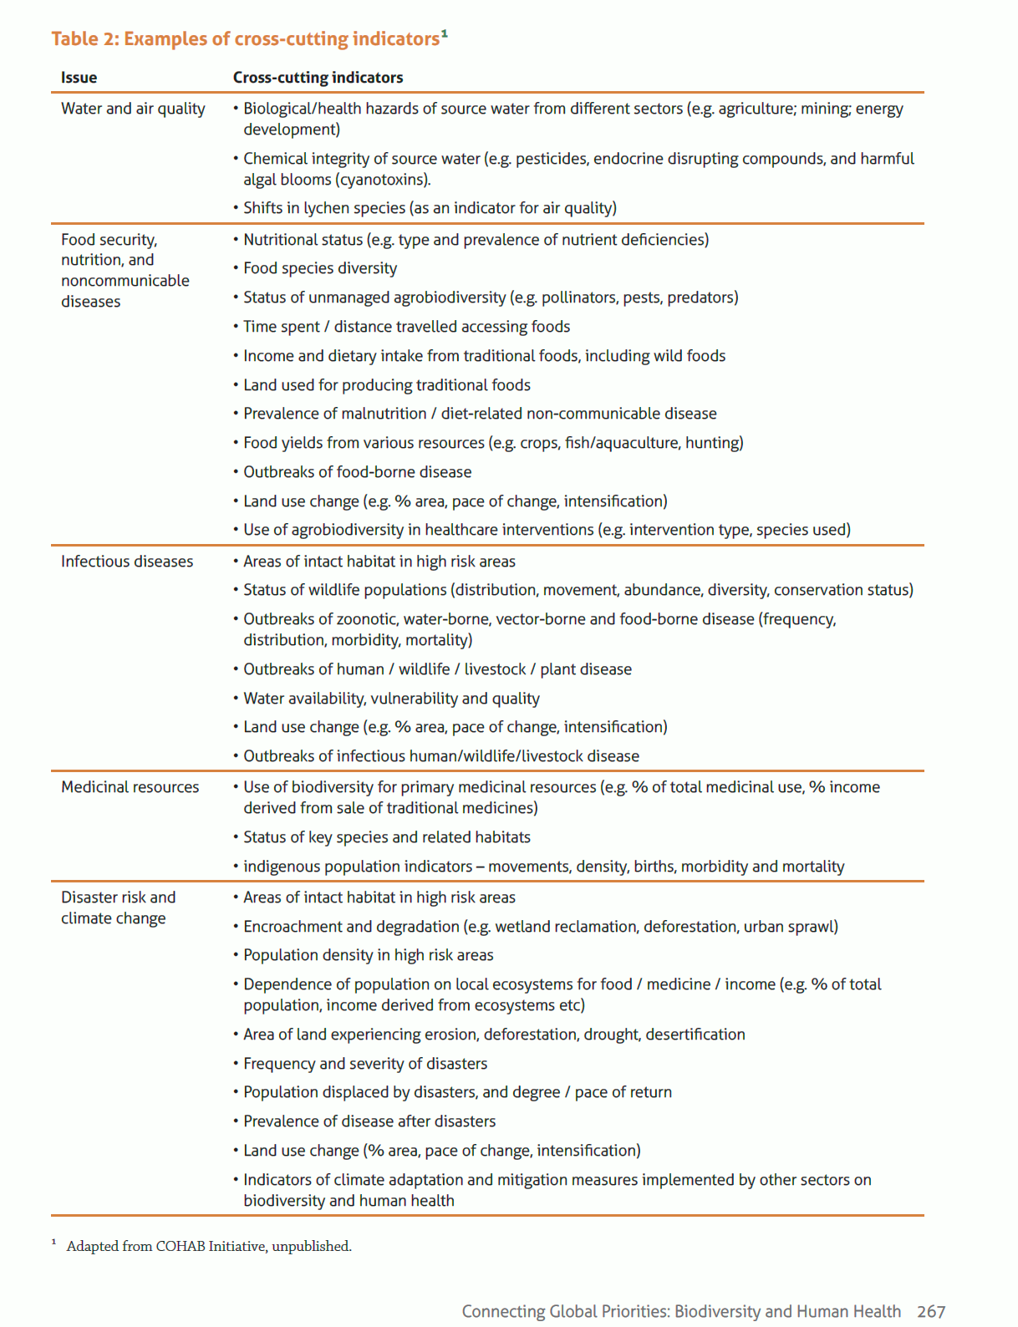
Examples of cross-cutting indicators for assessing state of relationships between biodiversity
and human health.
https://www.who.int/publications/i/item/guidance-mainstreaming-biodiversity-for-nutrition-and-health

Slide 30
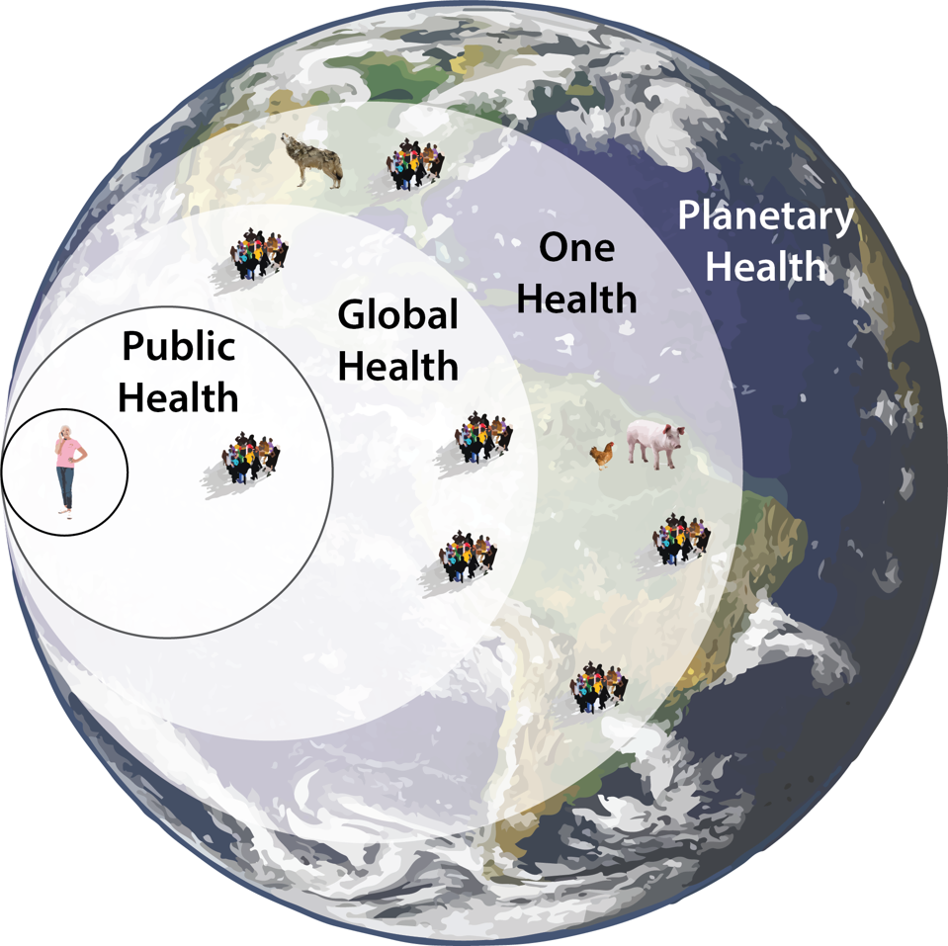
“One Health” brings in consideration of animals as well as humans. Plants? No.
“Planetary Health” encompasses plants, microbes and ecosystems (soils and aquatic).
All biodiversity and ecosystem services are crucial part.

Slide 31
Is biodiversity ever seen as harmful to human health?
How does biodiversity relate to HIV?

Slide 32
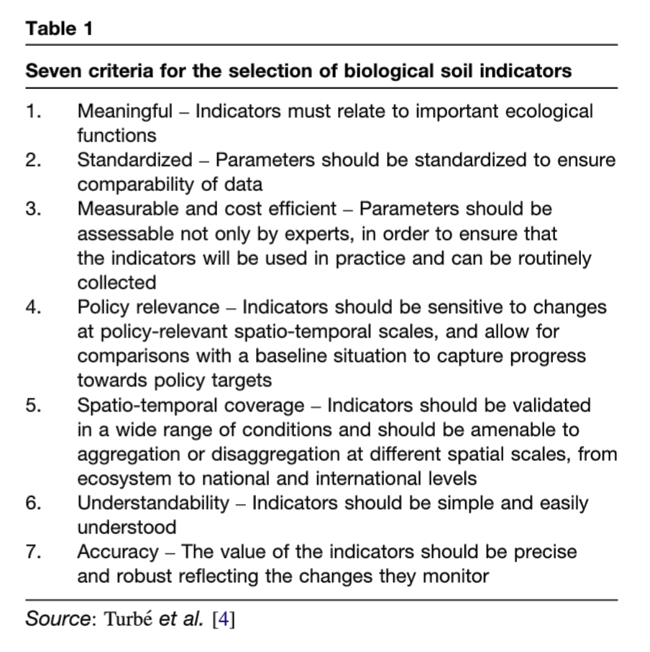
Stepping back: what makes a good indicator of biodiversity?

Slide 33
Role of policy.
Example: linking soil biodiversity to policies
“indicators”
“Services”

Slide 34
Layers of protection needed from individual to institutions to global
Myers, S.S., Gaffikin, L., Golden, C.D., Ostfeld, R.S., Redford, K.H., Ricketts, T.H., Turner, W.R. and Osofsky, S.A., 2013. Human health impacts of ecosystem alteration. Proceedings of the National Academy of Sciences, 110(47), pp.18753-18760.

Slide 35
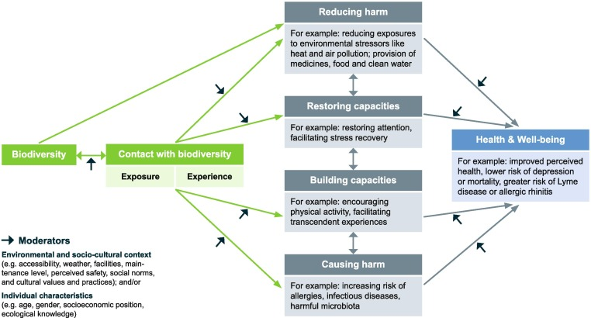
Pathways linking biodiversity and human health
Marselle, M.R., Hartig, T., Cox, D.T., de Bell, S., Knapp, S., Lindley, S., Triguero-Mas, M., Böhning-Gaese, K., Braubach, M., Cook, P.A. and de Vries, S., 2021. Pathways linking biodiversity to human health: A conceptual framework. Environment International, 150, p.106420.

Slide 36
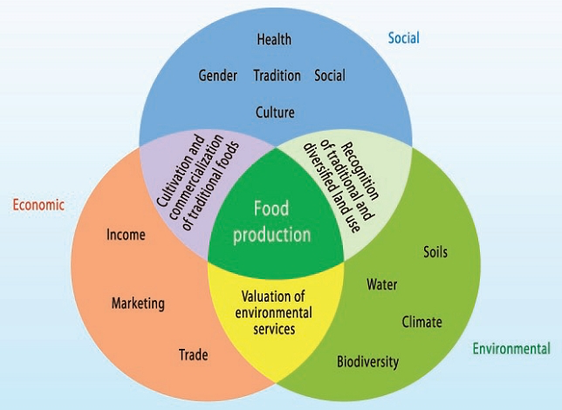
Crucial to regenerate multifunctional agroecosystems
(psychological)
Progress requires extensive and challenging relationship building and partnerships; soil scientists can play important roles.
Cultivation and comer-cialization of foods
Recognition of different land uses
(adapted from FAO IAASTD 2009)
Notes:
Now scaling down and drilling into agricultural systems, here is another conceptual model this time from the FAO’s International Assessment of Agricultural Knowledge, Science and Technology for Development. In this case with food production at the core, it illustrates the equal importance of economic, social and environmental factors in creating a sustainable and just food system. We as soil scientists often stay within the boundaries of the green, with our focus on soil, water, climate and maybe biodiversity, which we might call upon to design regenerative agriculture. Yet many other factors must be considered, economic (which is more accepted) and social (which is more diffuse and overlooked but can make or break some environmentally sound based solutions). For example……
we are running out of time. Increasingly it is urgent that research can be applied; actually that is backwards--research needs to address urgent questions. So much research that is conducted is never actually used. What are the consequences of that:
Pressing environmental and agronomic issues aren’t solved
Students feel no sense of purpose or connection (recent NSF study on depression) Only 26% of Economics students report feeling that their work is useful always or most of the time, compared 63% of the working age population. Only 19% of Economics students feel that they have opportunities to make a positive impact on their community or society compared to 58% of faculty and 53% of the population. Having sources of meaning and usefulness appears to be crucial to mental health. Those who have goals to aspire to, feelings of doing useful work, sense of accomplishment, and opportunities to make a positive impact on their surroundings have better mental health than those who do not. (Barreira et al 2018)

Slide 37
